Slide 1
Research Methods For International Relations
Prof. Dr. Mahir Nakip
mnakip@cankaya.edu.tr
Office hours:
Wednesday:10.00-11.30 and 13.00-14.00
Thursday: 10.00-11.30 and 13.00-14.00

Slide 2
Teaching Sources
1. Main Source: Business Research Methods
Zikmund, Babin, Griffin
Ninth Edition, 2013

Slide 3
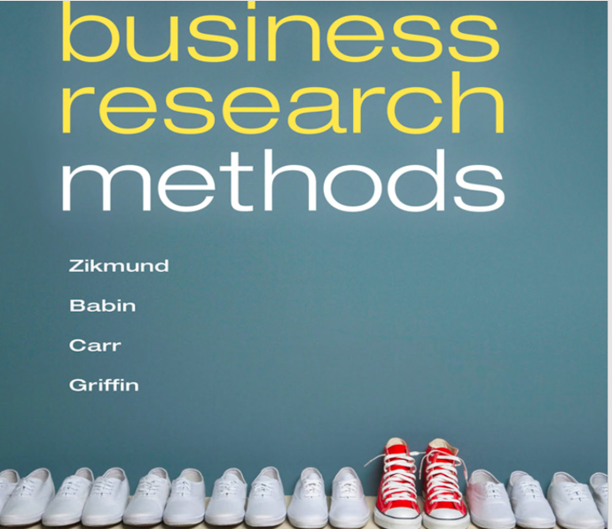

Slide 4
2. Main Source: Marketing Research
Naresh Malhotra and Imad B. Baalbaki, 2013

Slide 6
3. Auxiliary Source: Pazarlama Araştırmalarına Giriş
Prof. Dr. Mahir Nakip,
Prof. Dr. Eyyup Yaraş
Seçkin Yayın Evi
Üçüncü Baskı, 2017

Slide 7
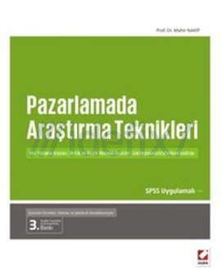

Slide 8
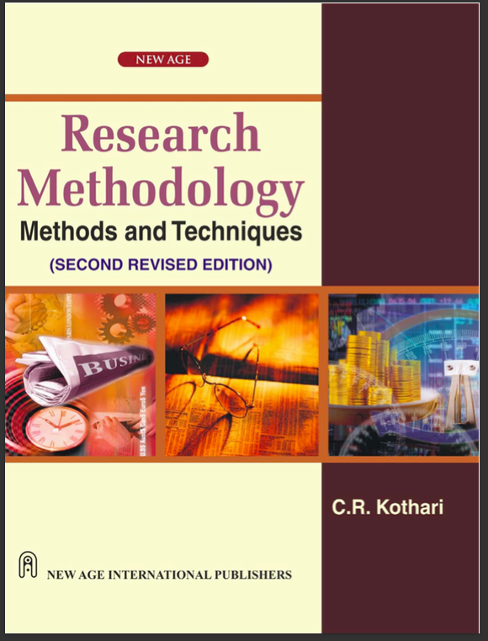

Slide 10
The main purpose of teaching this course is….
to teach the students how to conduct a research in international field,
how many research types there are,
how to apply international methods,
what does it mean secondary and primary data,
how many stages a research process have,
how can prepare survey and observation questionnaire,
what does it mean sampling and where should be used
how hypothesis can be designed,
how SPSS package program can be used,
how many statistical methods can be used in interpreting the findings?
How to write an international relationship report?

Slide 11
This Course Gives What to the Students?
Elementary information in how to design an international research plan or proposal
Basic information in scientific international research sources.
How to reach secondary data and get benefit of it?
What does it mean primary data, qualitative and quantitative data
Preparing a questionnaire and conducting survey methods to collect original data
Using hypothesis testing, Chi-Square, regression, correlation and variance analysis to solve any problems.
Using statistical package program such as SPSS
Writing an international relationship scientific paper

Slide 12
Mid term examine
Mid term examine
Style: Classic, fill blanks, multiple choice
Weight: 40%
Final examine
Style: Classic, fill blanks, multiple choice
Weight: 40%
Assignment
Style: Scientific paper, solving statistical problems, short research essay
Weight: 20%

Slide 13
1. WEEK: An Introduction to International Research Methods
- The Nature of International Research
- Some Basic Definitions Related to IBM
- Decision-making process
-International Research & Ethics
-Calssifications of IRM
-Research suppliers and services
-International Research Process

Slide 14
2. WEEK: International Relationship Information and Support System
- Some basic definitions
- The Characteristics of Valuable Information
- International Knowledge Management
- International Dicision Support System
- Problem definition and process
- Types of variables
- Proposal as a planning tool
- Information Technology
- Research design definition & calssification
- Experiments
- Theory in international research

Slide 15
3. WEEK: Secondary data collection
- Secondary data types
- Advantages & disadvantages of secondary data
- Criterias for evaluating secondary data
- Classification of secondary data
- Computerised database
- Syndicated sources of secondary data
- Internal data sources
- Geodemographic data
- Data Warehouse

Slide 16
4. WEEK: Qualitative Research
1. Definition and uses of qualitative research
2. When qualitative research be used?
3. Qualitative versus Quantitative research
4. Categories of quantitative research
5. Ethnography
6. Grounded Theory
7. Philosophy and quantitative research
8. Calssification of quantitative research
9. Focus group
10. Depth interviews
11. Social networking
12. Projective techniques

Slide 17
5. Week: Sources of Secondary Data
and Qualitative Data Analysis
1. Sources of Internal and Proprietary Data
2. External Data
3. The process of qualitative data analysis
4. Using computers in qualitative research and analysis
5. Package programs used in qualitative researches
6. Advantages of computer-assisted qualitative data analysis
7. Disadvantages of computer-assisted qualitative data analysis
8. How to Write a Research Paper?
- Choosing Your Topic
- Researching
- Making an Outline
- Writing Your Paper

Slide 18
6. WEEK: Primary Data and
Data Collecting Techniques
Primary data
Classification of Survey Methods
3. Telephone interviews
4. Personal Face to Face
5. Traditional mail interviews
6. Internet Surveys
7. Pretesting
8. Observation

Slide 19
7. WEEK: Measurement and Scaling
Primary scales and measurement
Classification of measurement scales
3. Scaling techniques
4. Comparative scales
5. Non-comparative scales
6. Reliability and validity
7. Graphics and pie charts
8. Tabulation and cross tabulation

Slide 20
8. WEEK: Questionnaire Design
What should be asked?
Three basic objectives
3. Questionnaire design process
4. Structured questions
5. Types of fixed alternative questions
6. Choose question wording
7. Arranging the order of the questions
8. Internet questions
9. Pretesting the questionnaire

Slide 21
9. WEEK: Sampling
Meaning of the sampling
Differences between sampling and census
3. The sampling design process
4. Calssification of sampling techniques
5. Internet sampling
6. Sampling size determination
7. Calculating sampling size

Slide 22
10. WEEK: Data Inputing, Preparing, Coding, Presenting, Tabulaing and Index Numbers
Data inputting by using SPSS
Showing an examplie on SPSS with Likert scale
3. Stages of data analysis
4. Classification of statistical analysis
5. Descriptive analysis
6. How to graph the descriptive data
7. Graphics and pie chart
8. Tabulation and cross tabulation
9. Index numbers

Slide 23
11. WEEK: Using Univariate Statistics Analysis
Hypothesis Testing
Stages of hypothesis testing
3. Parametric tests
4. Non-parametric tests
5. Single sample
6. Two samples
7. Double sample
8. Chi Square analysis

Slide 24
12. WEEK: Simple linear Rregression
Meaning of causality
Types of regression
3. Simple linear regression
4. Application of regression analysis
5. Testing the validity of regression equation
6. Determination coefficient
7. Multiple regression
8. Some problems of multiple regression

Slide 25
13. WEEK: Correlation Analysis
The logic of correlation analysis
Types of correlation
3. Application of correlation analysis
4. Multiple correlation and its interpretation
5. Partial correlation
6. Non parametric correlation analysis
7. Using SPSS in correlation analysis

