Slide 1
research suppliers and services

Slide 2
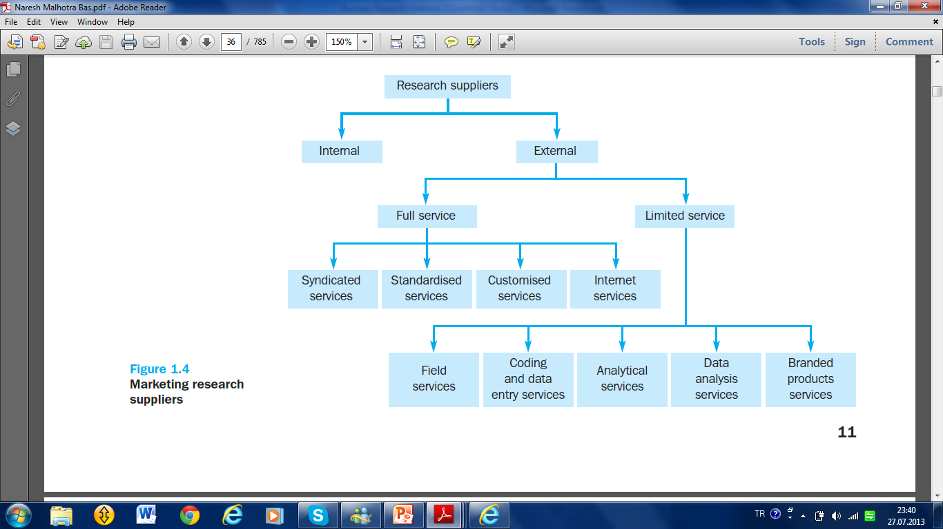

Slide 3
Internal supplier
is a research department or function located within an organization. Large organizations maintain in-house research departments. A research department’s place in an organization structure may vary quite considerably. For example Conservative Party in USA has an especial department for research.
At one extreme, the research function may be centralized and located at the organization headquarters. Such as research center of a political party.

Slide 4
At the other extreme is a decentralised structure in which the research function is organised along divisional lines
In a decentralized scheme, the organization may be organized into divisions by events, nations, or geographical regions, with political research personnel assigned to the various divisions.

Slide 6
External suppliers are outside organizations hired to supply research data. For example a political party can order a research center to conduct a research about party’s performance in the last election.
These external suppliers collectively comprise(kapsamak)the political research industry. These suppliers range from small operations to very large global organization.

Slide 7
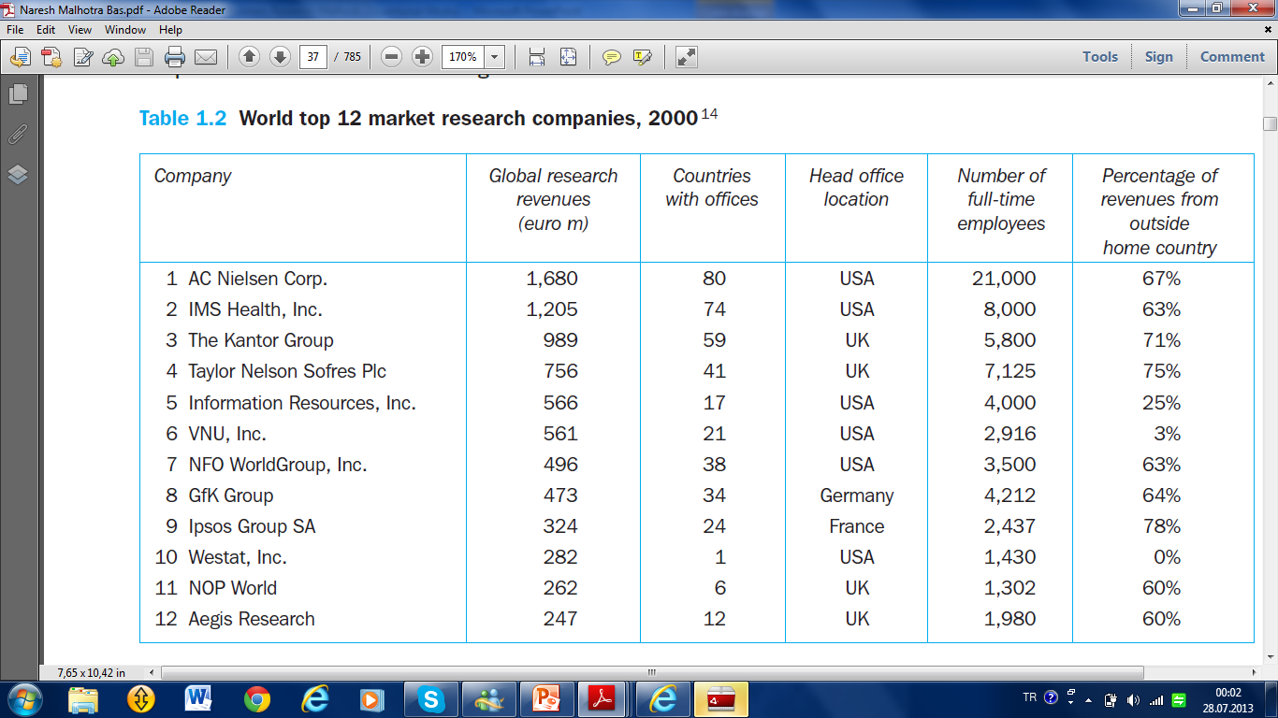

Slide 9
Full-service suppliers
offer the entire range of research services, for example defining any political problem, developing a research design, conducting focus group interviews, designing questionnaires, sampling, collecting, analyzing and interpreting data, and presenting reports in any political issue.

Slide 10
They may also address the political implications of the information they present. The services provided by these suppliers can be further broken down into syndicated services, standardized services and customized services

Slide 12
Full-service suppliers
Syndicated services collect information that they provide to subscribers (abonmen). Surveys, diary panels, scanners and audits are the main means by which these data are collected.
Standardised services are research studies conducted for different clients but in a standard way. For example, procedures for measuring political advertising effectiveness have been standardized.
Customised services offer a variety of political research services specifically designed to suit (uymak, uygun düşmek) a client’s particular needs. Each political research project is treated uniquely.
Internet services offer a variety of secondary data and intelligence gathering, survey or qualitative interviewing, and the analysis and publication of research findings, all through the Internet.

Slide 14
Limited-service suppliers specialize in one or a few phases of a political research project. Services offered by such suppliers are classified as field services, coding and data entry, analytical services, data analysis, and branded products.

Slide 15
Field services collect data through mail, personal interviews or telephone interviews, and organizations that specialize in interviewing are called field service organizations.
Coding and data entry services include editing completed questionnaires, developing a coding scheme, and transcribing the data into a computer.
Analytical services include designing and pretesting questionnaires, determining the best means of collecting data, and designing sampling plans, as well as other aspects of the research design.
Data analysis services are offered by organizations, that specialize in computer analysis of quantitative data such as those obtained in large surveys. Initially, most data analysis organizations supplied only tabulations and cross-tabulations. Many organizations offer sophisticated data analysis using advanced statistical techniques.

Slide 16
International Research Process

Slide 17
1. Determining research type
2. Defining problem/opportunity
First Step
Preparing stage
3. Past of the subject
4. Questioning the research
5. Planning of research proposal
Second Step
Designing
the study
6. Choosing research method
7. Selecting sampling method
8. Collecting data
9. Classifying data
10. Analyzing data
Third Step
Implementing
the study
11. findings interpretation
12. preparing report
13. Implementing the suggestions
14. monitoring the results

Slide 18
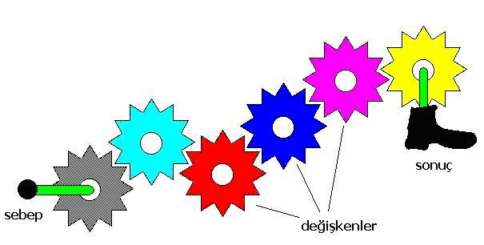
First Step Preparing stage 1. Determining research type
A. Exploratory Research
B. Descriptive Research
C. Causality Research

Slide 19
A. Exploratory Research
♦ Conducted for a problem that has not been clearly defined.
♦ It should draw definitive(kesin)conclusions only with extreme caution.
♦ Perceived problem does not actually exist. Exploratory research often relies on secondary research such as reviewing available literature and/or data, or qualitative approaches such as informal discussions
♦ The Internet allows for research methods that are more interactive in nature.
♦ Exploratory research is not typically generalizable to the population at large.

Slide 20
B. Descriptive Research
Descriptive research, is used to describe characteristics of a population or phenomenon being studied. It does not answer questions about how/when/why the characteristics occurred. For example the demographic characteristics of the voters in any city.
Rather it addresses the "what" question (What are the characteristics of the population or situation being studied?) The characteristics used to describe the situation or population are usually some kind of categorical scheme also known as descriptive categories. Descriptive research generally precedes (öncesinde gelmek) explanatory research.

Slide 21
C. Causality Research
Causality is the relation between an event (the cause) and a second event (the effect), where the second event is understood as a consequence of the first. The relation between the age of the political candidates (cause) and the voting rates (effect).
In common usage, causality is also the relation between a set of factors (causes) and a phenomenon (the effect).

Slide 22
Examples for Types of Research Designs
Uses
Types
Formulate problems more precisely
Establish priorities for research
Eliminate impractical ideas
Clarify concepts
Develop Hypotheses
Literature search
Experience survey
Analysis of select cases
Focus groups
Interviews
Projective tests
Ethnographies
Exploratory
Research
Describe segment characteristics
Estimate proportion of people who behave in a certain way
Make specific predictions
Test hypotheses
Descriptive
Research
Longitudinal study
True panel
Omnibus panel
Sample Survey
Provide evidence regarding causal relationships by means of:
Concomitant variation
Time order in which variables occur
Elimination other explanations
Causal
Research
Laboratory experiment
Field experiment

Slide 24
First Step Preparing stage 2. Defining problem/opportunity
The logical starting point in wishing to support the decision-maker is trying to understand what problem or opportunity is being tackled (ele alınan).

Slide 25
First Step Preparing stage 3. Past of the subject
Means literature review. Who did, accepted, proved or rejected what? Searching past of the subject simplify the methodology process. Literature review can be conducted in a library or on Internet.

Slide 26
First Step Preparing stage 4. Questioning the research
Studies should bring a benefit to the company and contribute to solve a problem or evaluate an opportunity. At this stage, the research must be carried out cost-benefit analysis. If the research cost is more than the benefit comes from the research, it is not necessary to continue the research.

Slide 27
Second Step Designing the study 5. Planning research proposal
The purpose of any research should be written down. There is no ideal and single format or standard in social researches which includes all the steps of a research. Political research plan identifies and thoroughly explains all the steps one by one. Apart from these two issues a plan should include:
Research cost and
(2) The time table

Slide 28
(A) Problem Definition
1. background information
2. decision problem
3. evaluation of alternative research problems
4. research problem(s) to be addressed
5. review: information needed for decision
(B) Research Plan: Exploratory / Secondary Research
1. purpose
2. methods
3. results
(C) Research Plan: Descriptive Research
1. purpose
2. methods
3. sampling plan
4. data collection forms
5. data collection procedures
6. projected analyses (w/dummy tables for bivariate analyses)
7. expected results
8. limitations
(D) Timeframe
(E) Cost Estimates
Research Proposal in Details

Slide 29
Second Step Designing the study 6. Choosing research method
Elementary Data
Secondary Data
Collected by us
Collected by Somebody else

Slide 31
Second Step Designing the study 7. Selecting sampling method

Slide 32
Third Step
Implementing
the study
8. Collecting data
Data collection usually takes place early on in an improvement project, and is often formalised through a data collection plan which often contains the following activity:
1. Pre collection activity — agree on goals, target data, definitions, methods
2. Collection — data collections
3. Present Findings — usually involves some form of sorting analysis and/or presentation.

Slide 33
Third Step
Implementing
the study
9. Classifying data
Data can be classify by using some statistical package programs such as SPSS, SAS, MINITAB. EXCEL also can be used for this purpose. Filtration or verification of data is also a part of data classification. Any mistake in data entering may cause a big analysis problem.

Slide 34
Third Step
Implementing
the study
10. Analyzing data
Analysis of data is a process of inspecting, cleaning, transforming, and modeling data with the goal of discovering useful information, suggesting conclusions, and supporting decision making.
Some statistical techniques use in analyzing data:
Chi square
Regression
Correlation
Variance
Discriminant
Cluster
Conjoint
Multidimensional scaling

Slide 35
Third Step
Implementing
the study
11. findings interpretation
Interpretation of the statistical results needs a special ability. Usually the expert who conduct the statistical\ interprets the findings. The interpretation also should be in harmony and parallel with the goal of the research.

Slide 36
Third Step
Implementing
the study
12. preparing report
The entire project should be documented in a written report that addresses the specific research questions identified, describes the approach, research design, data collection and data analysis procedures adopted. In addition, an oral presentation to management should be made using tables, figures and graphs to enhance clarity and impact.

Slide 37
Third Step
Implementing
the study
13. Implementing the suggestions
Actually the main process ends with the 12. phase. Phase 13. and 14. are feedbacks. Sides who are related to the research will start to implement the suggestions which offered in the final report.

Slide 38
Third Step
Implementing
the study
14. Monitoring the results
The executive managers should monitor the result of the research periodically. Otherwise the result of the research could be useless and needless.

Slide 39
The limitations of research
1 research does not make decisions. The role of marketing research is not to make decisions. Research results trys to make the decision more easier.
2 research does not guarantee success. Research, can improve the probability of making a correct decision. The real value of research can be seen over a long period where increasing the percentage of good decisions should be manifested in improved bottom-line performance and in the occasional revelation that arises from research.

Slide 40
Research in the Twenty-First Century
Global Research
Communication Technologies

Slide 41
International Research & Ethics
Conducting researches according to ethical cods, which are cumulated over time and suggested by marketing reserchers.

Slide 42
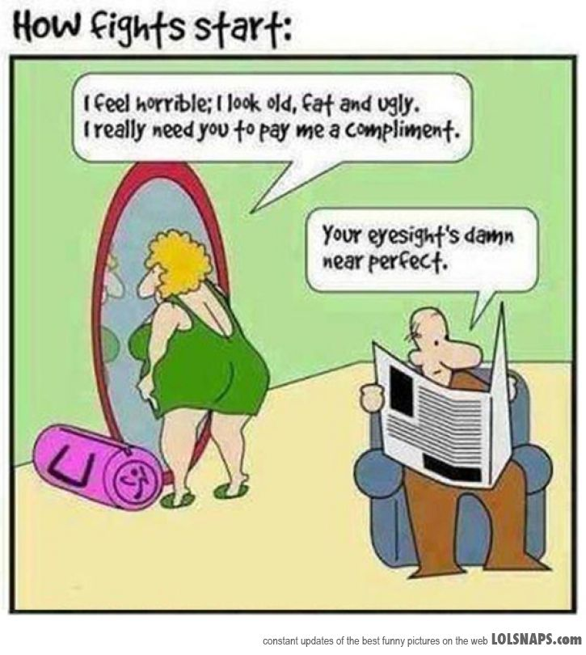
Ethical Codes in Researches
1. Honesty
Strive(gayret etmek)for honesty in all scientific communications. Honestly report data, results, methods and procedures, and publication status. Do not fabricate, falsify(tahrif etmek), or misrepresent data. Do not deceive(kandirmak)colleagues, granting agencies, or the public.
* Adapted from Shamoo A and Resnik D. 2009. Responsible Conduct of Research, 2nd ed. (New York: Oxford University Press).

Slide 43
Ethical Codes in Researches (Continue)
2. Objectivity
Strive to avoid bias in experimental design, data analysis, data interpretation, personnel decisions, expert testimony(Şahitlik), and other aspects of research where objectivity is expected or required.

Slide 44
Ethical Codes in Researches (Continue)
3. Integrity(dürüstlük)
Keep your promises and agreements; act with sincerity; strive çabalamak for consistency (tutarlılık) of thought and action.
4. Carefulness
Avoid careless errors and negligence; carefully and critically examine your own work and the work of your peers (ekip). Keep good records of research activities, such as data collection, research design, and correspondence (yazışma) with agencies or journals

Slide 45
Ethical Codes in Researches (Continue)
5. Openness
Share data, results, ideas, tools, resources. Be open to criticism and new ideas.
6. Respect for Intellectual Property (Fikri Mülkiyet)
Honor patents, copyrights, and other forms of intellectual property. Do not use unpublished data, methods, or results without permission. Give credit where credit is due. Give proper acknowledgement or credit for all contributions to research. Never plagiarize (intihal yapmak)

Slide 46
Ethical Codes in Researches (Continue)
7. Confidentiality (Gizlilik)
Protect confidential communications, such as papers or grants submitted for publication, personnel records, trade or military secrets, and patient records.
8. Responsible Publication
Publish in order to advance research and scholarship, not to advance just your own career. Avoid wasteful and duplicative publication.
9. Responsible Mentoring
Help to educate and advise students. Promote their welfare (refah) and allow them to make their own decisions.

Slide 47
Ethical Codes in Researches (Continue)
10. Respect for colleagues
Respect your colleagues and treat them fairly.
11. Social Responsibility
Strive to promote social good and prevent through research, public education, and advocacy.
12. Non-Discrimination
Avoid discrimination against colleagues or students on the basis of sex, race, ethnicity, or other factors that are not related to their scientific competence and integrity.

Slide 48
Ethical Codes in Researches (Continue)
13. Competence (Yeterlik)
Maintain and improve your own professional competence and expertise through lifelong education and learning; take steps to promote competence in science as a whole.
14. Legality
Know and obey relevant laws and institutional and governmental policies.

Slide 49
Ethical Codes in Researches (Continue)
15. Animal Care
Show proper respect and care for animals when using them in research. Do not conduct unnecessary or poorly designed animal experiments.
16. Human Subjects Protection
When conducting research on human subjects, minimize harms and risks and maximize benefits; respect human dignity (haysiyet), privacy, and autonomy; and strive to distribute the benefits of research fairly (dürüstçe).

Slide 50
Reasons for Conducting Ethical Researches
1. Unethical research is morally wrong: Unethical research may not be illegal, but at least it is not the right thing to do.
2. Unethical research can affect the image of the firm and management.
3. Unethical research can lead to poor-quality data and, ultimately to poor decision
4. New, potentially damaging ethical challenges are being created because of the explosive growth of technological capabilities in the research arena.

