Slide 1
Secondary data collection

Slide 2
Secondary Data
Collecting Data
Primary Data
InternationalIntelligence

Slide 3
Secondary data
are data that have already been collected (by somebody) for purposes other than the problem at hand. At face value this definition seems straightforward(basit).

Slide 4
Secondary data, are data collected by someone other than the user. Common sources of secondary data for social and political science include censuses, organisational records and data collected through qualitative research.
Primary data, by contrast, are collected by the investigator conducting the research.

Slide 5
Primary data
are originated by a researcher for the specific purpose of addressing the problem at hand.

Slide 6
Primary Data consists of a collection of original primary data. It is often undertaken after the researcher has gained some insight into the issue by reviewing secondary research or by analyzing previously collected primary data. Primary data can be collected by:
Survey (questionnaire)
Observation
Experiment
Projection

Slide 7
International intelligence
can be defined as qualified observations of events and developments in the international environment. The use of the word ‘observations’ is presented in a wide sense to include a variety of types of data.

Slide 8
International intelligence (IB) is a set of theories, methodologies, processes, architectures, and technologies that transform raw data into meaningful and useful information for international purposes.

Slide 9
Advantages of secondary data
Secondary data are easily accessible
relatively inexpensive
quickly obtained

Slide 10
Secondary data can help us:
Diagnose(teşhis) the research problem
2. Develop an approach to the problem
3. Develop a sampling plan
4. Formulate an appropriate research design (for example, by identifying the key variables to measure or understand)
5. Answer certain research questions and test some hypotheses
6. Interpret primary data with more insight
7. Validate qualitative research findings

Slide 11
Disadvantages of secondary data
Because secondary data have been collected for purposes other than the problem at hand, their usefulness to the current problem may be limited in several important ways, including relevance and accuracy. The objectives, nature and methods used to collect the secondary data may not be appropriate to the present situation.
Also, secondary data may be lacking in accuracy or may not be completely current or dependable. Before using secondary data, it is important to evaluate them according to a series of factors.

Slide 12
Criterias for evaluating secondary data
Specifications and research design
Error and accuracy
Currency: when the data were collected
Objective: the purpose for which the data were collected
Nature: the content of the data
Dependability: how dependable are the data?

Slide 13
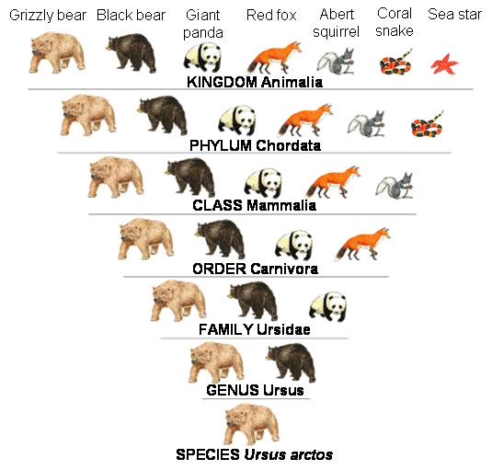
Classification of secondary data

Slide 15
Published external secondary sources

Slide 16
Guides
Guides are an excellent source of standard information.
A guide may help identify other important sources of directories, trade associations and trade publications.

Slide 17
Directories
Directories are helpful for identifying individuals or organisations that collect specific data.
An example of a directory that you can examine on the Internet is the Central and Eastern European Business Directory.

Slide 19
Indexes
It is possible to locate information on a particular topic in several different publications by using an index and abstracts.
Indexes and abstracts can increase the efficiency of the search process. Several indexes and abstracts are available for both academic and business sources.
Examples of newspaper indexes include the Financial Times Index (www.news.ft.com),

Slide 20
Published external secondary sources-1

Slide 21
Non-government statistical data
Published statistical data are of great interest to researchers. Graphic and statistical analyses can be performed on these data to draw important insights. Examples of non governmental statistical data include trade associations such as the Swedish Tourism Trade Association (www.sverigeturism.se)

Slide 22
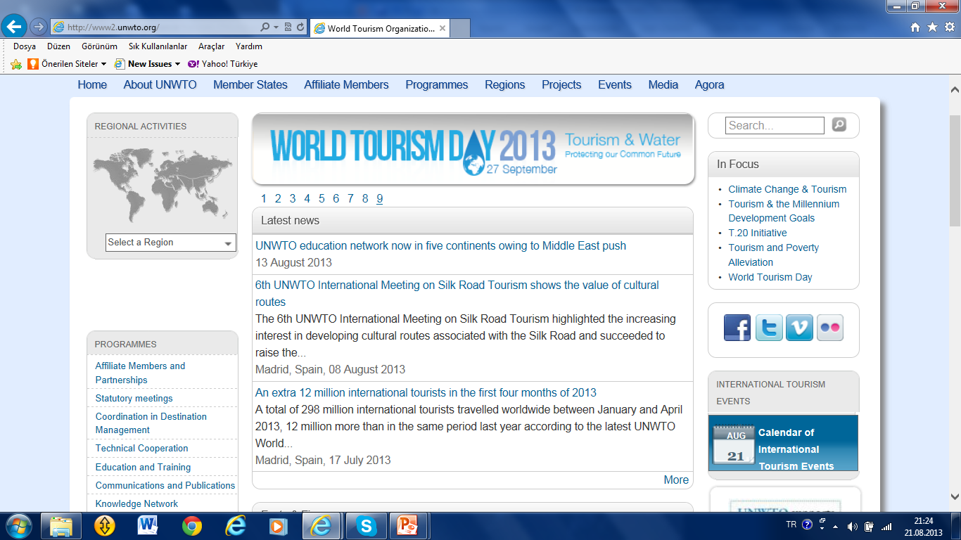

Slide 23
Government sources
Turkish government and the EU also produce large amounts of secondary data. Each European country has its own statistical office which produces lists of the publications available.

Slide 24
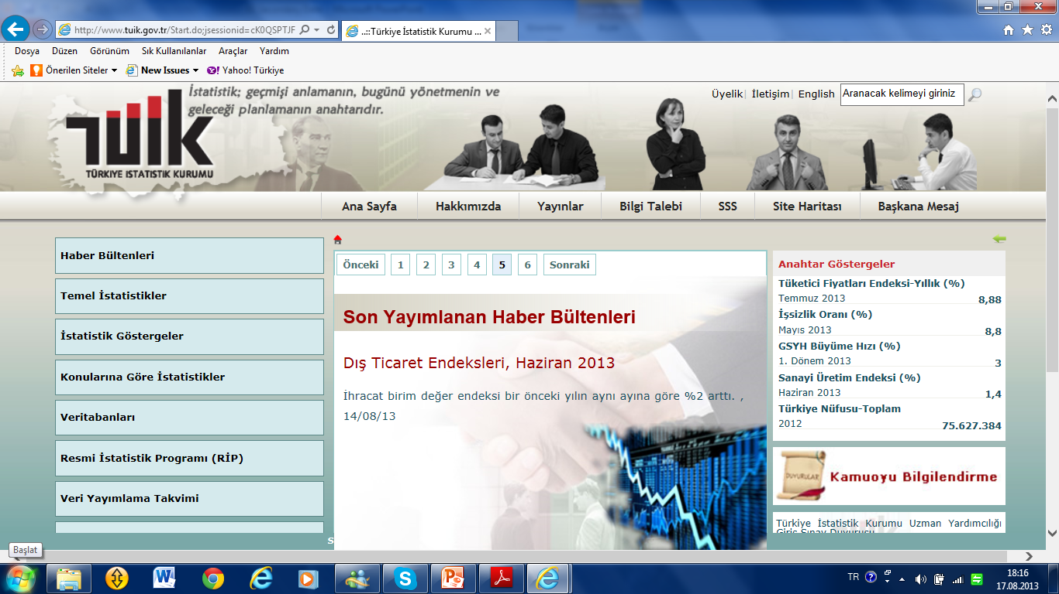

Slide 25
Census data
Most world countries produce either catalogues or newsletters that describe the array(seri)of census publications available and the plans for any forthcoming census.

Slide 26
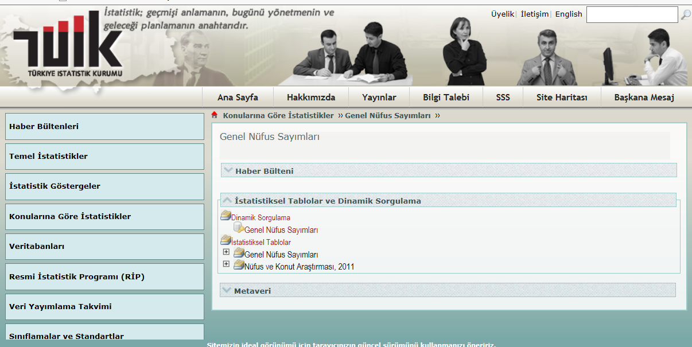

Slide 27
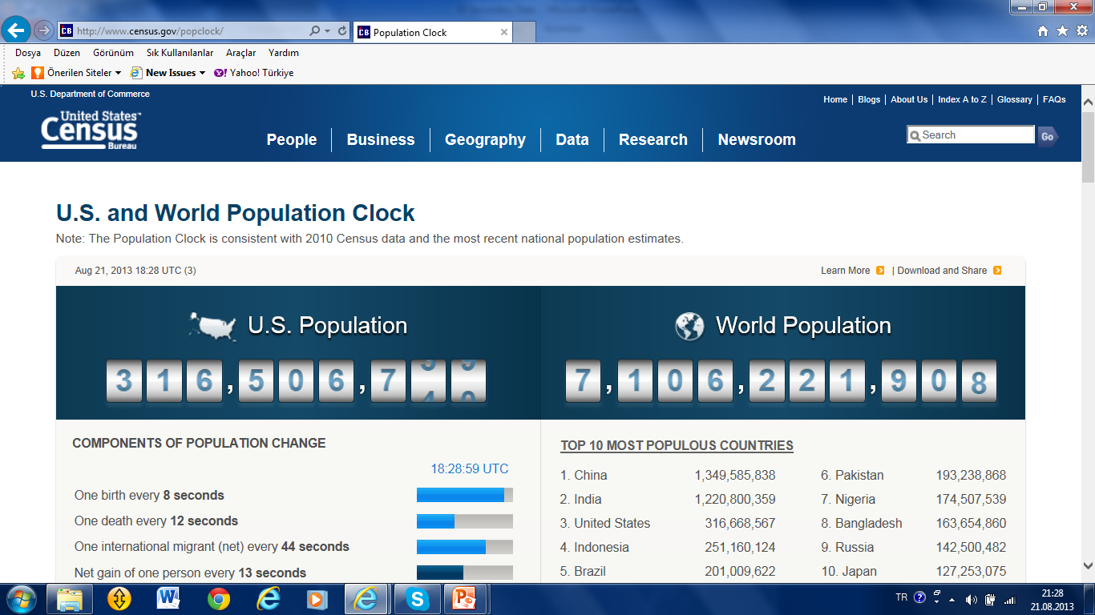

Slide 28
Published external secondary sources-2

Slide 29
Periodicals
Periodical literature (also called a periodical publication) is a published work that appears in a new edition on a regular schedule.
The most familiar examples are the newspaper, often published daily, or weekly; or the magazine, typically published weekly, monthly or as a quarterly.

Slide 30
Published external secondary sources-2

Slide 31
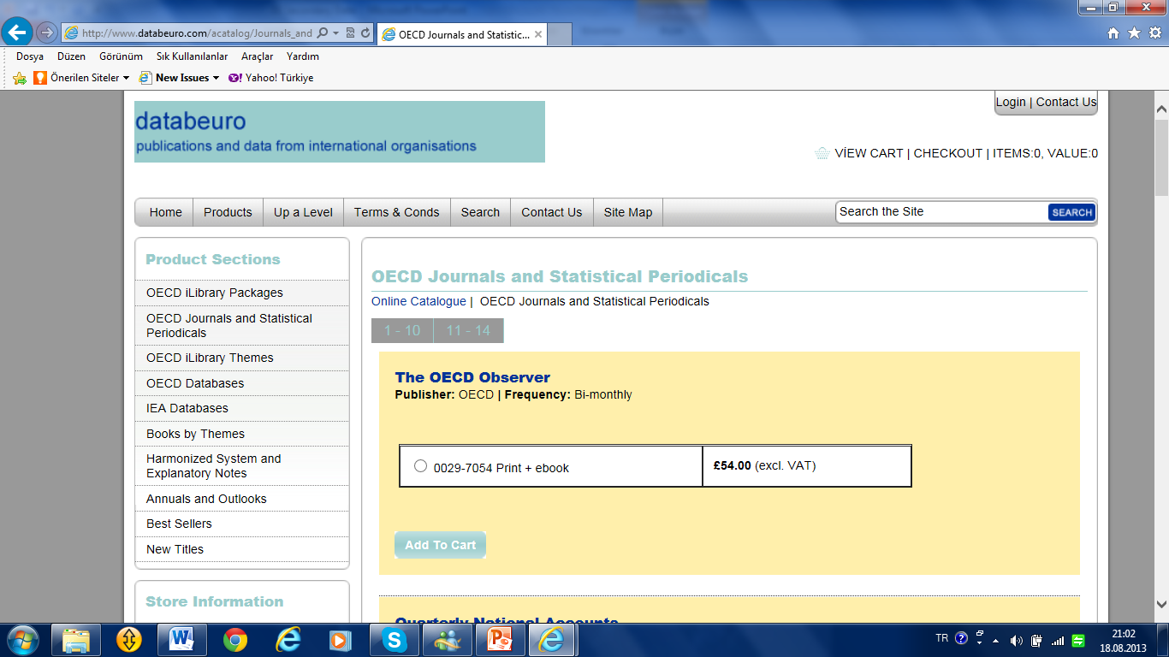
Statistical data are periodicals published by government or non-governments, also can be published nationally or internationally.

Slide 32
In academia, proceedings are the collection of academic papers published in the context of an academic conference. They are usually distributed as printed volumes or in electronic form either before the conference opens or after it has closed.
They are the written record of the work that is presented to fellow researchers.

Slide 33
The collection of papers is organized by one or more persons, who form the editorial team. The quality of the papers is typically ensured by having external people read the papers before they are accepted in the proceedings. This process is called reviewing.

Slide 35
A journal is usually referred to as a diary a newspaper or other periodical, in the literal sense of one published each day many publications issued at stated intervals, such as magazines, or scholarly journals, academic journals, or the record of the transactions of a society, are often called journals. In academic use, a journal refers to a serious, scholarly publication that is peer-reviewed.

Slide 36
Published external secondary sources-2

Slide 37
An academic journal is a peer-reviewed periodical in which scholarship relating to a particular academic discipline is published.
The term academic journal applies to scholarly publications in all fields; this article discusses the aspects common to all academic field journals. Scientific journals and journals of the quantitative social sciences vary in form and function from journals of the humanities and qualitative social sciences.

Slide 38
Published external secondary sources-2

Slide 39
Social Sciences Citation Index (SSCI) is an interdisciplinary citation index product of Thomson Reuters' Healthcare & Science division. It was developed by the Institute for Scientific Information (ISI) from the Science Citation Index.
This citation database covers some 2,474 of the world's leading journals of social sciences across more than 50 disciplines. This database product provides information to identify the articles cited most frequently and by what publisher and author

Slide 41
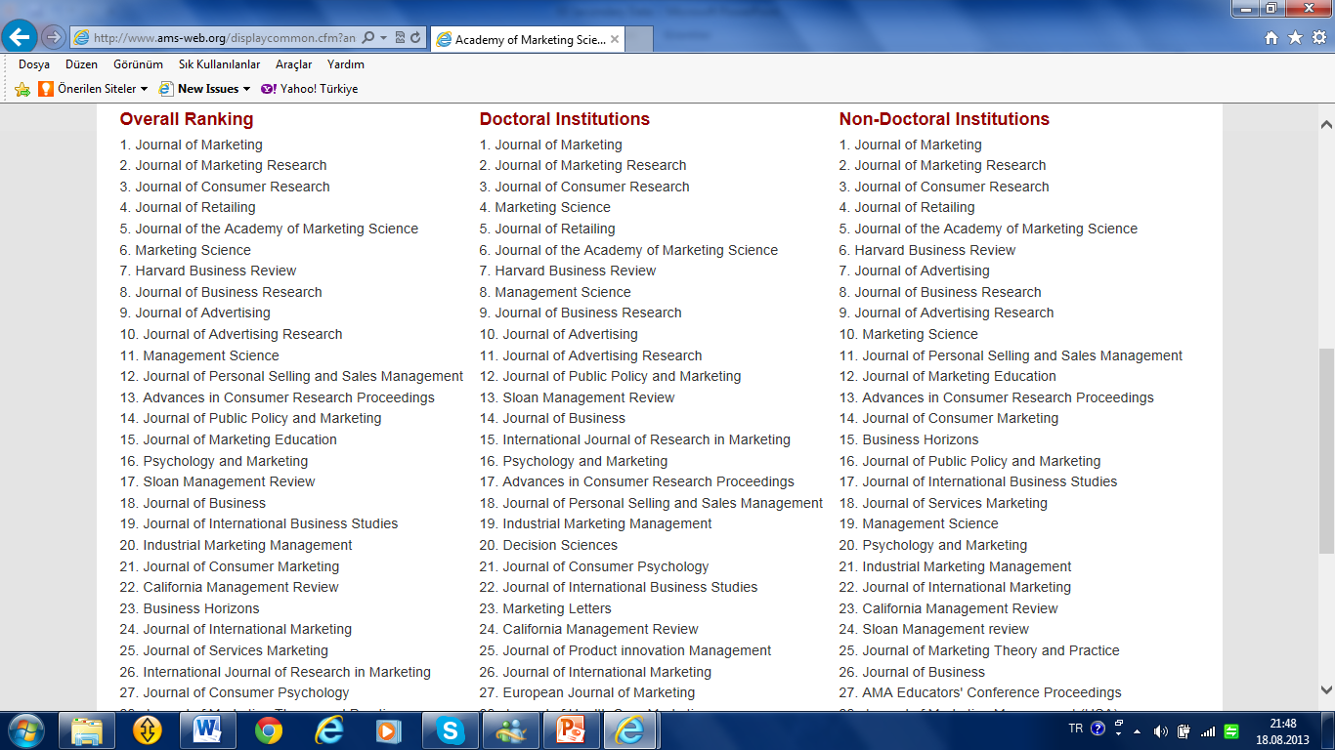

Slide 43
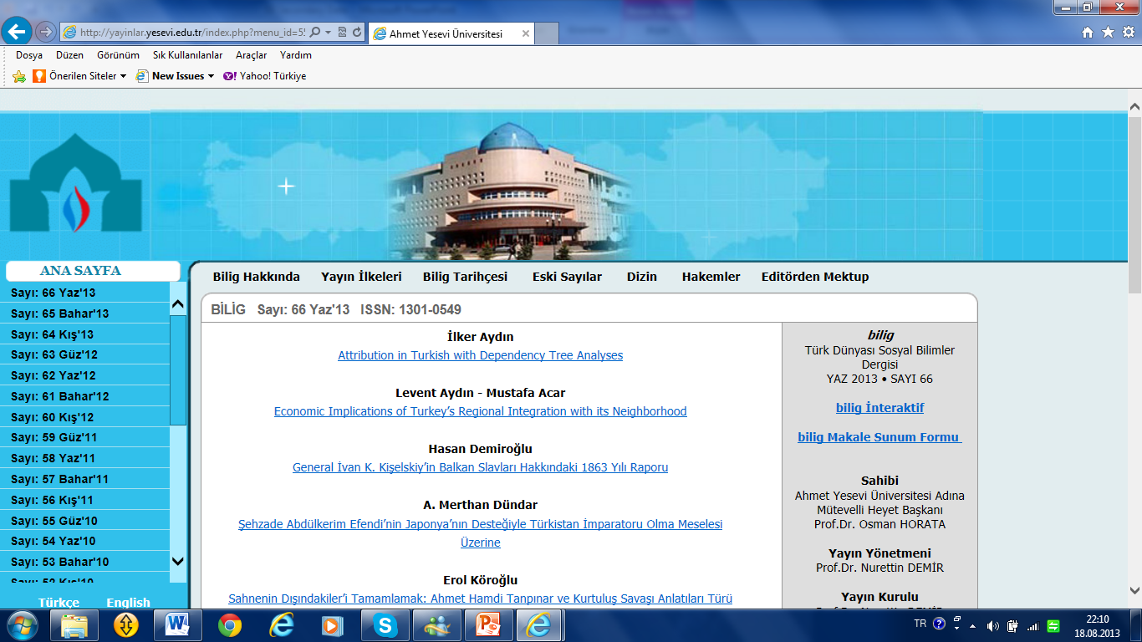

Slide 44
Published external secondary sources-2

Slide 45
Non-indexed journals are peer-reviewed but not cited in any indexes. There are many conditions in order to be an indexed journal.

Slide 46
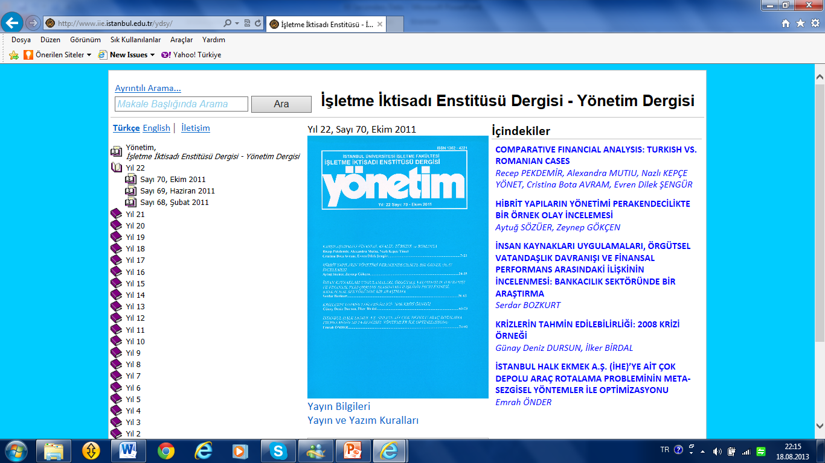

Slide 48
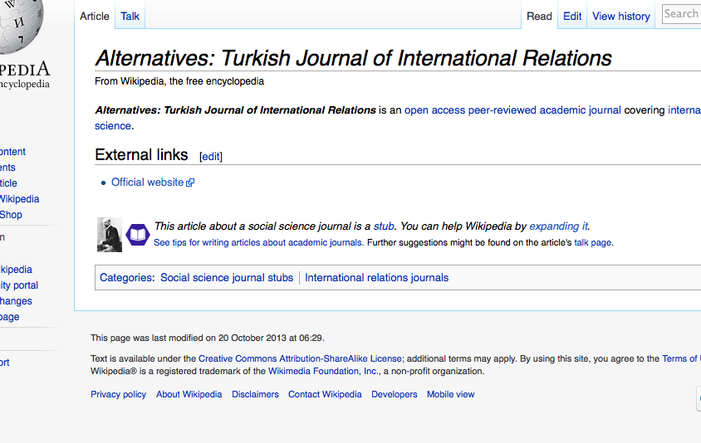

Slide 49
Published external secondary sources-2

Slide 50
Non-peered(akran,emsal)journals are usually non-scientific journal, but can be include some scientific data or information about any subjects. These journals do not have review boards.

Slide 51
Published external secondary sources-2

Slide 53
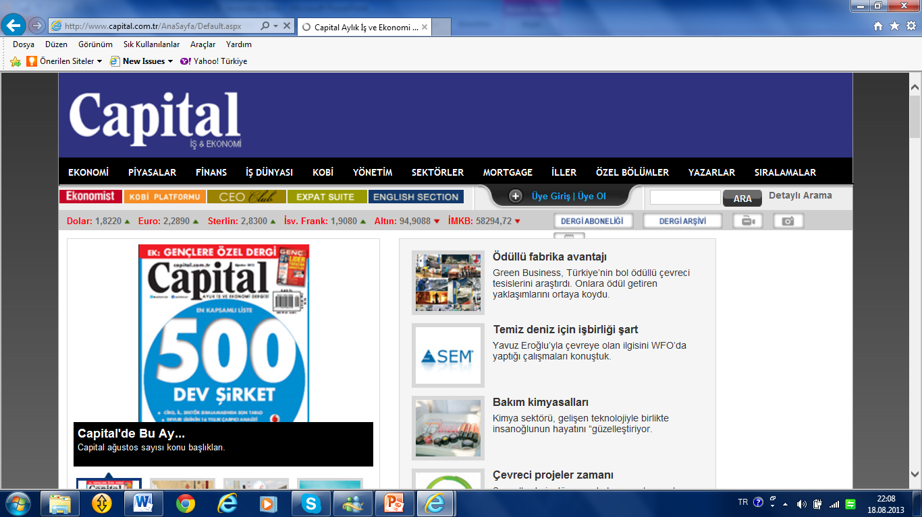

Slide 55
Komputerised databases

Slide 56
Online databases
Databases, stored in computers, that require a telecommunications network to access.

Slide 57
Internet databases
Databases that can be accessed, searched and analysed on the Internet. It is also possible to download data from the Internet and store it on the computer or an auxiliary device.

Slide 58
Offline databases
Databases that are available on diskette or CD-ROM.

Slide 59
Bibliographic databases
Databases composed of citations to articles in journals, magazines, newspapers, marketing research studies, technical reports, government documents, and the like. They often provide summaries or abstracts of the material cited.
(www.theses.com)

Slide 60
Numeric databases
Databases containing numerical and statistical information that may be important sources of secondary data.

Slide 61
Full-text databases
Databases that contain the complete text of secondary source documents comprising the database. World Advertising Research Center WARC (www.warc.com)
A full text database or a complete text database is a database that contains the complete text of books, dissertations, journals, magazines, newspapers or other kinds of textual documents.

Slide 62
special-purpose databases
For example, the Non-Governmental Organisation NGO directory (www.rec.org/REC/Databases/NGODirectory/ NGOfind.html) helps to track down information about environmental organisations working in central and eastern Europe.

Slide 63
Syndicated sources of secondary data

Slide 64
syndicated services,
are companies that collect and sell common pools of data designed to serve information needs shared by a number of clients. These data are not collected with a focus on a specific political problem, but the data and reports supplied to organizations can be personalized to fit specific needs. For example, public opinion pull conducted for political parties.

Slide 66
Syndicated data from households
Surveys
Various syndicated services regularly conduct surveys and omnibus surveys(çok amaçlı gözatım). In general, these surveys involve interviews with a large number of respondents using a pre-designed questionnaire.
Mail diary panels
are samples of respondents who provide specified information at regular intervals over an extended period of time. These respondents may be organisations, households or individuals, although household diary panels are most common.
Electronic scanner services
The following example illustrates the nature and scope of electronic scanner services as undertaken by A.C. Nielsen, who conduct consumer panel services in 18 countries around the world.

Slide 67
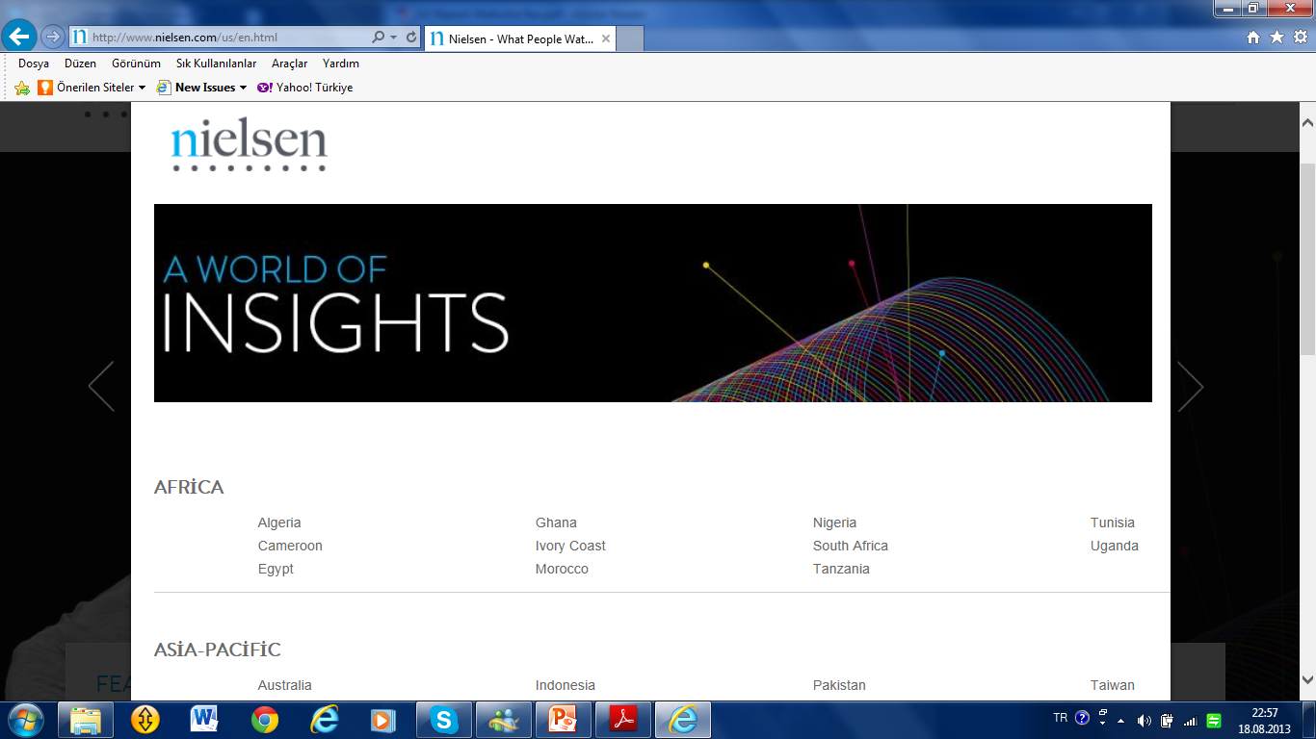

Slide 68
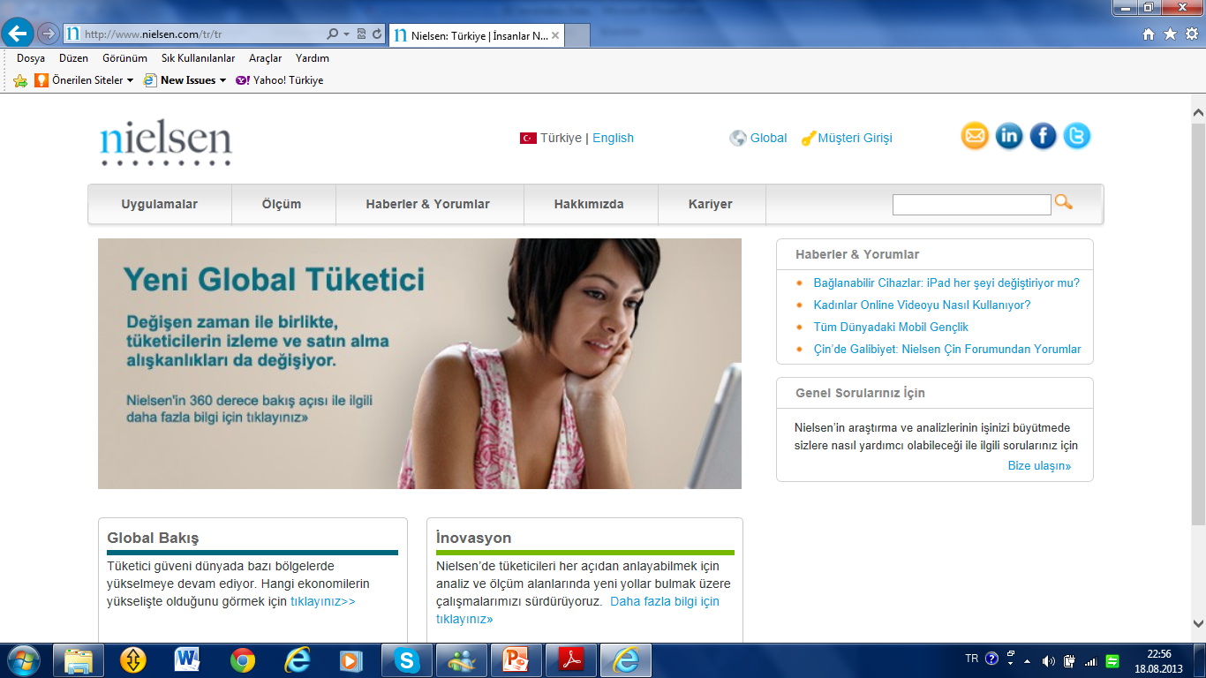

Slide 71
Internal Data Sources
A vital source of secondary data comes from within organisations that commission(görevlendirme)business research, namely internal secondary data. These data are generally seen as being ‘operational data’, i.e. data that represent the daily activities and transactions of a business.
Daily transactions may be held in different departments such as sales, accounts or human resources and stored in different manners.

Slide 72
Many companies see the benefits of compiling(derlemek) comprehensive information about their customers and invest great amounts in developing and maintaining a customer database. The customer database for many companies is used to drive all business strategies. Customer data can be created by companies from past records, promotional devices such as competitions or direct response advertising.
The database is used to stimulate business activities, and the response from these activities is fed back to improve and update it.

Slide 73
Public relations (PR)
is the practice of managing the spread of information between an individual or an organization and the public. Public relations may include an organization or individual gaining exposure to their audiences using topics of public interest and news items that do not require direct payment.

Slide 74
Public relations:
Voters complaints, and voters recommendations, results of the voter panels.

Slide 75
Geodemographic data
The ability to create those links and to graphically display analyses has been achieved with the development of geodemographic information systems (GIS). At a base level, a GIS matches geographic information with demographic information, allowing analyses to be presented on thematic maps.

Slide 76
Thematic maps
Maps that solve marketing problems. They combine geography with demographic information and a company’s sales data or other proprietary information and are generated by a computer.

Slide 77
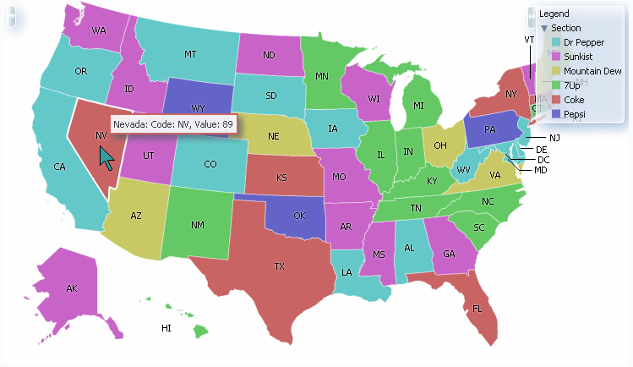

Slide 79
Data warehouse
A data warehouse is as much a process of gathering disparate(farklı)data, converting it into a consistent format that can aid political decision-making, as it is a configuration of software and hardware.
Data warehouses empower users by providing them with access to a whole array of information in an organisation, making it available for use in other applications.

Slide 80
Datawarehouse
1 Is a collection of integrated databases designed to support managerial decision making and problem solving.
2 Essentially becomes a giant database that can include survey data held in a database format.
3 Physically separates an organisation’s operational data systems from its decision
support systems.

Slide 81
Data mining
Data mining is a process of discovering meaningful correlations, patterns and trends by shifting through large amounts of data stored in repositories. The process uses pattern recognition as well as statistical and mathematical techniques.
Data mining should not be confused with datawarehousing. The datawarehouse could be termed a ‘repository’ or a place where large amounts of sometimes disparate sources of data are stored; data mining is a process that depends upon access to the data held in that repository.

Slide 82
Examples of what data mining aims to do:
■ Classify customers into specific categories that are meaningful to decision-makers
■ Identify potential target markets that possess the characteristics that decision makers seek
■ Forecast sales or the use of services
■ Discover which types of products or services are purchased together
■ Discover patterns and trends over time, such as ‘after graduation, students take a holiday’, and be able to show the probabilities associated with different holiday types.

Slide 83
Time to run out!!!

