Slide 1
Primary Data
and Data
Collecting Techniques

Slide 2
Primary data
are originated by a researcher for the specific purpose of addressing the problem at hand. The purpose of survey research is to collect primary data.
Compared with readily available data from a variety of sources, this tailoring means higher costs and a longer time frame in collecting and analyzing the data.

Slide 3
Primary Data
consists of a collection of original primary data. It is often undertaken after the researcher has gained some insight into the issue by reviewing secondary research.
Primary data can be collected only by survey or observation techniques.
It can be accomplished through various methods, including questionnaires and telephone interviews in market research, or experiments and direct observations in the physical sciences, amongst others.

Slide 4
Classification of Survey Methods

Slide 5
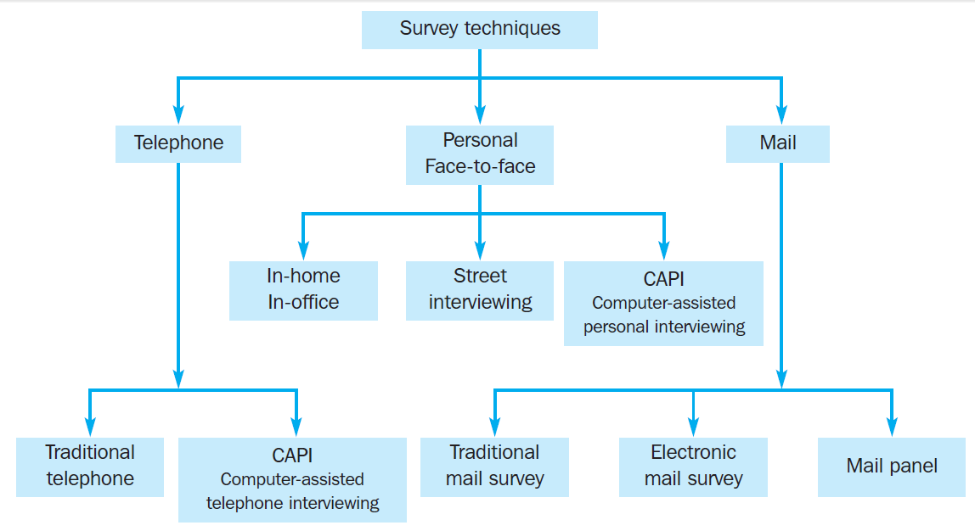

Slide 6
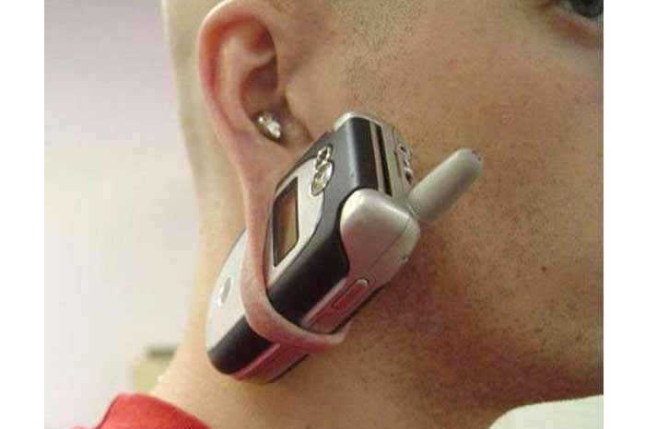
Telephone interviews
Traditional telephone interviews involve phoning a sample of respondents and asking them a series of questions. The interviewer uses a paper questionnaire and records the responses with a pencil.
From a central location, a wide geographical area can be covered, including international markets.

Slide 7
These interviews tend to be short in duration and have questions with few options as answers.
Today, this approach is rarely used in commercial marketing research, the common approach being a computer- assisted telephone interview.

Slide 8
Phone Interview Characteristics
■ SPEED
■ COST
■ LESS COOPERATION
■ NO FACE-TO-FACE CONTACT

Slide 10
Computer-assisted telephone interviews (CATI)

Slide 11
Computer-assisted telephone interviewing (CATI) uses a computerised questionnaire administered to respondents over the telephone.
The interviewer sits in front of a terminal and wears a small headset. The terminal replaces a paper and pencil questionnaire, and the headset substitutes for a telephone. Upon command, the computer dials the telephone number to be called.
When contact is made, the interviewer reads questions posed on the screen and records the respondent’s answers directly into the computer memory bank, ready for immediate analysis.

Slide 12
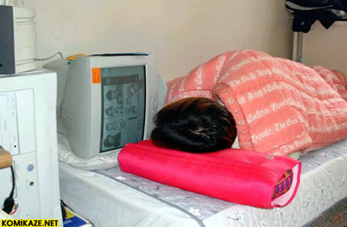
The computer systematically guides the interviewer. Only one question at a time appears on the screen. The computer checks the responses for appropriateness and consistency.
It uses the responses as they are obtained to personalis the questionnaire.

Slide 13
The data collection flows naturally and smoothly. Interviewing time is reduced, data quality is enhanced, coding questionnaires and entering data into the computer are eliminated.
Because the responses are entered directly into the computer, interim and update reports on data collection or results can be provided almost instantaneously.

Slide 14
Electronic interactive media are controlled by the users themselves. No other human need be present. Survey respondents today are not passive audience members. They are actively involved in a two-way communication using electronic interactive media.
The Internet is radically altering(değiştirmek)many organizations’ research strategies, providing a prominent example of the new electronic interactive media.

Slide 16
Personal Face to Face
In personal in-home interviews, respondents are interviewed face-to-face in their homes or in their workplace. The interviewer’s task is to contact the respondents, ask the questions and record the responses.
In recent years, the use of personal in-home interviews has declined due to their high cost. Nevertheless, they are still used, particularly by syndicated firms.

Slide 17
In-office research
is used extensively in business-to-business research to research subjects who cannot be effectively interviewed by telephone or mail.
Managers being interviewed have the comfort and security of their office and can control the timing and pace of the interview. For the researcher, the big benefit of meeting managers in their office is the ability to build up a rapport, probe and gain the full attention of the manager.

Slide 18
Street interviews
In street interviews, respondents are intercepted(durdurmak)while they are shopping in town centers or shopping centers. They may be questioned there and then in the street or taken to a specific test facility.
In the testing of new product formulations, test facilities are ideal to allow respondents the time and context to sample and evaluate products. The technique can also be used to test merchandising ideas, advertisements and other forms of marketing communications

Slide 20
Computer-assisted personal interviews
In the third form of personal interviewing, the respondent sits in front of a computer terminal and answers a questionnaire on the screen by using the keyboard or a mouse.
There are several user-friendly electronic packages that design relatively simple questions for the respondent to understand. Help screens and courteous error messages are also provided.

Slide 21
A major development for marketers, especially in financial services, has been the use of customer satisfaction surveys to guide strategic and operational decisions.
With traditional interview techniques, the interviewer may have to carry a huge questionnaire to cope with questions that measure attitudes to a range of banks and a range of services taken from those banks.

Slide 22
Advantages of Personal Interviews
OPPORTUNITY FOR FEEDBACK
Provides the opportunity for feedback and clarification. For example, if a consumer is reluctant to provide sensitive information, the interviewer may offer reassurance that his or her answers will be strictly confidential.
2. PROBING COMPLEX ANSWERS
If a respondent’s answer is too brief or unclear, the researcher may request a more comprehensive or clearer explanation. In probing, the interviewer asks for clarification with standardized questions such as “Can you tell me more about what you had in mind?
3. LENGTH OF INTERVIEW
If the research objective requires an extremely lengthy questionnaire, personal interviews may be the only option. A general rule of thumb on mail surveys is that they should not exceed six pages, and telephone interviews typically last less than ten minutes

Slide 23
4. COMPLETENESS OF QUESTIONNAIRE
The social interaction between a well-trained interviewer and a respondent in a personal interview increases the likelihood that the respondent will answer all the items on the questionnaire.
5. PROPS (destek) AND VISUAL AIDS
Interviewing respondents face-to-face allows the investigator to show them new product samples, sketches of proposed advertising, or other visual aids.
6. HIGH PARTICIPATION
Although some people are reluctant to participate in a survey, the presence of an interviewer generally increases the percentage of people willing to complete the interview. Respondents typically are required to do no reading or writing—all they have to do is talk

Slide 24
Disadvantages of Personal Interviews
■ INTERVIEWER INFLUENCE
Some evidence suggests that demographic characteristics of the interviewer influence respondents’ answers. For example, one research study revealed that male interviewers produced larger amounts of interviewer variance than female interviewers in a survey in which 85 percent of the respondents were female.
Older interviewers who interviewed older respondents produced more variance than other age combinations, whereas younger interviewers who interviewed younger respondents produced the least variance.

Slide 25
■ LACK OF ANONYMITY OF RESPONDENT
Because a respondent in a personal interview is not anonymous and may be reluctant to provide confidential information to another person, researchers often spend considerable time and effort to phrase sensitive questions to avoid social desirability bias.

Slide 26
■ COST
Personal interviews are expensive, generally substantially more costly than mail, Internet, or telephone surveys. The geographic proximity of respondents, the length and complexity of the questionnaire, and the number of people who are nonrespondents because they could not be contacted (not-at-homes) will all influence the cost of the personal interview

Slide 27
■ LACK OF ANONYMITY OF RESPONDENT
Because a respondent in a personal interview is not anonymous and may be reluctant to provide confidential information to another person, researchers often spend considerable time and effort to phrase sensitive questions to avoid social desirability bias.
For example, the interviewer may show the respondent a card that lists possible answers and ask the respondent to read a category number rather than be required to verbalize sensitive answers.

Slide 28
■ DOOR-TO-DOOR INTERVIEWS
Door to door inteviews are a part of street interviews. The presence(mevcudiyet)of an interviewer at the door generally increases the likelihood that a person will be willing to complete an interview. Because door-to-door interviews increase the participation rate, they provide a more representative sample of the population than mail questionnaires.
People who do not have telephones, who have unlisted telephone numbers, or who are otherwise difficult to contact may be reached using door-to-door interviews.

Slide 29
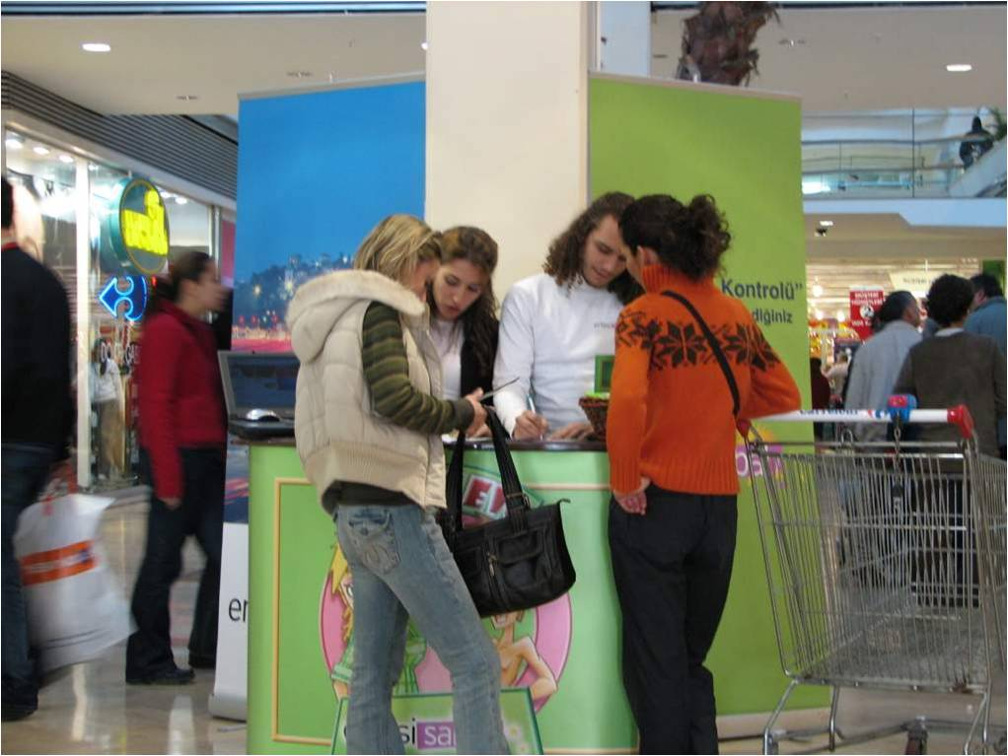
MALL INTERCEPT
INTERVIEWS

Slide 30
The main reason mall intercept interviews are conducted is because their costs are lower. No travel is required to the respondent’s home; instead, the respondent comes to the interviewer, and many interviews can be conducted quickly in this way.
A major problem with mall intercept interviews is that individuals usually are in a hurry to shop, so the incidence of refusal is high—typically around 50 percent.

Slide 31
In a mall interview, the researcher must recognize that he or she should not be looking for a representative sample of the total population. Each mall has its own target market’s characteristics, and there is likely to be a larger bias than with careful household probability sampling.
However, personal interviews in shopping malls are appropriate when the target group is a special market segment such as the parents of children of bike-riding age.

Slide 33
Traditional mail interviews
In the traditional mail interview, questionnaires are mailed to preselected potential respondents. A typical mail interview package consists of the outgoing envelope, cover letter, questionnaire, return envelope, and possibly an incentive(teşvik edici). The respondents complete and return the questionnaires.
There is no verbal(sözel)interaction between the researcher and the respondent in the interview process. There may be an initial contact with potential respondents, to establish who is the correct person to send the questionnaire to, and to motivate them before they receive the survey.

Slide 34
An initial task is to obtain a valid mailing list. Mailing lists can be compiled from telephone directories, customer databases or association membership databases, or can be purchased from publication subscription lists or commercial mailing list companies.

Slide 36
Mail panels
A mail panel consists of a large, nationally representative sample of households that have agreed to participate in periodic mail questionnaires, political issues, product tests and telephone surveys. The households are compensated(telafi etmek)with various incentives. Mail panels can be used to obtain information from the same respondents repeatedly. Thus, they can be used to implement a longitudinal design.

Slide 38
Electronic mail
Electronic mail can be broken down into email and Internet interviews. To conduct a survey by email, a list of email addresses needs to be obtained. The survey is written within the body of the email message and sent to respondents.

Slide 39
Internet Surveys
An Internet survey is a self-administered questionnaire posted on a Web site. Respondents provide answers to questions displayed onscreen by highlighting a phrase, clicking an icon, or keying in an answer. Like every other type of survey, Internet surveys have both advantages and disadvantages.

Slide 40
■ RESPONSE RATES
The methods for improving response rates for an Internet survey are similar to those for other kinds of survey research. A personalized invitation may be important.
In many cases, the invitation is delivered via e-mail. The respondents may not recognize the sender’s address, so the message’s subject line is critical.

Slide 41
■ SECURITY CONCERNS
Many organizations worry that hackers or competitors may access Web sites to discover new product concepts, new advertising campaigns, and other top-secret ideas.
Respondents may worry whether personal information will remain private. So may the organizations sponsoring the research.

Slide 42
Respondents type their answers to either closed-ended or open-ended questions at designated places, and click on ‘reply’. Responses are then entered into an analysis package and tabulated.
Alternatively, a program can be written that interprets the emailed responses and reads the answers directly into a format compatible with the requirements of an analysis package.

Slide 43
Speed
Cost
Interviewer bais removed
Quality of response
Data quality
Contacting certain target group
Geographic flexibility
Absence o interviewer
Advantages

Slide 44
Sampling frames
Access to WEB
Technical problems
Disadvantages

Slide 47
Response Rates
All questionnaires that arrive via bulk mail are likely to get thrown away. Questionnaires that are boring, unclear, or too complex are even more likely to get thrown in the wastebasket. A poorly designed mail questionnaire may be returned by less than 5 percent of those sampled (that is, a 5 percent response rate).
The basic calculation for obtaining a response rate is to count the number of questionnaires returned or completed, then divide the total by the number of eligible people who were contacted or requested to participate in the survey.

Slide 48
KEYING MAIL QUESTIONNAIRES WITH CODES
A researcher planning a follow-up letter or postcard should not disturb respondents who already have returned the questionnaire.
Blind keying of questionnaires on a return envelope (systematically varying the job number or room number of the marketing research department, for example) or a visible code number on the questionnaire has been used for this purpose.

Slide 49
In order to reach maximum response rate, usually researchers prefer to use more than one survey technique.

Slide 50
Pretesting
İnvolves a trial run with a group of respondents to iron out fundamental problems in the instructions or design of a questionnaire.
Unfortunately, this stage of research is sometimes eliminated because of costs or time pressures.

Slide 51
OBSERVATION AND IT’S TECHNIQUES

Slide 52
Observation in Business Research
In business research, observation is a systematic process of recording behavioral patterns of people, objects, and occurrences as they happen. No questioning or communicating with people is needed.
Researchers who use observation as a method of data collection either witness and record information while watching events take place or take advantage of some tracking system such as check-out scanners or Internet activity records.

Slide 53
What Can Be Observed?
mekansal
geçici

Slide 54
Limitation of Observation Technique
While the observation method may be used to describe a wide variety of behavior, cognitive phenomena such as attitudes, motivations, and preferences cannot be observed. As a result, observation research cannot provide an explanation of why a behavior occurred or what actions were intended.
Another limitation is that the observation period generally is short. Observing behavior patterns that occur over a period of several days or weeks generally is too costly or even impossible.

Slide 55
Structured versus
unstructured observation

Slide 56
structured observation
The researcher specifies in detail what is to be observed and how the measurements are to be recorded, such as when an auditor performs a stock or inventory analysis in a store. This reduces the potential for observer bias and enhances the reliability of the data. Structured observation is appropriate when the phenomena under study can be clearly defined and counted.
For example, suppose that the researcher wished to measure the ratio of visitors to buyers in a store. The reason for such observations could be to understand the amount of browsing that occurs in a store.

Slide 57
unstructured observation
The observer monitors all aspects of the phenomenon that seem relevant to the problem at hand, such as observing children playing with new toys and trying to understand what activities they enjoy the most.
This form of observation can be used when a research problem has yet to be formulated precisely and when flexibility is needed in observation to identify essential components of the problem and to develop hypotheses. Unstructured observation is most appropriate for exploratory research

Slide 58
Hidden versus
Unhidden observation

Slide 59
In hidden observation, the respondents are unaware that they are being observed. Hidden observation enables respondents to behave naturally because people tend to behave differently when they know they are being observed.
Researcher may be accomplished by using two-way mirrors, hidden cameras or secret electronic devices. Observers may be hidden as shoppers, sales assistants or other appropriate roles. One of the most widespread techniques of observation is through the use of mystery(gizli)shoppers.

Slide 60
The mystery shopper takes the role of the ordinary ‘man or woman in the street’, behaves just as a normal customer would, asks the same sort of questions a customer would, leaves, and fills in a questionnaire detailing the various components observed in their visit.

Slide 61
Mystery shopping differs from conventional survey research in that it aims to collect facts rather than perceptions. Conventional customer service research is all about customer perceptions.
?

Slide 62
Natural versus
Contrived(planlı)observation

Slide 63
Natural observation
involves observing behaviour as it takes place in the environment. For example, one could observe the behaviour of respondents eating a new menu option in Burger King.
The advantage of natural observation is that the observed phenomenon will more accurately reflect the true phenomenon, as the behaviour occurs in a context that feels natural to the respondent. The disadvantages are the cost of waiting for the phenomenon to occur and the difficulty of measuring the phenomenon in a natural setting.

Slide 64
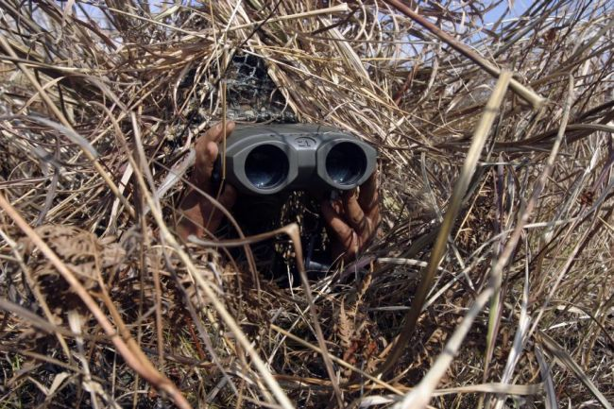
Observation techniques classified by mode of administration

Slide 66
Personal observation
In personal observation, a researcher observes actual behaviour as it occurs. The observer does not attempt to control or manipulate the phenomenon being observed but records what takes place.
For example, a researcher might record the time, day and number of shoppers who enter a shop and observe where those shoppers ‘flow’ once they are in the shop. This information could aid in designing a store’s layout and determining the location of individual departments, shelf locations and merchandise displays.

Slide 68
Electronic observation
In electronic observation, electronic devices rather than human observers record the phenomenon being observed. The devices may or may not require the respondents’ direct participation.
They are used for continuously recording ongoing behaviour for later analysis.

Slide 69
Of the electronic devices that do not require respondents’ direct participation, the A.C. Nielsen audimeter is best known. The audimeter is attached to a television set to record continually the channel to which a set is tuned. Another way to monitor viewers is through the people meter.

Slide 70
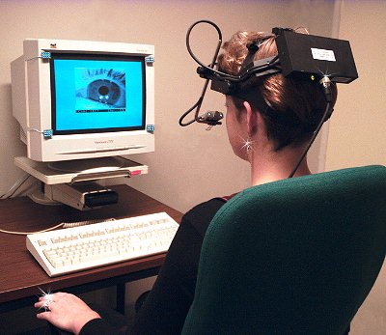
Eye tracking
equipment Instruments that record the gaze movements of the eye.
Pupilometer
An instrument that measures changes in the eye pupil diameter.

Slide 71
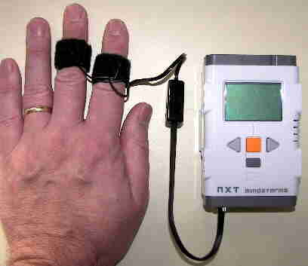
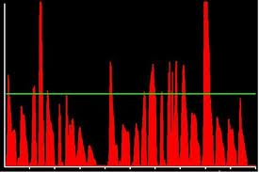
Psycho-galvanometer
An instrument that measures a respondent’s galvanic skin response.
Response latency(gecikme)
The amount of time it takes to respond to a question.
Voice pitch analysis
Measurement of emotional reactions through changes in the respondent’s voice.

Slide 73
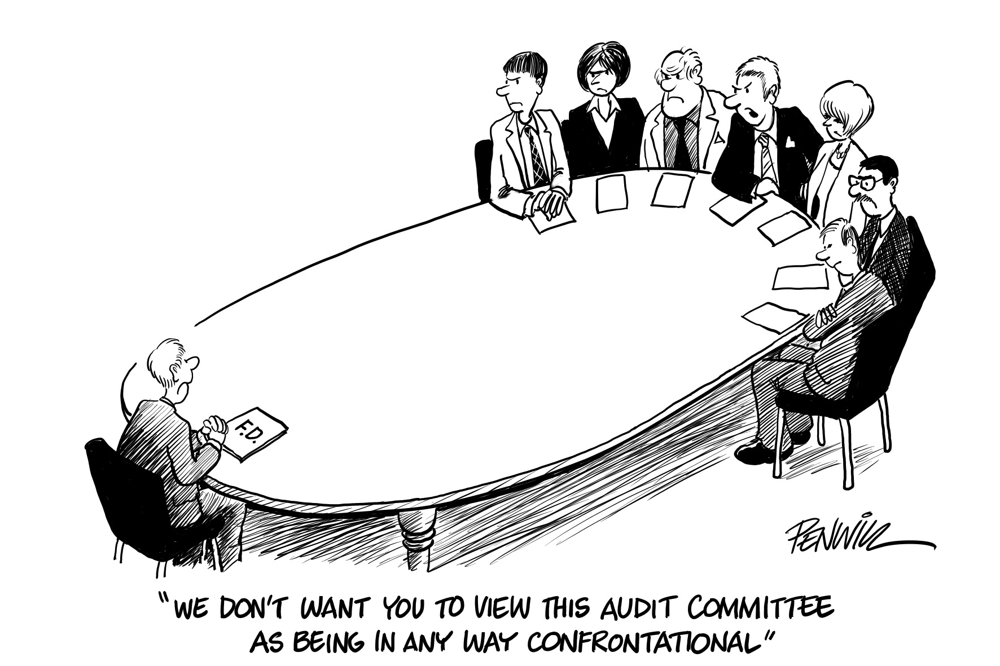
Audit
Çatışmacı
In an audit, the researcher collects data by examining physical records or performing inventory analysis. Audits have two distinguishing features. First, data are collected personally by the researcher. Second, the data are based upon counts, usually of physical objects.

Slide 75
Content analysis
is an appropriate method when the phenomenon to be observed is communication, rather than behaviour or physical objects.
It is defined as the objective, systematic and quantitative description of the manifest content of a communication. It includes observation as well as analysis. The unit of analysis may be words, characters, themes, space and time measures or topics.
Analytical categories for classifying the units are developed, and the communication is broken down according to prescribed rules.

Slide 77
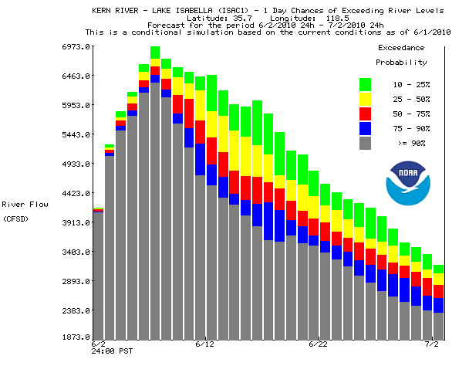
Trace(izleme)analysis
An observation method that can be inexpensive if used creatively is trace analysis. In trace analysis, data collection is based on physical traces, or evidence, of past behaviour. These traces may be left by the respondents intentionally or unintentionally.

Slide 78
A comparative evaluation of observation techniques

Slide 79
gizlilik

Slide 80
Relative advantages of observation techniques
The greatest advantage of observational techniques is that they permit measurement of actual behaviour rather than reports of intended or preferred behaviour.
There is no reporting bias, and potential bias caused by the interviewer and the interviewing process is eliminated or reduced. Certain types of data can be collected only by observation.
These include behaviour patterns which the respondent is unaware of or unable to communicate. For example, information on babies’ toy preferences is best obtained by observing babies at play, because they are unable to express themselves adequately.

Slide 81
Relative disadvantages of observation techniques
The biggest disadvantage of observation is that the reasons for the observed behaviour may be difficult to determine because little is known about the underlying motives, beliefs, attitudes and preferences.
For example, people observed buying a brand of cereal may or may not like it themselves; they may be purchasing that brand for someone else in the household. Another limitation of observation is the extent to which the researcher is prepared to evaluate the extent of their own bias, and how this can affect what they observe.
In addition, observational data can be time-consuming and expensive to collect. It is also difficult to observe certain forms of behaviour such as personal activities that occur in the privacy of the consumer’s home. Finally, in some cases such as in the use of hidden cameras, the use of observational techniques may border on being or may actually be unethical.

Slide 82
Silently
bye bye

