Slide 1
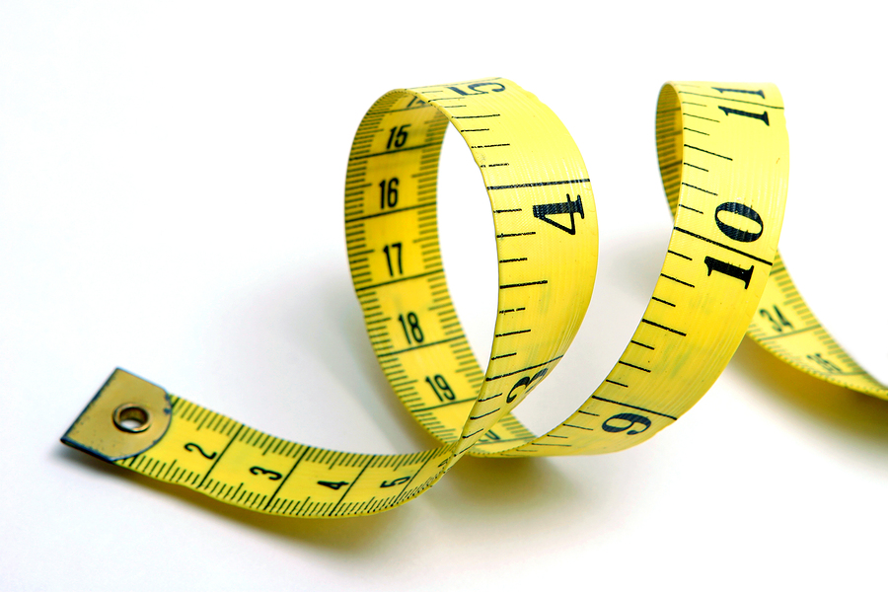
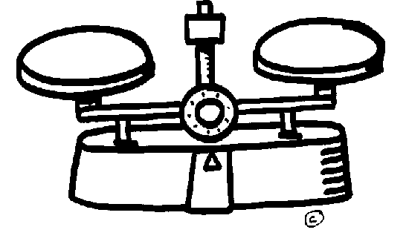
Measurmenet & Scaling

Slide 2
Measurement means assigning numbers or other symbols to characteristics of objects according to certain pre-specified rules.
We measure not the object but some characteristic of it. Thus, we do not measure consumers, only their perceptions, attitudes, preferences or other relevant characteristics.

Slide 3
Scaling may be considered an extension of measurement. Scaling involves creating a continuum upon which measured objects are located.
Scaling is the process of placing the respondents on a continuum with respect to their attitude towards banks. In our example, scaling is the process by which respondents would be classified as having an unfavourable, neutral or positive attitude.

Slide 4
Primary scales of measurement
There are four primary scales of measurement: nominal, ordinal, interval and ratio. First two are nonmetric the other two are metric.

Slide 5
Measurement Scales
Nonmetric
Metric
Nominal
Ordinal
Interval
Ratio

Slide 6
Nominal scale
A nominal scale is a figurative labelling scheme(plan)in which the numbers serve only as labels for identifying and classifying objects.
For example, the numbers assigned to the respondents in a study constitute(oluşturmak)a nominal scale, thus a female respondent may be assigned a number 1 and a male respondent 2.

Slide 7
When a nominal scale is used for the purpose of identification, there is a strict one-to-one correspondence between the numbers and the objects.
Each number is assigned to only one object, and each object has only one number assigned to it.

Slide 8
No matter which one is first or second

Slide 9
Common examples include student registration numbers at their college or university and numbers assigned to football players or jockeys in a horse race. In marketing research, nominal scales are used for identifying respondents, brands, attributes, banks and other objects.

Slide 10
When used for classification purposes, the nominally scaled numbers serve as labels for classes or categories.
For example, you might classify the control group as group 1 and the experimental group as group 2. The classes are mutually exclusive and collectively exhaustive.

Slide 11
Only a limited number of statistics, all of which are based on frequency counts, are permissible(izinverilebilir). These include percentages, mode, chi-square and binomial tests.
It is not meaningful to compute an average student registration number, the average gender of respondents in a survey, or the number assigned to an average bank.

Slide 12
Examples
Gender ( ) Female ( ) Male
Marital Status ( ) Married ( ) Single ( ) Divorced
Nationality ( ) Turk ( ) Arab ( ) Germen ( ) English
Telephone Nu………

Slide 13
Which kind of media product do you use?
( ) Newspaper
( ) Television
( ) Internet
( ) Radio
( ) Magazine

Slide 14
What can we do or can not with nominal measures?
Percentage of the numbers can be calculated
40% Male and 60% Female
Can not be ranked
First Turk
Second Arab
Third Germen
Fourth English
- Arithmatical means can not be calculated

Slide 15
- Mod and frequencies can be calculated
Table 1: The Nationality of the Tourists
Nationality Ferquency (%)
Turkish 330 21
Germeny 610 38
Japanies 560 35
Arab 100 06
Total 1600 100

Slide 16
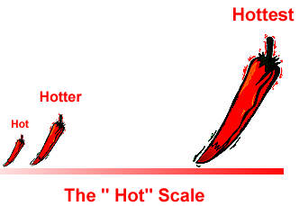
^{Ordinal scale}
An ordinal scale is a ranking scale in which numbers are assigned to objects to indicate the relative extent to which the objects possess some characteristic. An ordinal scale allows you to determine whether an object has more or less of a characteristic than some other object, but not how much more or less.

Slide 17
Thus, an ordinal scale indicates relative position, not the magnitude of the differences between the objects.
The object ranked first has more of the characteristic as compared with the object ranked second, but whether the object ranked second is a close second or a poor second is not known.

Slide 18
Common examples of ordinal scales include quality rankings, rankings of teams in a tournament and occupational status. In marketing research, ordinal scales are used to measure relative attitudes, opinions, perceptions and preferences.
Measurements of this type include ‘greater than’ or ‘less than’ judgments from the respondents.

Slide 19
Table 2: Usage Frequencies of Four Milk Brands Frequency by two Consumers
Consumers Milk Brands
A B C D
Oğuz 3 2 1 4
Gökçen 4 1 2 3

Slide 20
Consumers Milk Brands
A B C D
Oğuz 3 2 1 4
Gökçen 4 1 2 3
This table shows that Oğuz prefers C to B, B to A and A to D. But do not show how much prefers. So this scale is nonmetric and ordinal.

Slide 21
Interval scale
In an interval scale, numerically equal distances on the scale represent equal values in the characteristic being measured because it is metric.
An interval scale contains all the information of an ordinal scale, but it also allows you to compare the differences between objects.
The difference between any two scale values is identical to the difference between any other two adjacent values of an interval scale.

Slide 22
There is a constant or equal interval between scale values. The difference between 1 and 2 is the same as the difference between 2 and 3, which is the same as the difference between 5 and 6.
A common example in everyday life is a temperature scale. In marketing research, attitudinal data obtained from rating scales are often treated as interval data.

Slide 23
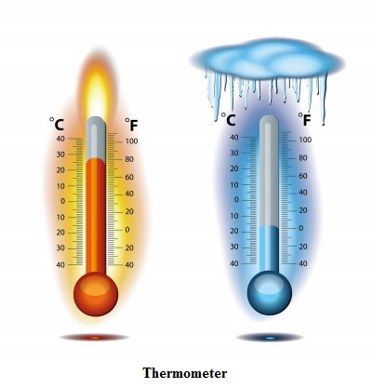

Slide 24
Turkish people are generous.
(5) Strongly agree
(4) Agree
(3) Neither agree nor disagree
(2) Disagree
(1) Strongly disagree
I am proud of my country.

Slide 25
Interval is a metric scale, so it is possible to calculate the arithmetical means of interval scale. Interval scale can be five, seven or nine-level scale.
Let us assume that 200 students have answered the question above as follow, calculate the arithmetical means

Slide 26
Participation Degree | Frequency | %
5 Strongly agree | 75 | 37,5
4 | 64 | 32
3 | 38 | 19
2 | 18 | 9
1 Strongly disagree | 5 | 2,5
Total | 200 | 100
The weighted arithmetic means is?
(5x0,375)+(4x0,32)+(3x0,19)+(2x0,09)+(1x0,025)=3,93

Slide 27
Interpretation of the result:
The arithmetical means (the average) of the population is 3,93 which it means that the population almost agree that they are proud of their country.

Slide 28
Ratio scale
A ratio scale possesses all the properties of the nominal, ordinal and interval scales, and in addition, an absolute zero point.
Thus, in ratio scales we can identify or classify objects, rank the objects, and compare intervals or differences. It is also meaningful to compute ratios of scale values.

Slide 29
In marketing, sales, costs, market share and number of customers are variables measured on a ratio scale.
In Economics income, inflation rate, exchange rate, population, income per capita etc. are good examples of ratio scale.

Slide 30
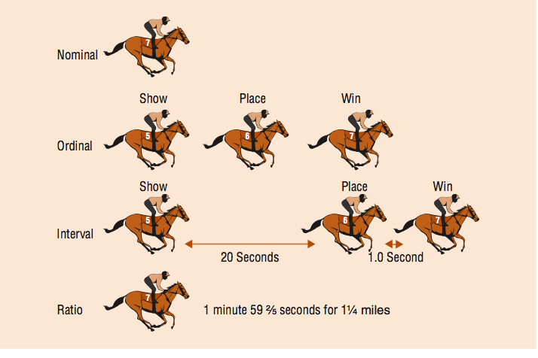
All measurements together

Slide 31
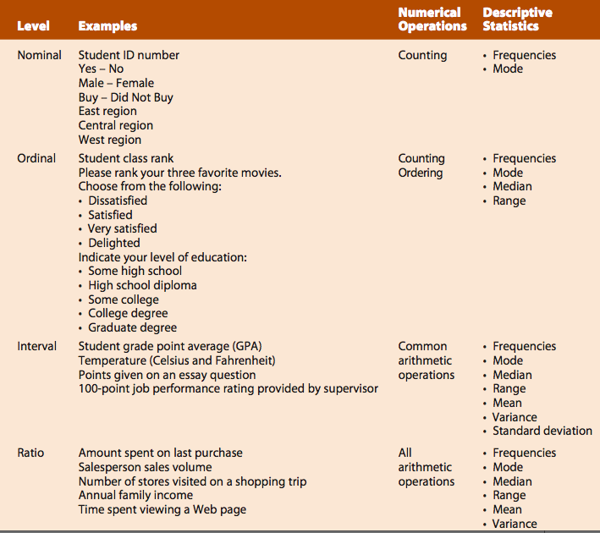

Slide 32
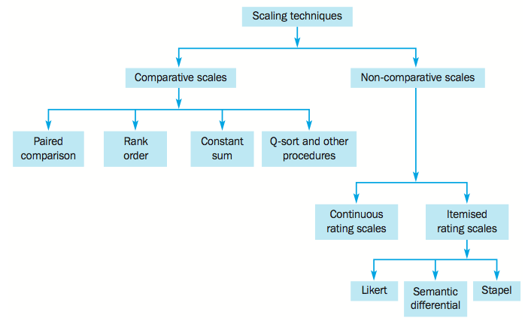
^{Scaling techniques}

Slide 33
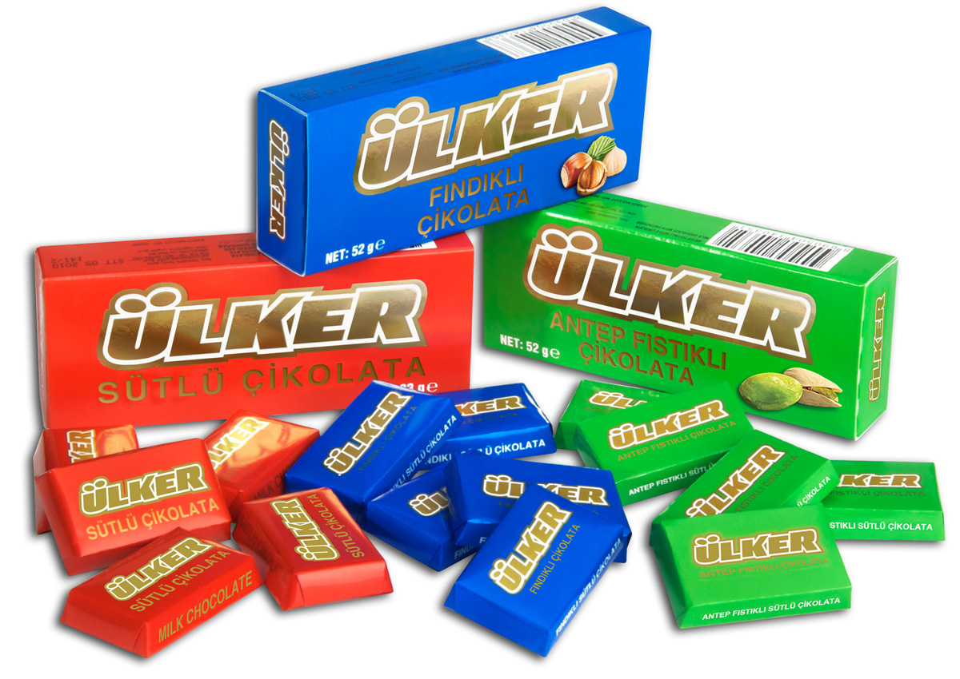
^{Paired comparison scaling}
A respondent is presented with two objects and asked to select one according to some criterion. The data obtained are ordinal in nature. A respondent may state that he or she prefers Ülker chocolate to Nestle, likes Maraş ice-cream better than Algida.

Slide 34
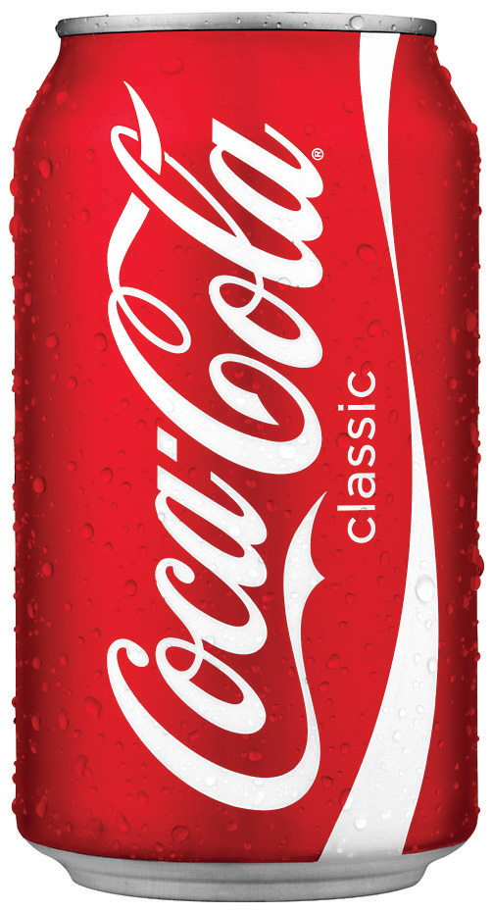
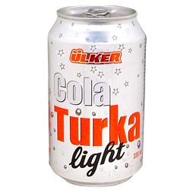
Paired comparison scales are frequently used when the stimulus objects are physical products. Coca-Cola is reported to have conducted more than 190,000 paired comparisons before introducing New Coke. Paired comparison scaling is the most widely used comparative scaling technique.

Slide 35
EXAMPLE: Comparing 4 different package materials by using 0-1 scale
1: Preferring the column to the row.
0: Preferring the row to the column.

Slide 36
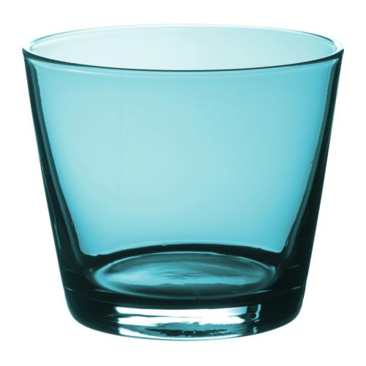
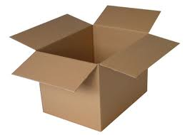
Material Glass Plastic Can Carton
Glass - 0 1 0
Plastic 1 - 1 1
Can 0 0 - 0
Carton 1 0 1 -

Slide 37
Material Glass Plastic Can Carton
Glass - 0 1 0
Plastic 1 - 1 1
Can 0 0 - 0
Carton 1 0 1 -
Let us start with reading the first cell of the first column which is glass-plastic cell (1). it means that this consumer prefers glass to plastic.

Slide 38
Material Glass Plastic Can Carton
Glass - 0 1 0
Plastic 1 - 1 1
Can 0 0 - 0
Carton 1 0 1 -
Glass-can cell is (0) so, the consumer prefers glass to can. Also Glass-carton cell is (1). So the consumer prefers the glass to carton.

Slide 39
100 consumers were asked to fill this table and the result is as in the table. it looks like wherein glass, cardboard, etc. are preferred.

Slide 40
Preference of 4 Packing Material by100 Consumers.
Material Packing Materials Total
Glass Plastic Can Carton
Glass - 20 75 40 135
Plastic 80 - 90 70 240
Can 25 10 - 35 70
Carton 60 30 65 - 155
Total 165 60 230 145 595

Slide 41
This means that 80 consumers preferred the glass to the plastic, 25 the glass to can and 60 the glass to the carton.
In another words 100 consumers preferred the glass 165 times, the plastic 60 times, the can 230 times and the carton 145 times to other materials .
Accordingly, it is easy to say that the can is the most and the plastic is the least preferred package materials.

Slide 42
Scaling techniques

Slide 43
Rank Order scaling
Respondents are presented with several objects simultaneously and asked to order or rank them according to some criterion. For example, respondents may be asked to rank brands of cars according to overall preference. There is no paired comparison.

Slide 44
Example: 10 consumers asked to rank 4 different brands by severity, from most important to less important.
Consumers A B C D
Consumer 2 1 3 4
Consumer 1 2 4 3
3. Consumer 2 1 3 4
4. Consumer 4 2 1 3
5. Consumer 3 1 2 4
6. Consumer 2 1 3 4
7. Consumer 1 3 2 4
8. Consumer 4 2 1 3
9. Consumer 2 1 4 3
10.Consumer 3 1 4 2

Slide 45
The classification of the Data
Brands First Second Third Fourth
A 2 4 2 2
B 6 3 1 0
C 2 2 3 3
D 0 1 4 5

Slide 46
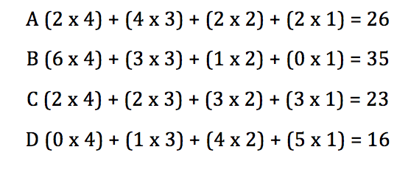
Given 4 point to be first, 3 points to be second, 2 points to be third and 1 point to be fourth, we can calculate the weight of preference for each brand.

Slide 47
It is easy to say that brand B ranks first, A ranks second, C ranks third and D ranks last. Therefore, B>A>C>D.
Calculating the distance among the brands also is possible
Between B & A 35-26 = 9 Units
Between A & C 26-23 = 3 Units
Between C & D 23-16 = 7 Units

Slide 48
Scaling techniques

Slide 49
Constant sum scaling
In constant sum scaling, respondents allocate a constant sum of units, such as points, among a set of stimulus objects with respect to some criterion.
Example
Below are three attributes of four supermarkets. Please allocate 100 points among the attributes so that your allocation reflects the relative importance you attach to each attribute. The more points an attribute receives, the more important an attribute is. If an attribute is not at all important, assign it no points. If an attribute is twice as important as some other attribute, it should receive twice as many points.

Slide 50
Average Points of Evaluating 3 Supermarkets By 3 Criteria
Brands Criteria
Staff Product
Behavior Cheapness Assortment Total
A Market 30 40 40 110
B Market 40 10 40 90
C Market 10 20 5 35
D Market 20 30 15 65
Total 100 100 100

Slide 51
It is clear that supermarket A ranks first then market B then D and finally C.

Slide 52
Scaling techniques

Slide 53
Q-sort and other procedures
Q-sort scaling was developed to discriminate among a relatively large number of objects quickly. This technique uses a rank order procedure in which objects are sorted into piles based on similarity with respect to some criterion.

Slide 54
For example, respondents are given 100 attitude statements on individual cards and asked to place them into 11 groups, ranging from ‘most highly agreed with’ to ‘least highly agreed with’.
The number of objects to be sorted should not be less than 60 nor more than 140; a reasonable range is 60 to 90 objects.15 The number of objects to be placed in each group is pre-specified, often to result in a roughly normal distribution of objects over the whole set.

Slide 55
^{Scaling techniques}

Slide 56
Non-comparative Scaling Techniques
Respondents using a non-comparative scale employ whatever rating standard seems appropriate to them.
They do not compare the object being rated either with another object or to some specified standard, such as ‘your ideal brand’. They evaluate only one object at a time.

Slide 57
^{Scaling techniques}

Slide 58
Continuous rating scale
In a continuous rating scale, also referred to as a graphic rating scale, respondents rate the objects by placing a mark at the appropriate position on a line that runs from one extreme of the criterion variable to the other.
Thus, the respondents are not restricted to selecting from marks previously set by the researcher. The form of the continuous scale may vary considerably.

Slide 59
How would you evaluate our Hotel?
How do you compare Coca Cola with Pepsi Cola?
Totally Different
Totally Same

Slide 60
^{Scaling techniques}

Slide 61
Likert scale
is a widely used rating scale that requires the respondents to indicate a degree of agreement or disagreement with each of a series of statements about the stimulus objects.
Typically, each scale item has five response categories, ranging from ‘strongly disagree’ to ‘strongly agree’.

Slide 62
Likert scale is not a kind of question. It is a scale which measures an attitude or behavior.

Slide 63
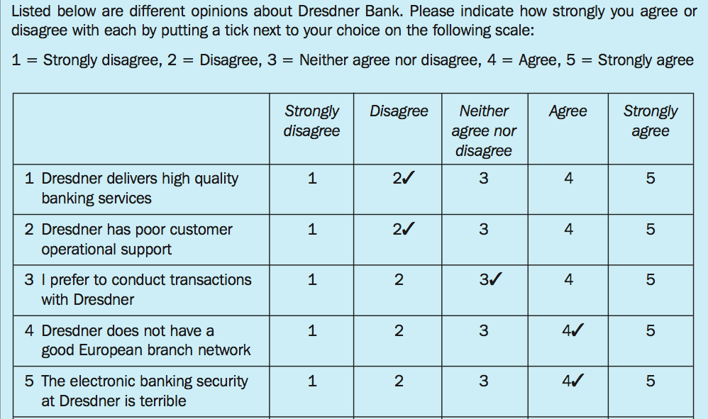
Example
…..
…..
…..
…..
…..
…..
…..

Slide 64
^{Scaling techniques}

Slide 65
Semantic differential scale
The semantic differential is a seven-point rating scale with end points associated with bipolar labels that have semantic meaning.
In a typical application, respondents rate objects on a number of itemised, seven-point rating scales bounded at each end by one of two bipolar adjectives, such as ‘cold’ and ‘warm’.

Slide 66
…..
…..
…..

Slide 67
^{Scaling techniques}

Slide 68
Stapel scale
The Stapel scale, named after its developer, Jan Stapel, is a unipolar rating scale with 10 categories numbered from –5 to +5, without a neutral point (zero). This scale is usually presented vertically.

Slide 69
Respondents are asked to indicate by selecting an appropriate numerical response category how accurately or inaccurately each term describes the object.
The higher the number, the more accurately the term describes the object.

Slide 70
…..

Slide 71
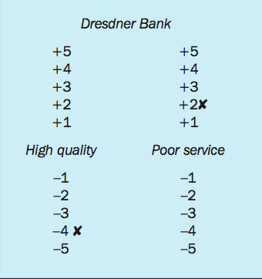
…..

Slide 72
Reliability and Validity

Slide 73
Reliability refers to the extent to which a scale produces consistent results if repeated measurements are made.
Systematic sources of error do not have an adverse impact on reliability, because they affect the measurement in a constant way and do not lead to inconsistency.

Slide 74
Reliability is assessed by determining the proportion of systematic variation in a scale. This is done by determining the association between scores obtained from different administrations of the scale.
If the association is high, the scale yields consistent results and is therefore reliable.

Slide 75
In contrast, random error produces inconsistency, leading to lower reliability. Reliability can be defined as the extent to which measures are free from random error, X_{R}. If X_{R} = 0, the measure is perfectly reliable.

Slide 76
Graphics and Pie Charts

Slide 77
Unemployment Rates in x Country
Years | Unemployment in x Country
2007 | 5
2008 | 8
2009 | 10
2010 | 9
2011 | 8
2012 | 12
2013 | 10

Slide 78
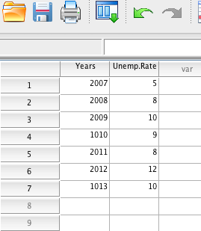

Slide 79
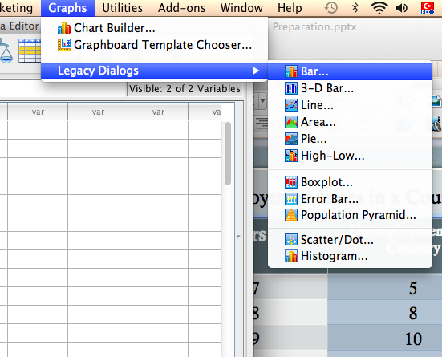

Slide 80
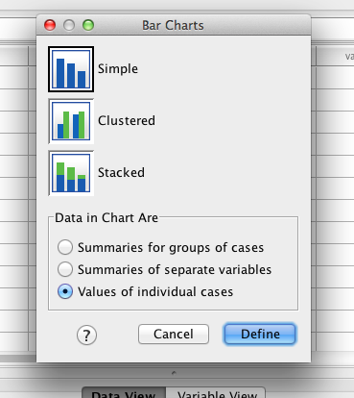

Slide 81
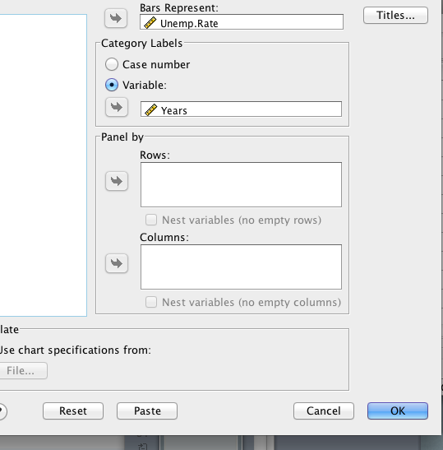

Slide 82
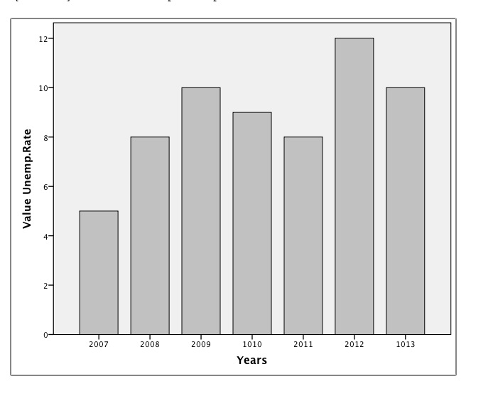

Slide 83
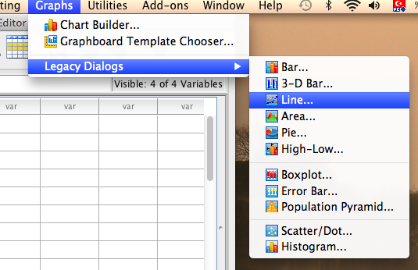
Line Graphs

Slide 84
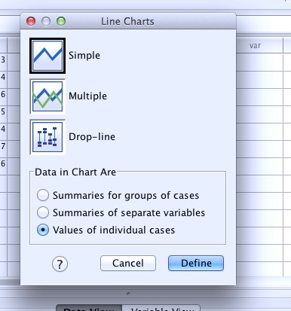

Slide 85
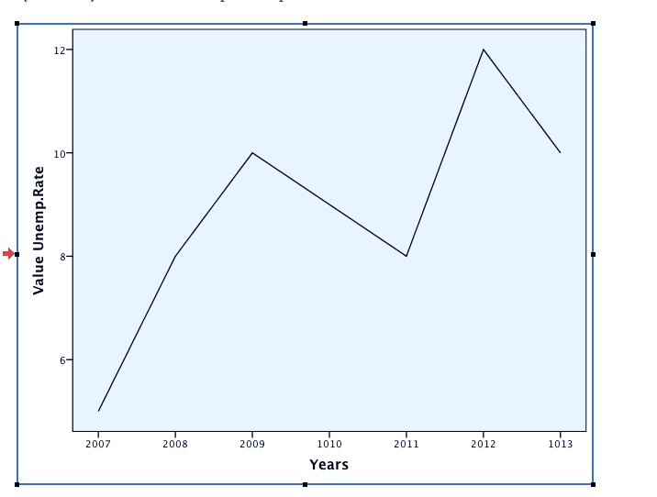
Unemployment By Years in X Country

Slide 86
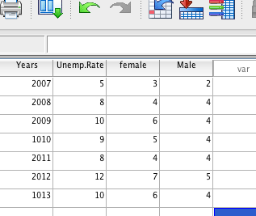
Histogram With Two Varıables

Slide 87
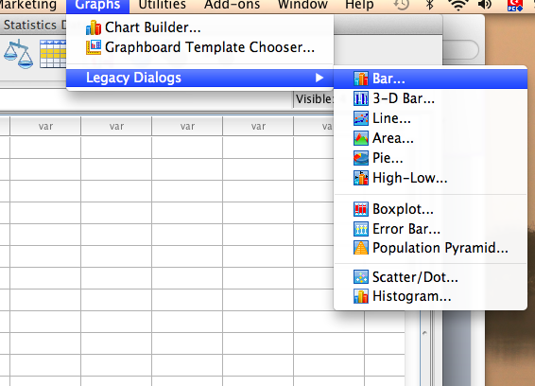

Slide 88
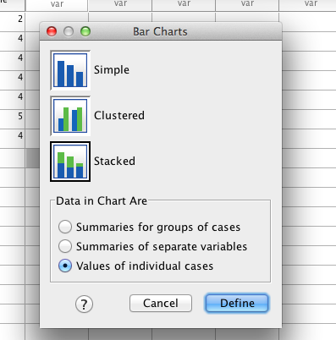

Slide 89
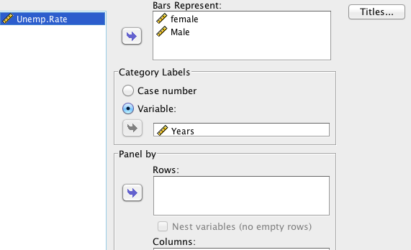

Slide 90
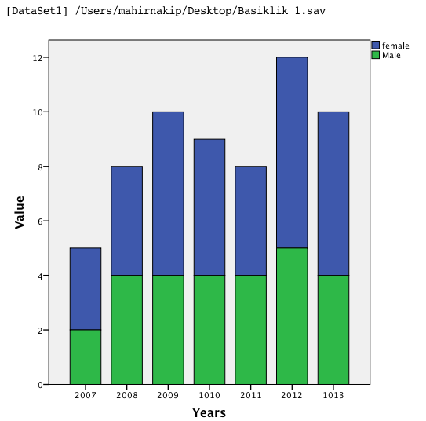
Unemployment by Gender in x Country

Slide 91
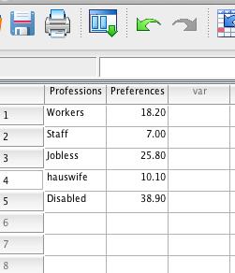
Pie Chart
100%

Slide 93
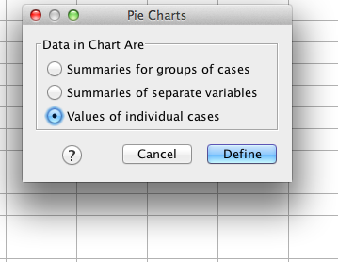

Slide 94
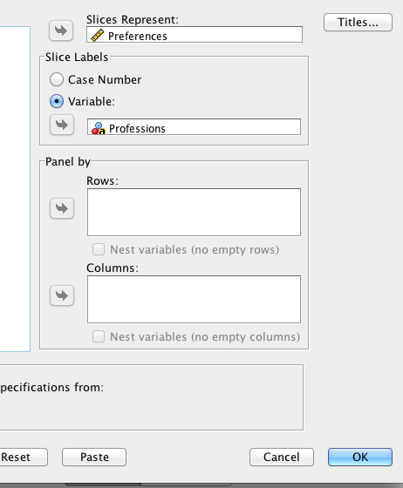

Slide 95
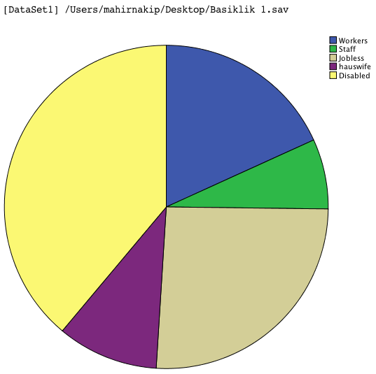

Slide 96
Tabulation and Cross Tabulation

Slide 97
Tabulation is a descriptive methods aimed to classify and arrange the raw data into readable, understandable, interpretable and visible form. This step consists of only one variable.

Slide 98
Example:
Let us conduct a mini survey on small group and ask which color do they prefer for their new car. The raw data has loaded into SPSS database as follow

Slide 100
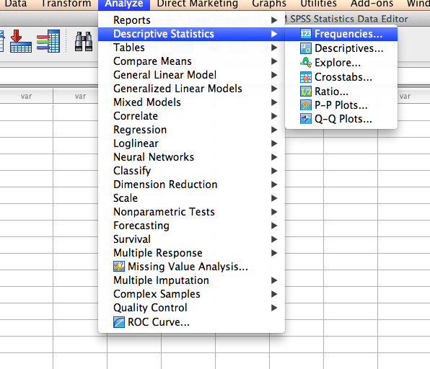

Slide 101
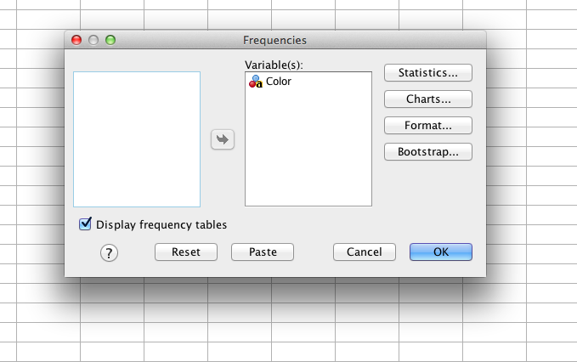

Slide 102
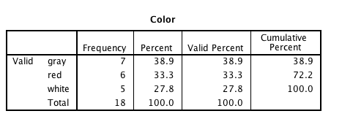

Slide 103
Two-side Cross Tabulation
Using tabulation with two nonmetric variables
EXAMPLE:
Let us add the gender of the participants to the mini survey as a second nonmetric variable

Slide 104
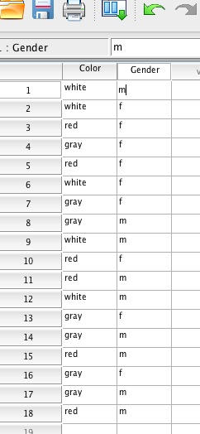

Slide 105
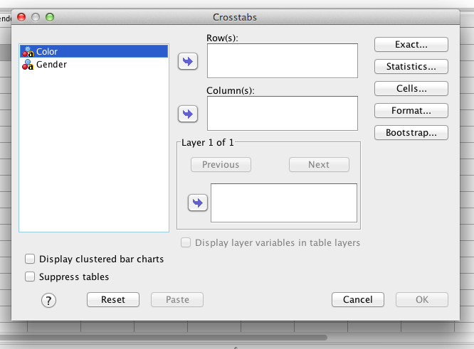

Slide 106
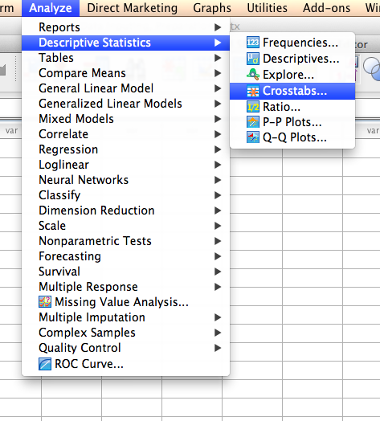

Slide 107
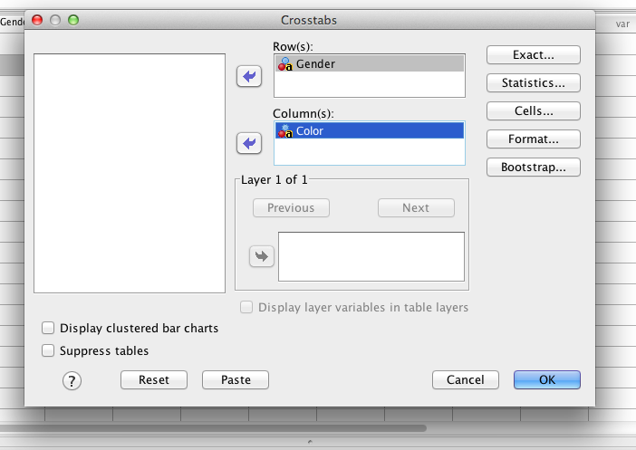

Slide 108
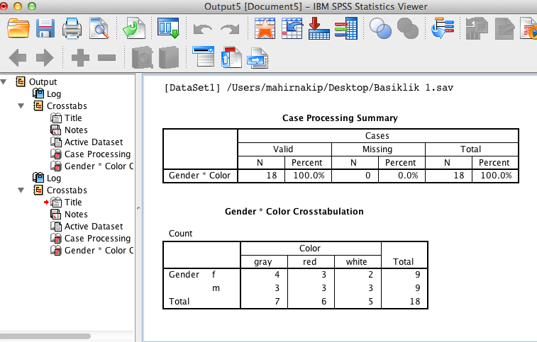

Slide 109
Total Percentage of the Cross Tabulation

Slide 110
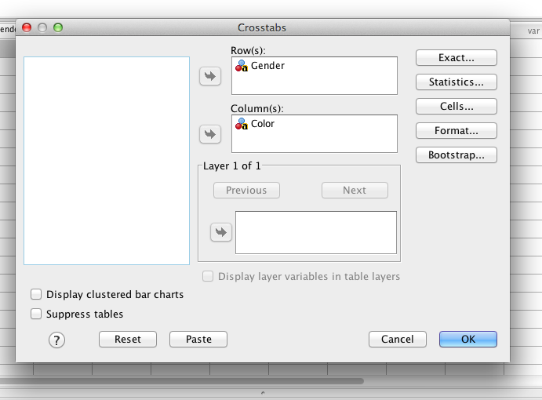

Slide 111
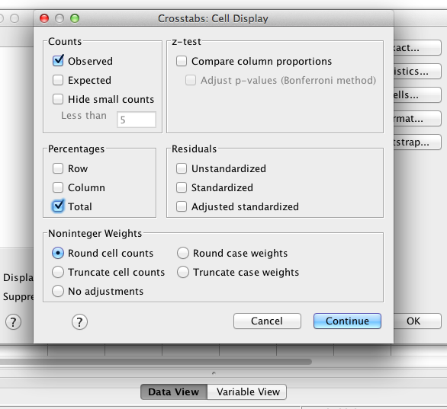

Slide 112
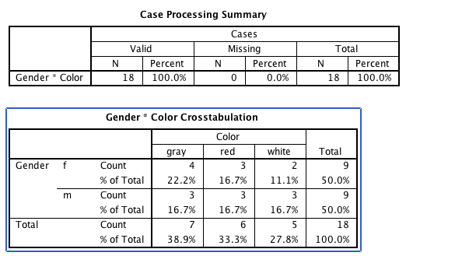
22.2% of the sample is female who prefers gray color.
16.7% of the sample is male who prefers white color.

Slide 113
Row or Column Percentage of the Cross Tabulation

Slide 114
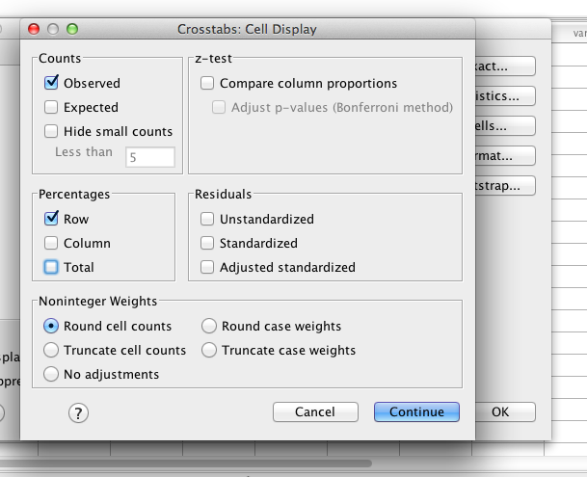

Slide 115
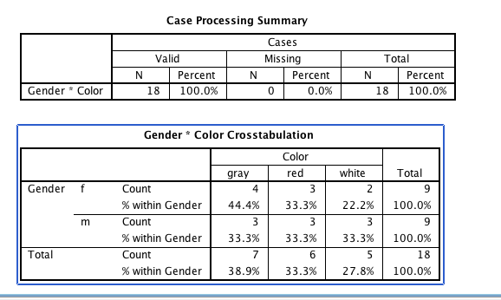
44.4% of the females prefer gray color.
33.3% of the males prefer white color.

Slide 116
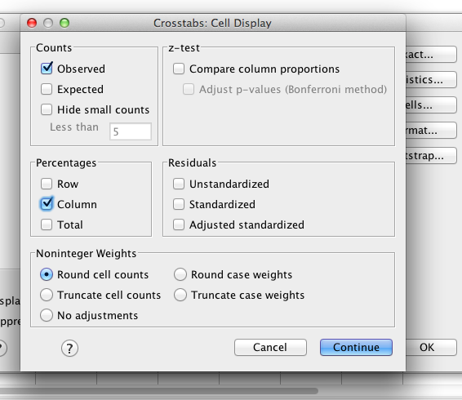

Slide 117
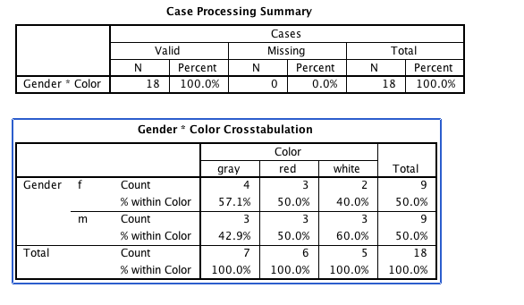
57.1% of people who prefers gray is female.
60% of people who prefers white is male.

Slide 118
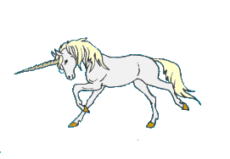
Have a
lucky day

