Slide 1
QUESTIONNAIRE DESIGN

Slide 2
1. What should be asked?
2. How should questions be phrased?
3. In what sequence should the questions be arranged?
4. What questionnaire layout will best serve the research objectives?
5. How should the questionnaire be pretested? 6. Does the questionnaire need to be revised?

Slide 3
What Should Be Asked?
Certain decisions made during the early stages of the research process will influence the question- naire design.
This leads to specific research hypotheses that, in turn, clearly indicate what must be measured. Different types of questions may be better at measuring certain things than are others.

Slide 4
In addition, the communication medium used for data collection—that is, telephone interview, personal interview, or self-administered questionnaire—must be determined.

Slide 5
This decision is another forward linkage that influences the structure and content of the questionnaire. At the same time, the latter stages of the research process will also have an important impact on questionnaire wording and measurement.
For example, when designing the questionnaire, the researcher should consider the types of statistical analysis that will be conducted.

Slide 6
A questionnaire, whether it is called a schedule, interview form or measuring instrument, is a formalised set of questions for obtaining information from respondents.
Questionnaire
A structured technique for data collection consisting of a series of questions, written or verbal, that a respondent answers.

Slide 7
Any questionnaire has three specific objectives.
First, it must translate the information needed into a set of specific questions that the respondents can and will answer. Developing questions that respondents can and will answer and that will yield the desired information is difficult.

Slide 8
Second,
a questionnaire must uplift, motivate and encourage the respondent to become involved in the interview, to cooperate, and to complete the interview.
Third,
a questionnaire should minimise response error.

Slide 9
Questionnaire design process

Slide 10
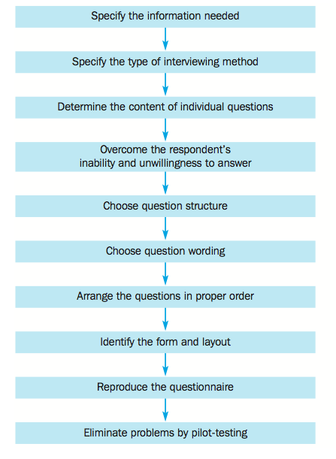

Slide 11
Specify the information needed
This is also the first step in the research design process. Note that, as the research project progresses, the information needed becomes more and more clearly defined.
It is helpful to review the components of the problem and the approach, particularly the research questions, hypotheses and characteristics that influence the research design.

Slide 12
Specify the type of interviewing method
An appreciation of how the type of interviewing method influences questionnaire design can be obtained by considering how the questionnaire is administered under each method.
In personal interviews, respondents see the questionnaire and interact face to face with the interviewer. Thus, lengthy, complex and varied questions can be asked.

Slide 13
In telephone interviews the respondents interact with the interviewer, but they do not see the questionnaire. This limits the type of questions that can be asked to short and simple ones.
Mail and electronic questionnaires are self administered, so the questions must be simple, and detailed instructions must be provided.

Slide 14
Determine the content of individual questions
Is the question necessary?
Every question in a questionnaire should contribute to the information needed or serve some specific purpose. If there is no satisfactory use for the data resulting from a question, that question should be eliminated.

Slide 15
Are several questions needed instead of one?
Once we have ascertained that a question is necessary, we must make sure that it is sufficient to get the desired information.
Example
Wrong
‘Do you think Coca-Cola is a tasty and refreshing soft drink?’

Slide 16
Do you think Coca Cola is tasty? Yes ( ) No ( )
2. Do you think Coca Cola is refreshing soft drink (Yes ( ) No ( )

Slide 17
Overcoming the respondent’s inability and unwillingness to answer
Is the respondent informed?
Respondents are often asked about topics on which they are not informed.
A parent may not be informed about their child’s daily purchasing or vice versa (especially when one considers that sons and daughters can have an age range from 0 to around 80!).

Slide 18
Overcoming the respondent’s inability and unwillingness to answer
Can the respondent remember?
Many things that we might expect everyone to know are remembered by only a few. Test this on yourself.
Can you remember the brand name of the socks you are wearing, what you had for lunch a week ago?

Slide 19
Overcoming the respondent’s inability and unwillingness to answer
Is the respondent able to articulate?
Respondents may be unable to articulate(izah etmek)certain types of responses. For example, if asked to describe the atmosphere of the bank branch they would prefer to patronise, most respondents may be unable to phrase their answers.

Slide 20
Choose question structure
Unstratured Questions
Stratured Questions

Slide 21
Unstructured questions
are open-ended questions that respondents answer in their own words. They are also referred to as free-response or free-answer questions. The following are some examples:
■ What is your occupation?
■ What do you think of people who patronise secondhand clothes shops?
■ Who is your favourite film personality?

Slide 22
More Examples of Open-Ended Questions

Slide 23
What names of local banks can you think of?
What comes to mind when you look at this advertisement?
In what way, if any, could this product be changed or improved? I’d like you to tell me anything you can think of, no matter how minor it seems.
What things do you like most about working for Federal Express? What do you like least?
Why do you buy more of your clothing in SARAR than in other stores?
How would you describe your supervisor’s management style?
Please tell us how our stores can better serve your needs.

Slide 24
Structured questions
Structured questions specify the set of response alternatives and the response format. A structured question may be multiple-choice, dichotomous(ikili)or a scale.

Slide 25
Multiple choice questions. In multiple-choice questions, the researcher provides a choice of answers and respondents are asked to select one or more of the alternatives given. Consider the following question:

Slide 26
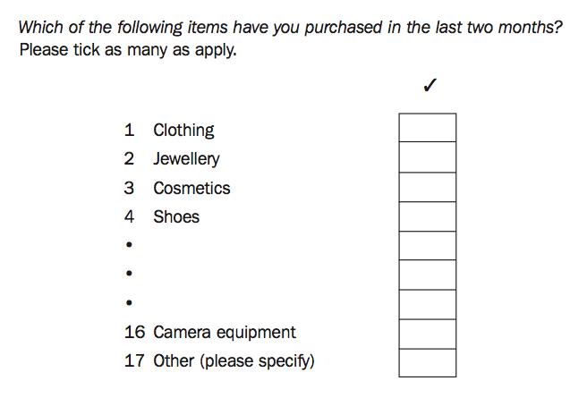

Slide 27
A dichotomous question has only two response alternatives, such as yes or no, or agree or disagree. Often, the two alternatives of interest are supplemented by a neutral alternative, such as ‘no opinion’, ‘don’t know’, ‘both’, or ‘none’, as in this example

Slide 29
Scales. To illustrate the difference between scales and other kinds of structural questions, consider the question about intentions to buy a new laptop computer.
One way of framing this using a scale is as follows:

Slide 30
Types of Fixed-Alternative Questions

Slide 31
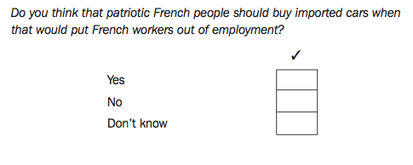

Slide 32
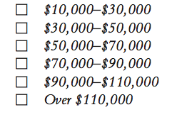
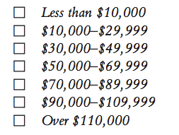
Wrong

Slide 33
Why do you prefer Pınar’s products? Put these reasons in order 1 very important 5 not important
( ) Delicious
( ) Cheap
( ) Available every where
( ) Reliable brand
( ) Others

Slide 34
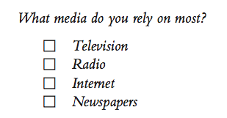
If you ask to put the alternatives in order the answer will be better. By this you can compare which alternative is more important than others.

Slide 36
Choose question wording

Slide 37
1. Define the issue
A question should clearly define the issue being addressed. Consider the following question:
Which brand of shampoo do you use?
This question is not clear, should be asked this way:
Which brand or brands of shampoo have you personally used at home during the last month? In the case of more than one brand, please list all the brands that apply.

Slide 38
2. Use ordinary words
Ordinary words should be used in a questionnaire, and they should match the vocabulary level of the respondents.
When choosing words, bear in mind the intellectual level of the target group of respondents, and how comfortable they are with technical terms related to any prod- ucts or services we are measuring.

Slide 39
3. Use unambiguous words
The words used in a questionnaire should have a single meaning that is known to the respondents. A number of words that appear to be unambiguous have different meanings for different people. These include ‘usually’, ‘normally’, ‘frequently’, ‘often’, ‘regularly’, ‘occasionally’ and ‘sometimes’. Consider the following question:

Slide 40
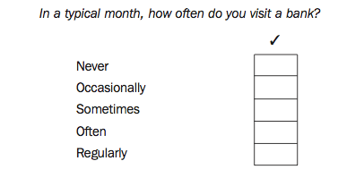
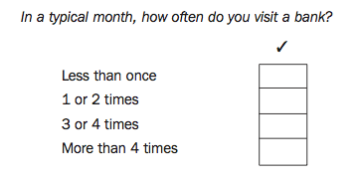
Wrong

Slide 41
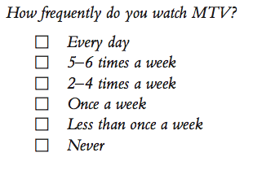
How frequently do you watch MTV?
( ) Constantly
( ) Every time
( ) Often
( ) Seldom
( ) Sometimes
( ) Rarely
Wrong

Slide 42
4. Avoid leading or biasing questions
A leading question is one that clues the respondent to what the answer should be, as in the following:

Slide 43
5. Avoid implicit(kapalı) alternatives
An alternative that is not explicitly (açıkça) expressed in the options is an implicit alternative.
Explicit may increase the percentage of people selecting that alternative, as in the following two questions.

Slide 44
Implicit (örtülü)
1. Do you like to fly when travelling short distances?
2. Do you like to fly when travelling short distances, or would you rather drive?
( ) Fly ( ) Drive
In the first question, the alternative of driving is only implicit, but in the second question it is explicit. The first question is likely to yield a greater preference for flying than the second question.

Slide 45
Avoid generalisations and estimates
Questions should be specific, not general. Moreover, questions should be worded so that the respondent does not have to make generalisations or compute estimates.

Slide 46
Difficult
What is the annual per capita expenditure on groceries in your household?
Instead of this ask two questions.
What is the monthly (or weekly) expenditure on groceries in your household?
How many members are there in your family?

Slide 47
Use positive and negative statements
Many questions, particularly those measuring attitudes and lifestyles, are worded as statements to which respondents indicate their degree of agreement or disagreement.

Slide 48
Arranging the Order of the Questions

Slide 49
Opening questions
classification questions seem simple to start a questionnaire, issues like age, gender and income can be seen as sensitive. Opening a questionnaire with these questions tends to make respondents concerned about the purpose of these questions and indeed the whole survey.

Slide 50
Classification information:
Socio-economic and demographic characteristics used to classify respondents.
Identification information:
A type of information obtained in a questionnaire that includes name, address and phone number.

Slide 51
Internet Questionnaires
Layout(tasarım)is also an important issue for questionnaires appearing on the Internet. A questionnaire on a Web site should be easy to use, flow logically, and have a clean look and overall feel that motivate the respondent to cooperate from start to finish.

Slide 52
With graphical user interface (GUI)(grafiksel kullanıcı arayüzü)software, the researcher can exercise control over the back- ground, colors, fonts, and other visual features displayed on the computer screen so as to create an attractive and easy-to-use interface between the computer user and the Internet survey.
GUI software allows the researcher to design questionnaires in which respondents click on the appro- priate answer rather than having to type answers or codes.

Slide 53
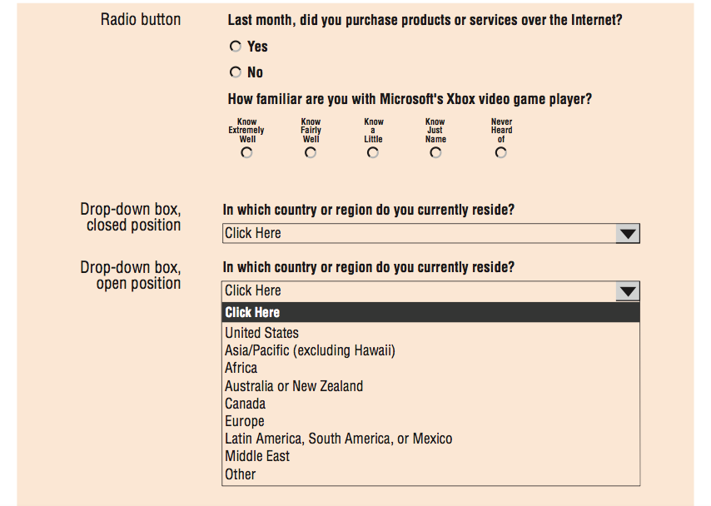

Slide 54
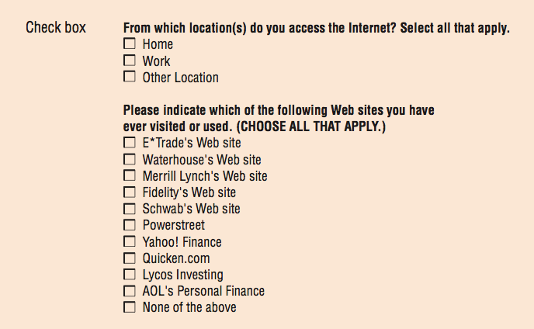

Slide 55
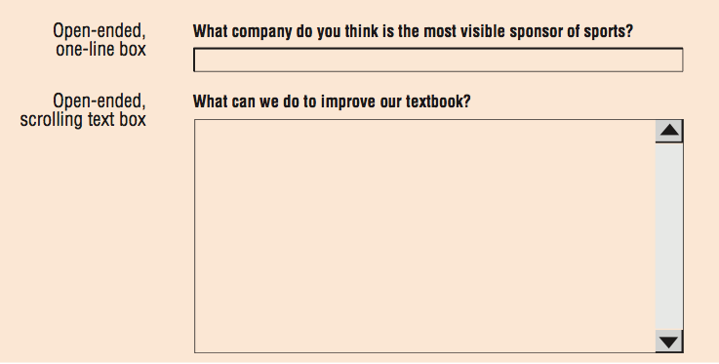

Slide 56
Pretesting the Questionnaire

Slide 57
The pretesting process allows the researcher to determine whether respondents have any difficulty understanding the questionnaire and whether there are any ambiguous or biased questions.
This process is exceedingly beneficial. Making a mistake with 25 or 50 subjects can avoid the potential disaster of administering an invalid questionnaire to several hundred individuals.

Slide 58
Example of a Questionnaire

Slide 59
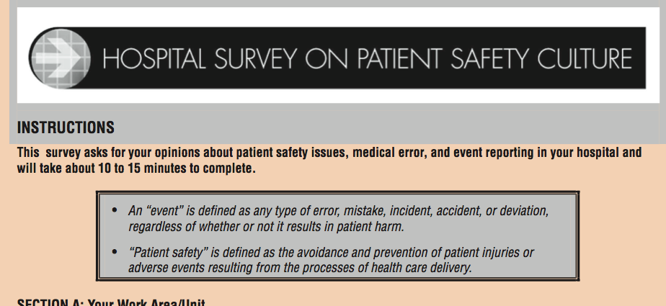

Slide 60
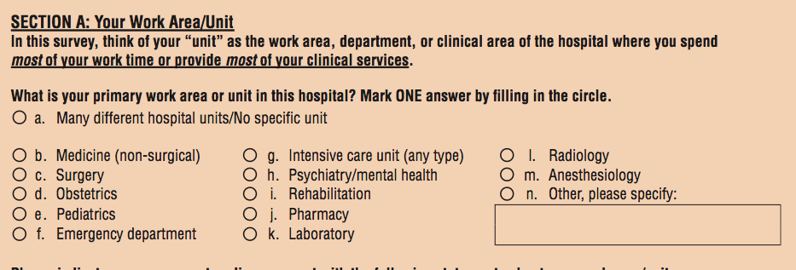

Slide 61
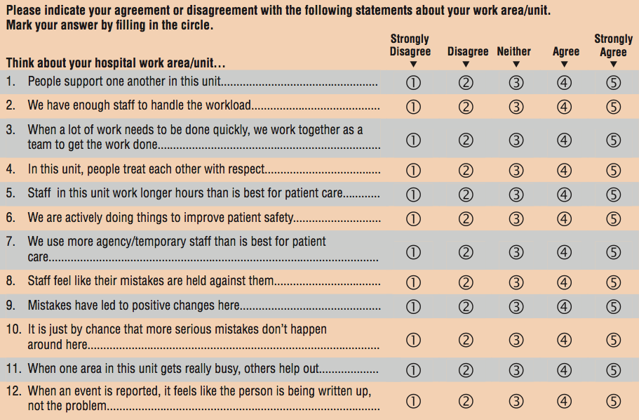

Slide 62
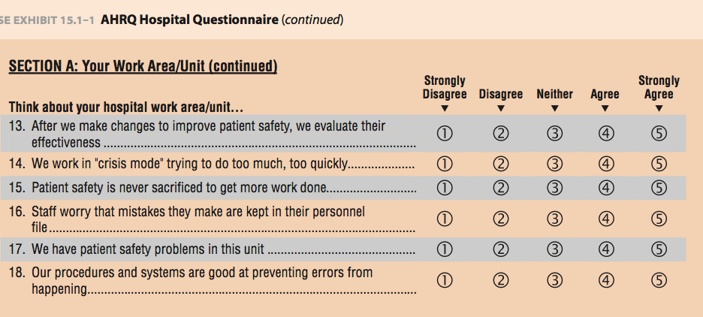

Slide 63
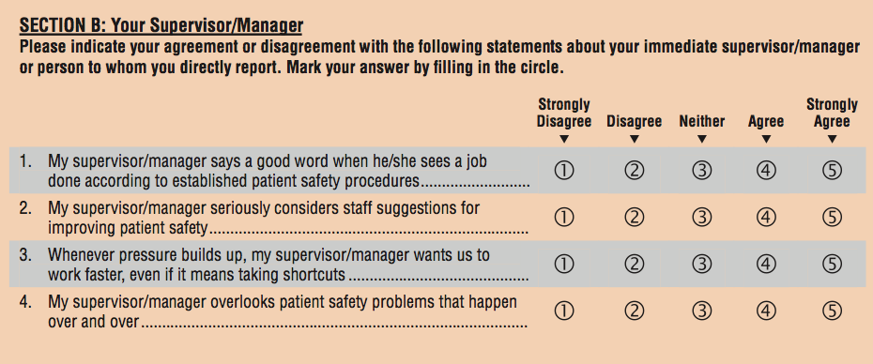

Slide 64
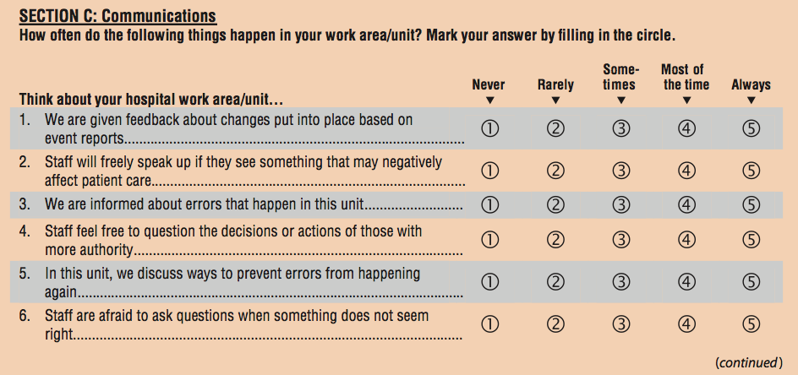

Slide 66
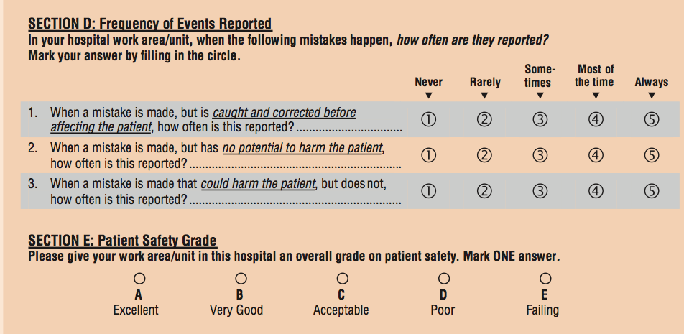

Slide 67
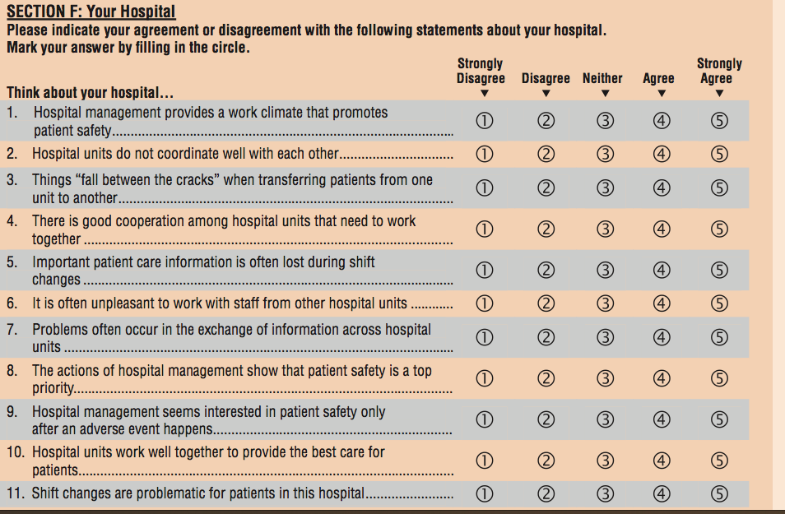

Slide 69
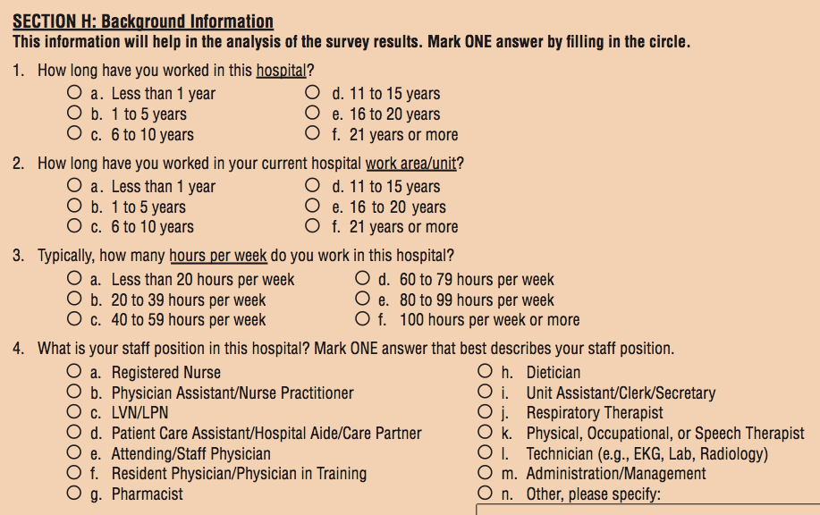

Slide 72
Run out otherwise I will keep teaching

