Slide 1
INTERNATIONAL INFORMATION AND SUPPORT SYSTEM

Slide 2
SOME DEFINITIONS

Slide 3
Data are facts or recorded measures of certain phenomena (things or events).
Data are values of qualitative (verbal) or quantitative (numerical) variables, belonging to a set of items.
Raw data, i.e., unprocessed data, refers to a collection of numbers, characters and is a relative term.

Slide 4
Information is data formatted (structured) to support decision making or define the relationship between two facts
Information is a sequence(dizi)of symbols that can be interpreted as a message. Information can be recorded as signs, or transmitted as signals.
Therefore, in a general sense, information is "Knowledge communicated or received concerning a particular fact or circumstance". Information cannot be predicted and resolves uncertainty

Slide 5
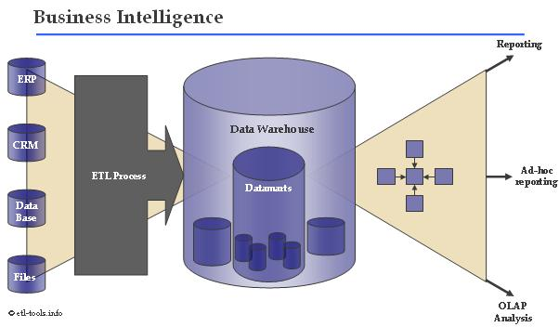
Özel amaçlı
International intelligence is a set of theories, methodologies, processes, architectures, and technologies that transform raw data into meaningful and useful information for international purposes.

Slide 6
The Characteristics of Valuable Information
Relevance
Quality
Timeliness
Completeness

Slide 7
Relevance
Relevance (ilişki) is the characteristics of data reflecting how pertinent (ilgili) these particular facts are to the political situation at hand.
Relevant data are facts about things that can be changed, and if they are changed, it will materially alter(değiştirmek) the situation.

Slide 8
Quality
Data quality is the degree to which data represent the true situation. High-quality data are accurate, valid, and reliable.
Sometimes, researchers will try to obtain the same data from multiple data sources. Data quality is a critical issue in international research.

Slide 9
Timeliness
International information must be timely—that is, provided at the right time. Computerized information systems can record events and apply relevant information soon after the event.
Timeliness means that the data are current enough to still be relevant.

Slide 10
Completeness
Information completeness refers to having the right amount of information. Managers must have sufficient information about all aspects of their decisions.
Population statistics, GDP, and information on inflation rates may be available on all countries. However, information about unemployment levels may be available for only some of the countries. If information about unemployment or other characteristics cannot be obtained, the information is incomplete. Often incomplete information leads decision makers to conduct their own international research.

Slide 11
International Knowledge
Management

Slide 12
International knowledge
is a blend(harmanlanmış) of previous experience, insight(kavrama), and data that forms organizational memory. It provides a framework that can be thoughtfully applied when assessing a international problem.
International researchers and decision makers use this knowledge to help create solutions to strategic and tactical problems. Thus, knowledge is a key resource and a potential competitive advantage.

Slide 13
International Knowledge management
is the process of creating an inclusive(kapsamlı), comprehensive (geniş), easily accessible organizational memory, which can be called the organization’s intellectual capital.
The purpose of knowledge management is to organize the intellectual capital of an organization in a formally structured way for easy use.
Knowledge is presented in a way that helps managers comprehend and act on that information and make better decisions in all areas of international.

Slide 14
Political science, marketing, management, and financial knowledge can be integrated. Recent research demonstrates how knowledge management systems are particularly useful in new product development and introduction.

Slide 15
EXAMPLE:
The think tank organizations play a particularly useful role in the knowledge management process. Researchers are in a key position to have a lot of knowledge about political events.

Slide 16
Benefits of Knowledge Management
Ө Encourages innovation through improved information and knowledge-handling ability
Ө Increases competitiveness because overall organizational knowledge will increase the responsiveness of the organization
Ө Improves customer service by encouraging relationship development and meeting customer expectation.
Ө Enhances employees effectiveness and moral
Ө Cerates effective organizational memory

Slide 17
Global Information Systems
is an organized collection of computer hardware, software, data, and personnel designed to capture, store, update, manipulate, analyze, and immediately display information about worldwide international activities.
A global information system is a tool for providing past, present, and projected information on internal operations and external activity.

Slide 18
Using satellite communications, high-speed microcomputers, electronic data interchanges, fiber optics, data storage devices, and other technological advances in interactive media, global information systems are changing the nature of international.

Slide 19
International Dicision Support System
is storing data and transforming them into organized information that is easily accessible to managers.
Doing so saves managers countless hours so that decisions that might take days or even weeks otherwise can be made in minutes using a DSS.
Modern decision support systems greatly facilitate (kolaylaştırmak) customer relationship management (CRM). A CRM system is the part of the DSS that addresses exchanges between the organization and its customers.

Slide 20
A CRM system describes customer relationships in sufficient detail so that financial directors, marketing managers, salespeople, customer service representatives, and perhaps the customers themselves can access information directly, match customer needs with satisfying product offerings, remind customers of service requirements, and know what other products a customer has purchased.

Slide 21
Database
is a collection of raw data arranged logically and organized in a form that can be stored and processed by a computer. A voters mailing list is one type of database.
Population characteristics may be recorded by state, county, and city in another database. Production figures and costs can come from internal company records.

Slide 22
Data warehousing
is the process allowing important day-to-day operational data to be stored and organized for simplified access. Data warehouse management requires that the detailed data from operational systems be extracted, transformed, placed into logical partitions (for example, daily data, weekly data, etc.), and stored in a consistent(uygun) manner.

Slide 23
STATISTICAL DATABASES
Statistical databases contain numerical data for analysis and forecasting. Often demographic, sales, and other relevant international variables are recorded by geographical area. Geographic information systems use these geographical databases and powerful software to prepare computer maps of relevant variables.

Slide 24
Networks and Electronic Data
Interchange
Individual personal computers can be connected through networks to other computers. Networking involves linking two or more computers to share data and software.
Electronic data interchange (EDI) systems integrate one organization’s computer system directly with another organization’s system.

Slide 25
How Is the Internet
Useful in Research?
ACCESSING
AVAILABLE DATA
COLLECTING
DATA

Slide 26
ACCESSING
AVAILABLE DATA
The Internet allows instantaneous(ani)and effortless access to a great deal of information. Noncommercial and commercial organizations make a wealth of data and other resources available on the Internet.
For example, the U.S. Library of Congress provides full text of all versions of House and Senate legislation and full text of the Congressional Record.

Slide 27
COLLECTING
DATA
Questionnaires can be posted on a Web site and respondents can be invited to go to the particular site and participate in the survey.

Slide 28
International Problem Definition
involves stating the general problem and identifying the specific components of the international research problem. Only when the international research problem has been clearly defined can research be designed and conducted properly.

Slide 29
Problem
Definition
Refers to the process of defining and developing a decision statement and the steps involved in translating it into more precise research terminology, including a set of research objectives.
If this process breaks down at any point, the research will almost certainly be useless or even harmful.

Slide 30
The Problem-Definition
Process Steps
Understand the international situation
2. Identify key problem(s) from symptoms (belirtiler)
3. Write managerial decision statement and corresponding research objectives
4. Determine the unit of analysis
5. Determine the relevant variables
6. Write research questions and/or research hypotheses

Slide 31
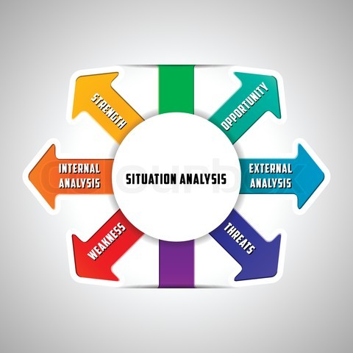
Understand the
international Decision
A situation analysis involves the gathering of background information to familiarize researchers and managers with the decision-making environment. The situation analysis can be written up as a way of documenting the problem definition process.
The situation analysis begins with an interview between the researcher and management.

Slide 32
2. Identifying Symptoms (belirti)
Interviews with key decision makers also can be one of the best ways to identify key problem symptoms.
Once symptoms are identified, then the researcher must probe to identify possible causes of these changes. Probing(tahkik)is an interview technique that tries to draw deeper and more elaborate explanations from the discussion. This discussion may involve potential problem causes.

Slide 33
Identifying the Relevant Issues from the Symptoms
Anticipating(tahmin) the many influences and dimensions of a problem is impossible for any researcher or executive. The preceding(önceki) interview is extremely useful in translating the decision situation into a working problem definition by focusing on symptoms.

Slide 34
EXAMPLES:
when a firm has a problem with advertising effectiveness, the possible causes of this problem may be low brand awareness, the wrong brand image, use of the wrong media, or perhaps too small a budget.

Slide 35
3. Writing Managerial Decision Statements and Corresponding Research Objectives
The situation analysis ends once researchers have a clear idea of the managerial objectives from the research effort.
A decision statement that says in what “ways” a problem can be solved is better than one that says in what “way” a problem can be solved. Ultimately, research may provide evidence showing results of several ways a problem can be attacked.

Slide 36
4. Determine the
Unit of Analysis
The unit of analysis for a study indicates what or who should provide the data and at what level of aggregation(yığıştırma).
Researchers specify whether an investigation will collect data about individuals (such as voters, employees, and owners), households (families, extended families, and so forth), organizations (civil organizations and business units).

Slide 37
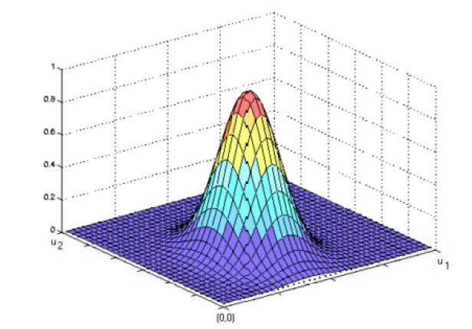
5. Determine
Relevant Variables
What things should be studied to address a decision statement? Researchers answer this question by identifying key variables. A variable is anything that varies or changes from one instance to another.

Slide 38
The converse(ters)of a variable is a constant. A constant is something that does not change. Constants are not useful in addressing research questions.
Since constants don’t change, management isn’t very interested in hearing the key to the problem is something that won’t or can’t be changed.

Slide 39
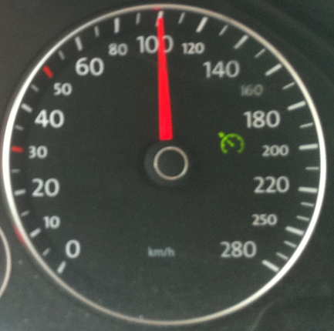
TYPES OF VARIABLES
Mathematically
continuous variable
Discrete variable
is one that can take on a range of values that correspond to some quantitative amount and can be diveded gradually. Age, income, weight kg, distance km etc.
is one that indicates membership in some group. Can not be diveded. gender, profession, education, living districts, cities, contries,names, etc.

Slide 40
TYPES OF VARIABLES
Causality
Independent variable
Dependent variable
is one that affects other variables. A variable that is expected to influence the dependent variable in some way. Will explain later.
is one that be affected by other variables. A process outcome or a variable that is predicted and/or explained by other variables, will explain later.

Slide 41
6. Write Research Objectives and Questions
Both managers and researchers expect problem-definition efforts to result in statements of research questions and research objectives. At the end of the problem-definition stage, the researcher
Both managers and researchers expect problem-definition efforts to result in statements of research questions and research objectives.
Research questions express the research objectives in terms of questions that can be addressed by research.

Slide 42
The Proposal as
a Planning Tool

Slide 43
Ambiguouse(belirsiz)plans, abstract ideas, and sweeping(geniş)generalizations about problems or procedures must become concrete and precise statements about specific events.
Data requirements and research procedures must be specified clearly so others may understand their exact implications. All ambiguities about why and how the research will be conducted must be clarified before the proposal is complete.
The researcher submits the proposal to management for acceptance, modification, or rejection.

Slide 44
DUMMY TABLES
One such tool that is perhaps the best way to let management know exactly what kind of results will be produced by research is the dummy table. Dummy tables are placed in research proposals and are exact representations of the actual tables that will show results in the final report with one exception: The results are hypothetical. They get the name because the researcher fills in, or “dummies up,” the tables with likely but fictitious data.
Dummy tables include the tables that will present hypothesis test results. In this way, they are linked directly to research objectives.

Slide 45
Table 1: Frequency of Supporting Three Parties according to gender
Gender/ Usage Rate | Supporters of Party A | Supporter of Party B | Supporter of Party C | TOTAL
Female | 25 | 225 | 340 | 590
Male | 220 | 326 | 550 | 1096
TOTAL | 245 | 551 | 890 | 1686

Slide 46
Table 2: Percentages of Supporting Three Parties according to gender
Gender/ Usage Rate | Supporters of Party A | Supporter of Party B | Supporter of Party C | TOTAL
Female | 4 | 38 | 58 | 100
Male | 20 | 30 | 50 | 100
TOTAL | 14 | 33 | 53 | 100
58% of the females are supporting Party C, while 50% of the males are supporting the same party

Slide 47
Table 1: Percentages of The genders according to Supporting of Three Parties
Gender/ Usage Rate | Supporters of Party A | Supporter of Party B | Supporter of Party C | TOTAL
Female | 10 | 41 | 38 | 35
Male | 90 | 59 | 62 | 65
TOTAL | 100 | 00 | 100 | 100
41% of the voters of Party B are females while 59% of them are males

Slide 48
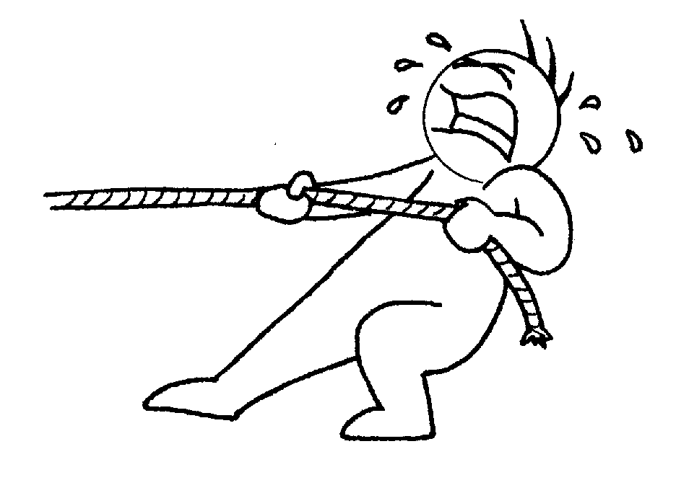
Information Technology
pull technology
push technology

Slide 49
pull technology
Consumers request information from a Web page and the browser then determines a response; the consumer is essentially asking for the data.

Slide 50
push technology
Sends data to a user’s computer without a request being made; software is used to guess what information might be interesting to consumers based on the pattern of previous responses.

Slide 51
international decision problem and international research problem

Slide 52
The international decision problem asks what the decision-maker needs to do, whereas the international research problem asks what information is needed and how it can best be obtained. The international decision problem is action oriented.
It is concerned with the possible actions the decision-maker can take. Should the voters be segmented differently? Should a new political slogan be introduced? Should the propaganda budget be increased?

Slide 53
In contrast, the international research problem is information oriented. It involves determining what information is needed and how that information can be obtained effectively and efficiently.

Slide 54
The international research brief
The international research brief is a document produced by the users of research findings of a piece of international research. The brief may be used to communicate the perceived requirements of an international research project to external agencies or internally within an organisation to international research professionals.
It should act as the first step for decision makers to express the nature of an international and research problem as they see it. This first step is vital in developing an agreement of an appropriate research approach.

Slide 55
Why define the Research Problem?
Defining your destination before beginning a journey.
It determines,
what you will do,
how you will do it, and
what you may achieve!

Slide 56
Steps in defining research problems
Identify a broad topic
Identify a narrow topic within the broad topic
Raise questions
Formulate objectives
Use action-oriented words - To demonstrate; To evaluate; To measure…

Slide 57
Identifying Broad Topics
Think of the BIG PICTURE
What is the problem you are trying to solve?
Think of something you like to learn more about
Consult text books, journal or your supervisor
Pick one based on:
Interest and relevance
Magnitude of work involved
Level of expertise
yours and your advisors

Slide 58
Examples of Broad Topics
Optimizing productivity of international and human resources
Ensuring Consumption Safety & Security
Sustaining(desteklenen)Agricultural & Marine Environments

Slide 59
From Broad Topic to Narrow Topic
Using promotion strategies to Optimize the productivity
The affect of official safety precautions (tedbir) on Food consumption
The direct effect of product design on sustaining agricultural & Marine Environments

Slide 60
Research design definition
A research design is a framework for conducting an international research project. It details the procedures necessary for obtaining the information needed to structure or solve international research problems.
Although a broad approach to the problem has already been developed, the research design specifies the details – the practical aspects – of implementing that approach. A research design lays the foundation for conducting the project. A good research design will ensure that the international research project is conducted effectively and efficiently

Slide 61
Research design classification
uzunlamasına

Slide 63
Descriptive Research
is to describe something, usually market characteristics or functions. A major difference between exploratory and descriptive research is that descriptive research is characterised by the prior formulation of specific research questions and hypotheses.
Thus, the information needed is clearly defined. As a result, descriptive research is pre-planned and structured. It is typically based on large representative samples. A descriptive research design specifies the methods for selecting the sources of information and for collecting data from those sources.

Slide 64
Examples of descriptive studies in international research are as follows:
■ international studies describing the size of the voter, or the political parties, availability of political distributors, and consumer profiles
■ Market share studies determining the proportion of total sales received by a company and its competitors
■ voting analysis studies describing voting by geographic region,
■ Product usage studies describing consumption patterns
■ Distribution studies determining traffic flow patterns and the number and location of distributors

Slide 65
Causal research
is used to obtain evidence of cause-and-effect (causal) relationships. Marketing managers continually make decisions based on assumed causal relationships.
These assumptions may not be justifiable, and the validity of the causal relationships should be examined via formal research.

Slide 66
DEGREES OF CAUSALITY
Effect
Cause
“smoking causes cancer.”
Lungs

Slide 67
Absolute causality
means the cause is necessary and sufficient to bring about the effect. Thus, if we find only one smoker who does not eventually (sonuçta) get cancer, the claim is false.
Although this is a very strong inference (sonuç çıkarma), it is impractical to think that we can establish absolute causality in the behavioral sciences.

Slide 68
Conditional causality
means that a cause is necessary but not sufficient (yeterli) to bring about an effect. This is a weaker causal inference. One way to think about conditional causality is that the cause can bring about the effect, but it cannot do so alone. If other conditions are right, the cause can bring about the effect. We know there are other medical factors that contribute to cancer.
For instance, genetics, lifestyle, and diet are also reasonable causes of cancer. Thus, if one smokes and has a genetic disposition, diet, and lifestyle that promote cancer, smoking could be considered a conditional cause of cancer. However, if we can find someone who has contracted cancer and never smoked, the causal inference would be proven wrong.

Slide 69
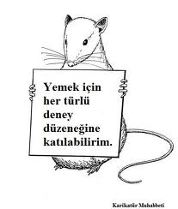
EXPERIMENTS
An experiment is an orderly procedure carried out with the goal of verifying(doğruluma), refuting(çürütme), or establishing the validity of a hypothesis. Experiments provide insight into cause-and-effect by demonstrating what outcome occurs when a particular factor is manipulated.
Experiments vary greatly in their goal and scale, but always rely on repeatable procedure and logical analysis of the results

Slide 70
international experiments
hold the greatest potential for establishing cause-and-effect relationships. An experiment is a carefully controlled study in which the researcher manipulates a proposed cause and observes any corresponding(birlikte) change in the proposed effect. An experimental variable represents the proposed cause and is controlled by the researcher by manipulating it.

Slide 71
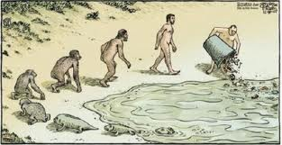
What is a Theory?
a formal, testable explanation of some events that includes explanations of how things relate to one another. Theory is a contemplative (derin düşünmek) and rational type of abstract or generalizing thinking, or the results of such thinking.

Slide 72
What are the Goals of Theory?
Understanding
Predicting
understanding of the relationship among various phenomena
predicting the behavior or characteristics of one phenomenon from the knowledge of another phenomenon

Slide 73
Hypotheses
is a formal statement explaining some outcome. A claim can be a hypotheses. In its simplest form, a hypothesis is a guess and proposed explanation for a phenomenon
H1: The behavioral characteristics of youth voters are different in Turkey and Greek.
H2: The more hours per week a student works, the more favorable the attitude toward online MBA class offerings.

Slide 74
H3: Companies within the Euro zone plan to use fewer banks after the introduction of Monetary Union compared with companies outside the Euro zone.
H4: Companies that select cash management banks on an informal basis have fewer bank relationships than those that select through formal tenders.

Slide 75
Pilot Studies
A pilot study is a small-scale research project that collects data from respondents similar to those that will be used in the full study. It can serve as a guide for a larger study or examine specific aspects of the research to see if the selected procedures will actually work as intended.

Slide 76
You can fly freely

