Slide 1
QUALITATIVE RESEARCH

Slide 2
What Is
Qualitative Research?

Slide 3
is research that addresses political objectives through techniques that allow the researcher to provide elaborate(ayrıntılı)interpretations of political phenomena without depending on numerical measurement.
Its focus is on discovering true inner meanings and new insights. Qualitative research is less structured than most quantitative approaches.

Slide 4
It does not rely on self-response questionnaires containing structured response formats. Instead, it is more researcher-dependent.
Researcher must extract meaning from unstructured responses, such as text from a recorded interview.

Slide 5
Uses of Qualitative Research

Slide 6
The researcher has many tools available and the research design should try to match the best tool to the research objective.

Slide 7
The less specific the research objective, the more likely that qualitative research tools will be appropriate.
Araştırmanın amacı ne kadar belirginleşirse, nitel araştırma araçları o kadar uygun olur.

Slide 8
WHEN QUALITATIVE RESEARCH BE USED?

Slide 9
When it is difficult to develop specific and actionable problem statements or research objectives.

Slide 10
2. When the research objective is to develop an understanding of some phenomena in great detail and in much depth.

Slide 11
3. When the research objective is to learn how a phenomena occurs in its natural setting
For example, how do voters discuss the political issues in their daily life?

Slide 12
4. When a fresh approach to studying some problem is needed. This is particularly the case when quantitative research has yielded less than satisfying results.
Qualitative tools can yield unique insights, many of which may lead the organization in new directions.

Slide 13
QUALITATIVE VERSUS
QUANTITATIVE RESEARCH

Slide 14
Qualitative research can accomplish research objectives that quantitative research cannot. Similarly truthful, but no more so, quantitative research can accomplish objectives that qualitative research cannot.
The key to successfully using either is to match the right approach to the right research context.

Slide 15
Many good research projects combine both qualitative and quantitative research. For instance, developing valid survey measures requires first a deep understanding of the concept to be measured and a description of the way these ideas are expressed in everyday language.

Slide 16
Quantitative business research can be defined as research that addresses research objectives through empirical assessments that involve numerical measurement and analysis approaches.

Slide 18
There are great differences between the quantitative and qualitative approaches to studying and understanding subjects
This means that seeking a singular and uniform approach to supporting decision-makers by focusing on one approach is useless. Business decision makers use both approaches and will continue to need both.

Slide 19
The distinction between qualitative and quantitative research can be in the context of research designs. There is a close parallel in the distinctions(fark)between ‘exploratory and conclusive research’ and ‘qualitative and quantitative research’. There is a parallel, but the terms are not identical.

Slide 20
Conversely(aksine), there may be circumstances where quantitative measurements are used to conclusively answer specific hypotheses or research questions using descriptive or experimental techniques.

Slide 21
Quantitative researchers direct a considerable amount of activity toward measuring concepts with scales that either directly or indirectly provide numeric values.
The numeric values can then be used in statistical computations and hypothesis testing.
qualitative researchers are more interested in observing, listening, and interpreting.

Slide 22
For these reasons, qualitative research is said to be more subjective, meaning that the results are researcher-dependent. Different researchers may reach different conclusions based on the same interview.
In that respect, qualitative research lacks the ability of different individuals following the same procedures to produce the same results or come to the same conclusion.

Slide 23
Qualitative research seldom involves samples with hundreds of respondents. Instead, a handful of people are usually the source of qualitative data. This is perfectly acceptable in discovery-oriented research.

Slide 24
Qualitative research is most often used in exploratory designs. Small samples, interpretive procedures that require subjective judgments, and the unstructured interview format all make traditional hypotheses testing difficult with qualitative research.

Slide 25
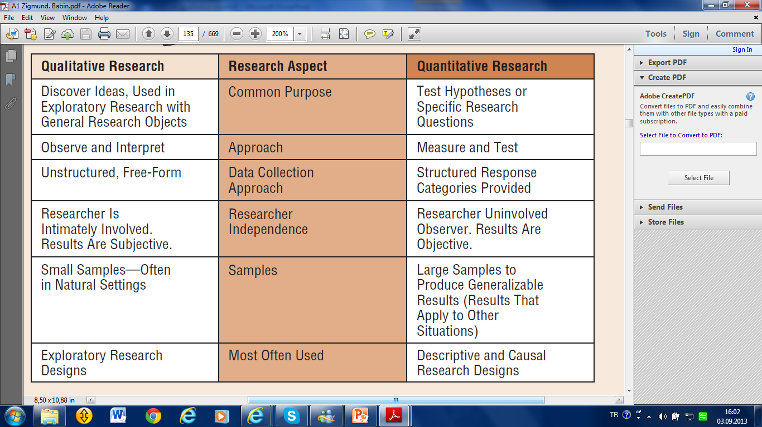

Slide 26
Contrasting (çelişken) Exploratory and Confirmatory Research

Slide 27
Most exploratory research designs produce qualitative data.
Often, exploratory research may be needed to develop the ideas that lead to research hypotheses.
In some situations the outcome of exploratory research is a testable research hypothesis. Confirmatory research then tests these hypotheses with quantitative data.

Slide 28
The major categories of qualitative research
Phenomenology—originating in philosophy and psychology
2. Ethnography—originating in anthropology
3. Grounded theory—originating in sociology
4. Case studies—originating in psychology and in business research

Slide 29
1. Phenomenology (olguculuk)
Represents a philosophical approach to studying human experiences based on the idea that human experience itself is inherently(doğasında)subjective and determined by the context in which people live.
The phenomenological researcher focuses on how a person’s behavior is shaped by the relationship he or she has with the physical environment, objects, people, and situations.

Slide 30
When conversational interviews are face to face, they are recorded either with video then interpreted by the researcher.
The phenomenological interviewer is careful to avoid asking direct questions when at all possible. Instead, the research respondent is asked to tell a story about some experience.

Slide 31
2. Ethnography
Participant observation, a tool of measuring the ethnographic events, means the researcher becomes immersed(bulaşmış) within the culture that he or she is studying and draws data from his or her observations.
A culture can be either a broad culture, like Turkish culture, or a narrow culture, like regional culture, Ford owners, or people who are intrested in football.

Slide 32
OBSERVATION IN ETHNOGRAPHY
Researchers today sometimes ask households for permission to place video cameras in their home. In doing so, the ethnographer can study the individuals in a “natural habitat” and use the observations to test new concept
For instance, discovering insights among children since it does not rely largely on their answers to questions. Instead, allow the children to do what they do naturally, and record their behavior.

Slide 34
Netnography
Netnography is the branch of ethnography (the scientific description of the customs of individual peoples and cultures) that analyses the free behaviour of individuals on the Internet that uses online marketing research techniques to provide useful insights.
Netnography compiles and analyzes data about the free social behavior of individuals on the Internet. The key is that this data is collected when consumers are behaving freely.

Slide 35
3. Grounded(gömülü)Theory
Represents an inductive(tümevarımsal) investigation in which the researcher asks questions about information provided by respondents or taken from historical records. The researcher asks the questions to him or herself and repeatedly questions the responses to derive deeper explanations.
Grounded theory is particularly applicable in highly dynamic situations involving rapid and significant change. Two key questions asked by the grounded theory researcher are “What is happening here?” and “How is it different?”

Slide 36
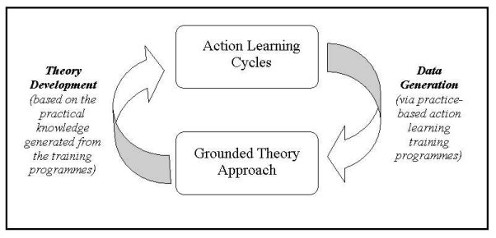

Slide 37
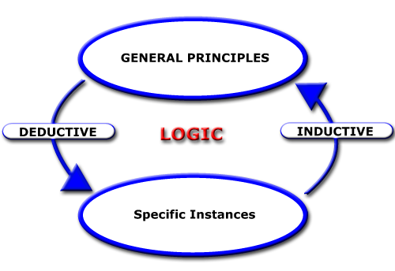

Slide 38
By questioning the events discussed in the political interviews and analyzing differences in the situations that may have led to the discussion, the researcher is able to develop a theory.
Grounded Theory is trying to extract a theory from events or texts

Slide 39
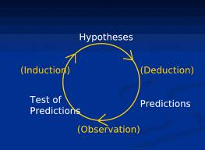

Slide 40
Example for diduction(tümdengelim). Every human dies. Ahmet is a human, so Ahmed one day will die. Decreasing the price of any elastic product will increase the demand. If the price of jewelry, luxury cars and hotel services increase the demand of these products will increase.
Example for induction(tümevarım). First and Second World War have brought disaster. So all wars bring disaster. Or If we put a piece of ice many times on a fire, the ice will be melted. Therefore the fire melts the ice.

Slide 41
Experiment 1 or observation 1
Experiment 2 or observation 2
Experiment 3 or observation 3
Inductive Approach
Result, certainty or reality
Diductive Approach
Conviction 1
Conviction 2
Conviction 3
Kanaat

Slide 42
4. Case Studies
Case studies simply refer to the documented history of a particular person, group, organization, or event. Typically, a case study may describe the events of a specific political party as it faces an important decision or situation, such as introducing a new campaign. Textbook cases typify this kind of case study.

Slide 43
Philosophy and
qualitative research

Slide 44
Pozitivizm and Emprizm

Slide 45
Empiricism A theory of knowledge. A broad category of the philosophy of science that locates the source of all knowledge in experience.
Positivism A philosophy of language and logic cosistent with an empiricist philosophy of science.
Paradigm A set of assumptions consisting of agreed upon knowledge, criteria of judgement, problem fields, and ways to consider them.

Slide 46
Action Research
A process whereby one could construct a social experiment with the aim of achieving a certain goal. For example, in the early days of the Second World War, Lewin conducted a study, commissioned by US authorities, on the use of tripe(işkembe) as part of the regular daily diet of American families.
The research question was: ‘To what extent could American housewives be encouraged to use tripe rather than beef for family dinners?’

Slide 47
Action research is a team research process, facilitated by one or more professional researchers, linking with decision-makers and other stakeholders who together wish to improve particular situations.

Slide 48
It is time to have fun

