Slide 1
CLASSIFICATION OF QUALITATIVE TECHNIQUES

Slide 2
Qualitative Research Proccedures
Direct
Indirect
Focus Groups
Depth Interviews
Projective Techniques
Association Techniques
Completion Techniques
Construction Techniques
Expressive Techniques

Slide 3
Focus Group

Slide 4
A focus group interview is an unstructured, free-flowing interview with a small group of people, usually between six and ten. Focus groups are led by a trained moderator who follows a flexible format encouraging dialogue among respondents.
Common focus group topics include political issues, international problems.

Slide 5
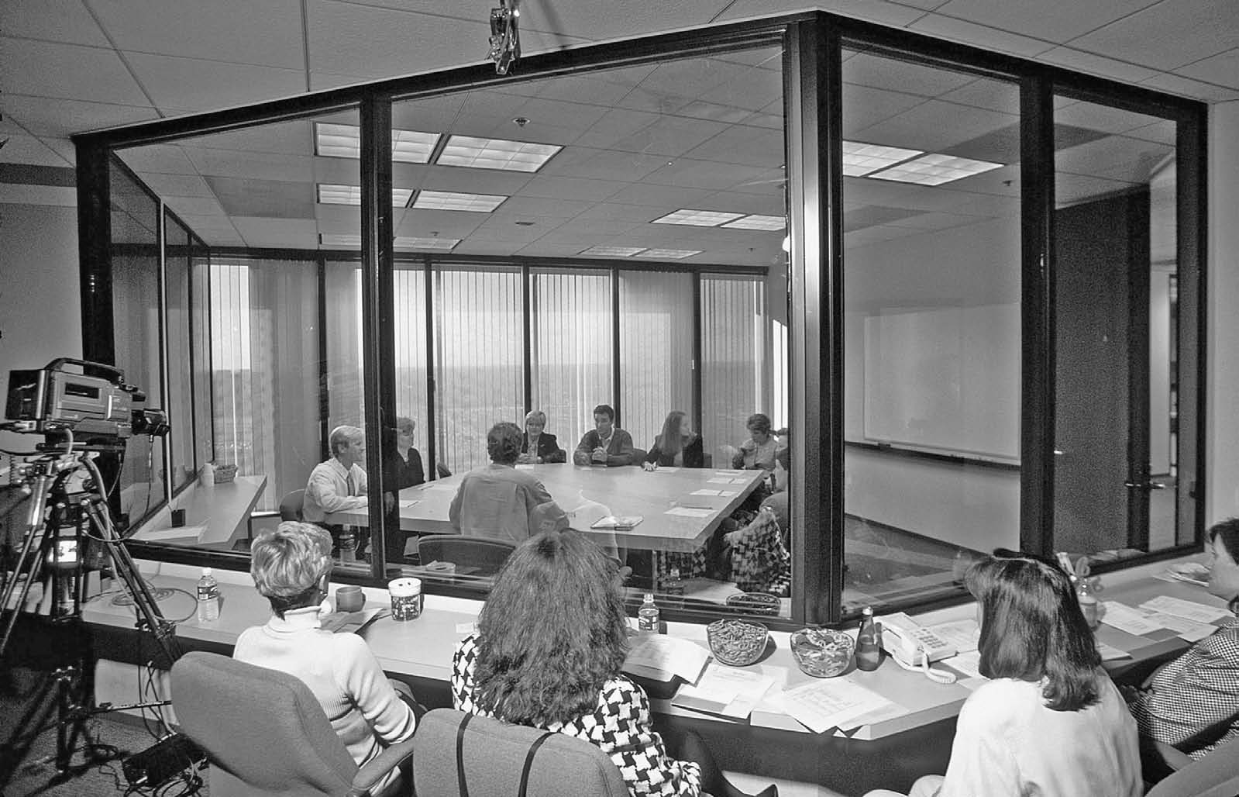

Slide 7
Procedure for Planning and Conducting Focus Groups

Slide 8
Advantages and disadvantages of focus groups

Slide 9
1 Synergy. Putting a group of people together will produce a wider range of information, insight and ideas than will individual responses secured privately.
2 Snowballing. A bandwagon effect often operates in a group discussion in that one person’s comment triggers a chain reaction from the other respondents. This process facilitates a very creative process where new ideas can be developed, justified and critically examined.
3 Stimulation. Usually after a brief introductory period, the respondents want to express their ideas and expose their feelings as the general level of excitement over the topic increases in the group.

Slide 10
4 Security. Because the respondents’ feelings may be similar to those of other group members, they feel comfortable and are therefore willing to ‘open up’ and reveal thoughts where they may have been reluctant if they were on their own.
5 Spontaneity(doğallık). Because respondents are not required to answer specific questions, their responses can be spontaneous and unconventional and should therefore provide an accurate idea of their views.
6 Serendipity(tesadüfilik). Ideas are more likely to arise unexpectedly in a group than in an individual interview. There may be issues that the moderator had not thought of. The dynamics of the group can allow these issues to develop and be discussed. Group members, to great effect, may clearly and forcibly ask questions that the moderator may be reluctant to ask.

Slide 11
7 Specialisation. Because a number of respondents are involved simultaneously, the use of a highly trained, but expensive, interviewer is justified.
8 Scientific scrutiny(ayrıntılı inceleme). The group discussion allows close scrutiny of the data collection process in that observers can witness the session and it can be recorded for later analysis. Many individuals can be involved in the validation and interpretation of the collected data.
9 Structure. The group discussion allows for flexibility in the topics covered and the depth with which they are treated. The structure can match the logical structure of issues from the respondents’ perspective as well as the language and expressions they are comfortable with.
10 Speed. Because a number of individuals are being interviewed at the same time, data collection and analysis proceed relatively quickly.

Slide 12
The Disadvanges og Focus Groups
1 Misjudgement. Focus group results can be more easily misjudged than the results of other data collection techniques. As a qualitative technique, focus groups can evolve through a line of questioning and probing. The specific direction of questioning and the ultimate interpretation of findings can be susceptible to bias.
2 Moderation. As well as being great fun to moderate, focus groups can be difficult to moderate. Much depends upon the ‘chemistry’ of the group in terms of how group members get on with each other and draw ideas and explanations from each other. Even moderators with many years of experience can get into difficulty with particular group members who disrupt the discussion. The quality of the results depends upon how well the discussion is managed and ultimately on the skills of the moderator.

Slide 13
3 Messiness (tertipsizlik). The unstructured nature of the responses makes coding, analysis and interpretation difficult in comparison with the structure of quantitative techniques. Focus group data tend to be messy and need either strong theoretical support or the discipline of a grounded theory approach to ensure that decisionmakers can rely upon the analyses and interpretations.
4 Misrepresentation. Focus group results concentrate on distinct target groups, describing them and contrasting them to other groups or types of respondent. Trying to generalise to much wider groups, in the same manner as with a quantitative survey based on a representative sample, can be very misleading.
5 Meeting. There are many problems in getting potential respondents to agree to take part in a focus group discussion. Even when they have agreed to participate, there are problems in getting focus group respondents together at the same time. Running focus groups on the Internet has helped to resolve these problems to some extent, but for some target groups even this does not offer a solution.

Slide 14
THE FOCUS GROUP MODERATOR

Slide 15
1. The moderator must be able to develop relation with the group to promote interaction among all participants.
2. The moderator must be a good listener. Without good listening skills, the moderator may direct the group in an unproductive direction

Slide 16
VIDEOCONFERENCING AND FOCUS GROUPS
With the widespread utilization of videoconferencing, the number of companies using these systems to conduct focus groups has increased. With videoconference focus groups, managers can stay home and watch on television rather than having to take a trip to a focus group facility.

Slide 17
Brain Storming
Traditional brainstorming has been used for several decades, especially in the context of management or political issues.
Whether formal or informal, the process is the same: think of as many ideas as you can and say them out loud; leave the evaluation until later; build on and combine others’ ideas; be as imaginative as possible, the wilder the ideas the better.

Slide 18
Qualitative Research Proccedures
Direct
Indirect
Focus Groups
Depth Interviews
Projective Techniques
Association Techniques
Completion Techniques
Construction Techniques
Expressive Techniques

Slide 19
Depth interviews

Slide 20
Depth interviews are an unstructured and direct way of obtaining information but, unlike focus groups, depth interviews are conducted on a one-on one basis.
A depth interview is an unstructured, direct, personal interview in which a single respondent is probed(tahkik, sorgulama)by an experienced interviewer to uncover underlying opinions, motivations, beliefs, attitudes and feelings on a topic.

Slide 21
Depth interview is common in the field of international relationship. If this interview is being done with a political leader or with any opposition group leader, the titles, subtitles and the general questions should be well prepared before the interview.

Slide 22
The questions and probes they put to respondents should follow the interest and logic of the respondent, making them feel motivated to respond in a manner that suits them.
As with a focus group discussion, the respondent should feel comfortable and relaxed.

Slide 23
Qualitative Research Proccedures
Direct
Indirect
Focus Groups
Depth Interviews
Projective Techniques
Association Techniques
Completion Techniques
Construction Techniques
Expressive Techniques

Slide 24
PROJECTIVE TECHNIQUES

Slide 25
Projective techniques are different from these techniques in that they attempt to totally camouflage (gizlemek)the purpose of the research.
A projective technique is an unstructured, indirect form of questioning that encourages respondents to project their underlying motivations, beliefs, attitudes or feelings regarding the issues of concern. In projective techniques, respondents are asked to interpret the behavior of others rather than to describe their own behavior.

Slide 26
In interpreting the behavior of others, it is contended (iddia, farz etmek) that respondents indirectly project their own motivations, beliefs, attitudes or feelings into the situation.
The more ambiguous(belirsiz)the situation, the more respondents project their emotions, needs, motives, attitudes and values, as demonstrated by work in clinical psychology.

Slide 27
Qualitative Research Proccedures
Direct
Indirect
Focus Groups
Depth Interviews
Projective Techniques
Association Techniques
Completion Techniques
Construction Techniques
Expressive Techniques

Slide 28
Association techniques
An individual is presented with a stimulus and asked to respond with the first thing that comes to mind. Word association is the best known of these techniques
In word association, respondents are presented with a list of words, one at a time, and are asked to respond to each with the first word that comes to mind.

Slide 29
A Sample: Dealing with dirt
Word association was used to study women’s attitudes towards detergents. Below is a list of stimulus words used and the responses of two women of similar age and household status. The sets of responses are quite different, suggesting that the women differ in personality and in their attitudes towards housekeeping.

Slide 30
Pessimist
Optimist
Fırçalamak
Kirli
Pislik
Çekişme

Slide 31
These findings suggest that the market for detergents could be segmented based on attitudes.

Slide 32
Qualitative Research Proccedures
Direct
Indirect
Focus Groups
Depth Interviews
Projective Techniques
Association Techniques
Completion Techniques
Construction Techniques
Expressive Techniques

Slide 33
Compilation (derleme) techniques
Respondents are asked to complete an incomplete stimulus situation. Common completion techniques in business research are sentence completion and story completion.

Slide 34
Our political relation with neighbor countries should be
…………………………………………………………………………………………..
2. In my opinion the future of Middle east will be,
………………………………………………………………………..
3. Can be said that he economical policy of Turkish government is
………………………………………………………………………………………………………….

Slide 35
In story completion, respondents are given part of a story, enough to direct attention to a particular topic but not to hint at the ending.
They are required to give the conclusion in their own words

Slide 36
Qualitative Research Proccedures
Direct
Indirect
Focus Groups
Depth Interviews
Projective Techniques
Association Techniques
Completion Techniques
Construction Techniques
Expressive Techniques

Slide 37
Construction techniques
In a construction technique, the researcher provides less initial structure to the respondents than in a completion technique. The two main construction techniques are picture response techniques and cartoon tests.

Slide 38
picture response
Consists of a series of pictures of ordinary as well as unusual events. In some of these pictures, the persons or objects are clearly definede, while in others they are relatively vague(müphem).
The respondent is asked to tell stories about these pictures. The respondent’s interpretation of the pictures gives indications of that individual’s personality.

Slide 40
Qualitative Research Proccedures
Direct
Indirect
Focus Groups
Depth Interviews
Projective Techniques
Association Techniques
Completion Techniques
Construction Techniques
Expressive Techniques

Slide 41
Expressive(etkileyici)techniques
Respondents are presented with a verbal or visual situation and asked to relate the feelings and attitudes of other people to the situation. The respondents express not their own feelings or attitudes, but those of others. The two main expressive techniques are role playing and third-person technique.
In role playing, respondents are asked to play the role or to assume the behavior of someone else. The researcher assumes that the respondents will project(yansıtmak)their own feelings into the role. ¨Assume that you are the president of X Party, how you will act in facing the political problem?¨

Slide 42
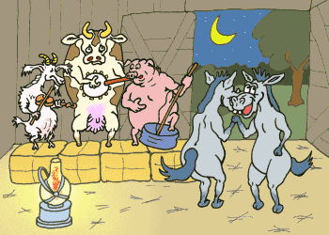
It is time to have fun

