Slide 1
SOURCES OF SECONDARY DATA AND QUALITATIVE DATA ANALYSIS

Slide 2
Sources of Internal and
Proprietary(kişisel)Data

Slide 3
Researchers frequently aggregate(biriktirmek)or disaggregate internal data. For example, a computer service firm used internal secondary data to analyze sales over the previous three years, categorizing business by industry, product, purchase level, and so on.
This simple investigation of internal records showed that, in effect, the firm was paying to attract customers it did not want.

Slide 4
Internet technology is making it easier to research internal and proprietary data. Often companies set up intranets so that employees can use Web tools to store and share data within the organization.
just as Google’s search software lets people search the entire World Wide Web, Google is offering the enterprise search, which is essentially the same technology in a version that searches a corporate intranet. The enterprise search considers not only how often a particular.

Slide 5
External Data
External data are generated or recorded by an entity(varlık)other than the researcher’s organization. The government, parties, newspapers and journals, trade associations, and other organizations create or produce information.
Traditionally, this information has been in published form, perhaps available from a public library, trade association, or government agency.

Slide 6
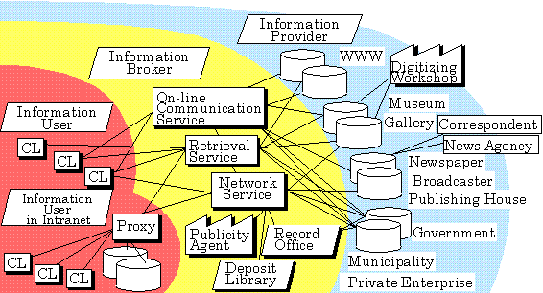
Information Distribution Channels
LIBRARIES
THE INTERNET
VENDORS
PRODUCERS

Slide 7
LIBRARIES
Traditionally, libraries’ vast storehouses of information have served as a bridge between users and producers of secondary data. The library staff deals directly with the creators of information, such as the federal government, and intermediate distributors of information, such as abstracting and indexing services.

Slide 8
THE INTERNET
Today, of course, much secondary data is conveniently available over the Internet. Its creation has added an international dimension to the acquisition(edinme)of secondary data. For example, Library Spot, at http://www.libraryspot.com, provides links to online libraries, including law libraries, political science, medical libraries, and music libraries.

Slide 9
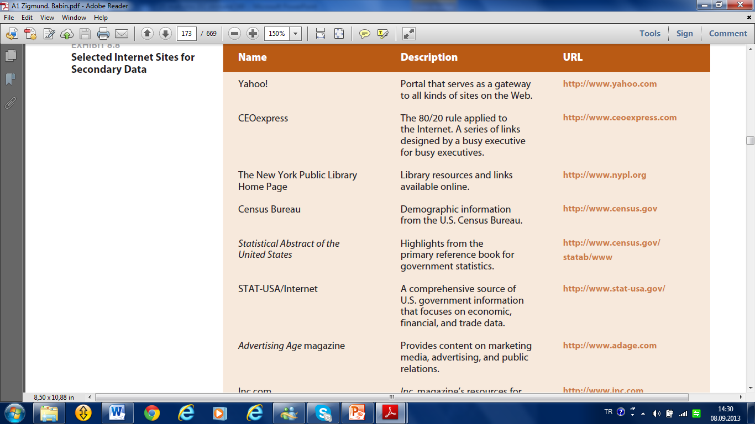

Slide 11
VENDORS(sağlayıcı)
Many external producers make secondary data available directly from the organizations that produce the data or through intermediaries, which are often called vendors.

Slide 14
PRODUCERS
Classifying external secondary data by the nature of the producer of information yields five basic sources: (1) publishers of books and periodicals, (2) government sources, (3) media sources, (4) trade association sources, and (5) commercial sources. The following section discusses each type of secondary data source.

Slide 15
Books and Periodicals
Government Sources
PRODUCERS
Media Sources
Trade Association Sources
Commercial Sources

Slide 16
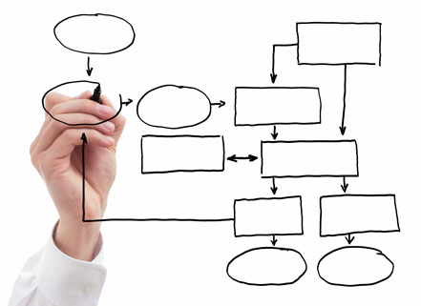
The process of qualitative
data analysis

Slide 17
doğrulama

Slide 18
Data assembly
Data assembly means the gathering of data from a variety of sources.

Slide 19
Includes
1 Notes taken during or after interviewing or observations.
2 Reflections of researchers, moderators or observers involved in the data collection process.
3 Theoretical support – from secondary data, intelligence or literature sources.
4 Documents produced by or sourced from respondents.
5 Photographs, drawings, diagrams, i.e. still visual images.
6 Audiotape recordings and transcripts of those recordings.
7 Videotape recordings.
8 Records made by respondents such as mood(ruh hali) boards or collages.

Slide 20
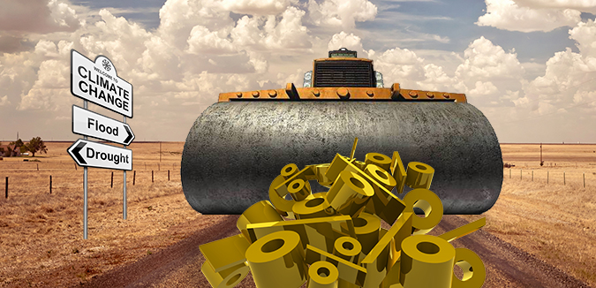
Data reduction
Data reduction involves handling the data. This process involves organising and structuring the data. It means having to throw some data away! There are the memories and notes of the moderator and any other observers who took part, there are the transcripts of what was actually said in interviews.

Slide 21
The researcher with their transcripts, notes and other supporting material has to decide what is relevant in all these data. Reducing the data involves a process of coding data, which means breaking down the data into discrete chunks and attaching a reference to those chunks of data.
Coding is a vital part of coping with qualitative data analysis, especially in the context of developing theory with a grounded theory approach. Given this importance, the process is discussed in some detail.

Slide 22
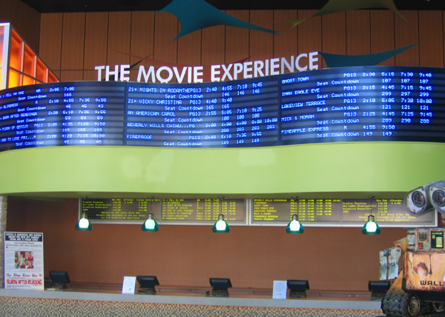
Data display
Data display involves summarising and presenting the structure that is seen in the collected data. The display allows a ‘public’ view of how the researcher has made connections between the different ‘data chunks’.
The display may be in a graphical format, with boxes summarising issues that have emerged and connecting arrows showing the interconnection between issues.

Slide 23
Data verification(doğrulama)
involves seeking alternative explanations through other data sources and theories. Researchers need to demonstrate that they have presented a valid meaning of the data that they have collected. They need to show that the structure or meaning they see is not just a reflection of their own views.

Slide 24
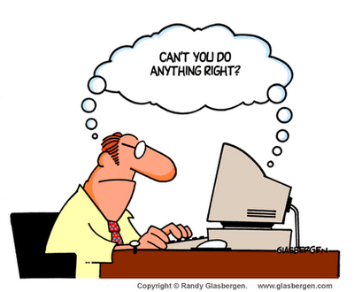
Using computers in qualitative research and analysis

Slide 25
A major problem for the qualitative researcher is the sheer(tamamen)volume of data that they may collect. As with quantitative data analyses, it is possible to complete analyses without the aid of a computer.
Overall it allows a much more efficient and ultimately effective process, as the researcher’s effort may be focused upon generating the most effective support for decision makers as quickly as possible rather than upon difficult administrative tasks.

Slide 26
Package programs used in qualitative researches
1. QSR Nvivo can cope (başa çıkmak) with qualitative data that emerges from ethnographic approaches, focus groups, depth interviews, open-ended questions in surveys, and even from Web searches. It enables the researcher to combine the analysis of text or multimedia images.
It allows one to display data in matrices or in a rich text format and ultimately to present graphical models of the analysis and research findings.

Slide 27
2. BEST (Behavioural Evaluation Strategy and Taxonomy) is a software package that is more geared(donanmış)to ethnographic observational data. Using BEST, the researcher can record a series of live behavioural events that may occur in a mutually exclusive manner or overlap.

Slide 28
3. Atlas.ti: The Knowledge Workbench is similar to Nvivo in that it can cope with large bodies of textual, graphical and audio or video data generated from ethnographic approaches, focus groups and depth interviews. The overall feel of the package tries to recreate the best features of manual analysis.

Slide 29
Advantages of computer-assisted qualitative data analysis

Slide 30
1 Speed. The speed at which programs can carry out sorting procedures on large volumes of data is remarkable, and continues to get faster. It gives the data analyst more time to think about the meaning of data, enabling rapid feedback of the results of particular analytic ideas so that new ones can be formulated. Analysis becomes more devoted to creative and intellectual tasks, less immersed in routine.
2 Rigour(kesinlik). Rigour adds to the trust placed in research findings. In this context it means counting the number of times things occur as well as demonstrating that negative incidences have been located rather than selecting anecdotes that support a particular interpretation.

Slide 31
3 Team. In collaborative research projects where researchers need to agree on the meaning of codes, a check can easily be made of whether team members are interpreting segments in the same way. Researchers can pass coded interviews between them, and compare the results.
4 Sampling. It is easy to keep track of who has been interviewed, compared with the intentions of who should be interviewed. Beyond the sampling of individuals is the concept of theoretical sampling, i.e. the inclusion(ihtiva etmek)of events that corroborate or contradict(çelişkili)developing theory.

Slide 32
Disadvantages of computer-assisted qualitative data analysis

Slide 33
1 Mechanistic data analysis. The computer cannot replace the creative process expected of the qualitative researcher. The researcher can evaluate the interrelated play on particular words, the tone of voice of a particular respondent. The sensitivity towards these relationships and connections can be lost in a mechanistic search for statements.
2 Loss of the overview. The researcher may be seduced into concentrating on the detail of individual chunks of data and assigning codes to the data. This focus may detract from the overall context that is so vital to identify and name chunks of data. Making sense of codes can be greatly facilitated by an ability to visualise the data in its entirety.

Slide 34
How to Write a
Research Paper?

Slide 35
Choosing Your Topic

Slide 36
Ask yourself important questions. Although you may be limited by specific classroom or work related guidelines, choosing your topic is the first and most important step in your research paper project.
It is important to keep a few questions in mind: is there enough research available on this topic? Is the topic new and unique enough that I can offer fresh opinions? Is it to my class/occupation?

Slide 37
2. Pick something you love. Whenever possible, choose a topic that you feel passionate(tutkulu)about.
Writing about something you enjoy certainly shows in the final product, making it more likely that you will be successful writing a paper about something you enjoy.

Slide 38
3. Stay original. If you are writing a research paper for a class, consider the other students. Is it likely that they will also be writing about your topic? How can you keep your paper unique and interesting if everyone is writing about the same thing?

Slide 39
4. Get advice. If you are struggling to come up with a topic that feels “just right,” ask your professor or coworkers/classmates for advice. They will likely have great ideas that, even if they aren’t options for you to choose, can inspire(ilham)you with new ideas.
Asking a professor for help may seem frightening, but they want you to be successful with your work, and will do what they can to make that happen.

Slide 40
5. Don’t be afraid to change your topic. If you choose a topic, begin researching, and realize that it isn’t the right decision for you for some reason, Although it requires a bit more time, you have the ability to change your topic even after you begin researching others.

Slide 41
Researching

Slide 42
Begin your research. With a topic selected, the next step is to begin research. Research comes in numerous forms including web pages, journal articles, books, encyclopedias, interviews, and blog posts, among others.
Take time to look for professional resources who offer valid research and insight into your topic. Try to use a minimum of five sources to vary your information; never rely on only 1-2 sources

Slide 43
2. Look for empirical research. Whenever possible, look for peer(dikkatlice)reviewed empirical research. These are articles or books written by experts in your field of interest, whose work has been read and vouched(kefil olmak)for by other experts in the same field.
These can be found in scientific journals or via an online search.

Slide 44
3. Visit the library. Take a trip to your local library or university library. Although it may seem old fashioned, libraries are chock full of helpful research materials from books to newspapers and magazines to journals.
Don’t be afraid to ask the librarian for help either - they are trained in research and know where everything about your topic is located.

Slide 45
4. Look online. Using a search engine and picking the top three results isn’t necessarily the best method of researching; use critical thinking to thoroughly read every source and determine if it is legitimate (geçerli, yasal).
Websites, blogs, and forums online aren’t required to publish facts only, so make sure that the information you find is trustworthy.

Slide 46
Websites that end with .edu, .gov, or .org contain information that is safe to use. That is because these websites belong to schools, the government, or organizations dealing with your topic.

Slide 47
5. Use academic databases. There are special search engines and academic databases available that search through thousands of peer-reviewed or scientifically published journals, magazines, and books.
Although many of these require a paid membership to use, if you are a current student in college you have free access through your university’s membership.

Slide 48
6. Get creative with your research. If you find one really awesome(harika)book or journal that fits your topic perfectly, try looking in the works cited/bibliography/reference list at the end of it.
This should contain many more books and journals that are about your topic as well.

Slide 49
Making an Outline

Slide 50
Annotate(derkenar düşmek)your research. Once you’ve gathered all your research, print it out (if it is an online source) and gather post-its or anything you need to mark notes in the books/magazines you are using.
This step is very important: read through your research, take notes on what you think is important, and highlight key facts and phrases. Write directly on copies you’ve made, or use slips of paper tucked into pages to mark places of importance.

Slide 51
2. Organize your notes. Annotating your research can take quite a bit of time, but needs to be taken one step further in order to add a bit more clarity for the outlining process. Organize your notes by collecting all of your highlighted phrases and ideas into categories based on topic.
For example, if you are writing a paper analyzing a famous work of literature, you could organize your research into a list of notes on the characters, a list of references to certain points in the plot(parsel), a list of symbols the author presents, et cetera.

Slide 52
3. Construct a preliminary bibliography/references page. As you go through your notes, mark down the author, page number, title, and publishing information for each resource.
This will come in handy when you craft your bibliography or works cited page later in the game.

Slide 53
4. Identify the goal of the paper. Generally, speaking, there are two types of research paper: an argumentative research paper or an analytical research paper.
Each requires a slightly different focus and writing style which should be identified prior to starting a rough draft.

Slide 54
5. Determine your audience. Who would be reading this paper, should it be published? Although you want to write for your professor or other superior, it is important that the tone and focus of your paper reflect the audience who will be reading it.
If you’re writing for academic peers(akran), then the information you include should reflect the information you already know; you don’t need to explain basic ideas or theories. On the other hand, if you are writing for an audience who doesn’t know much about your subject, it will be important to include explanations and examples of more fundamental ideas and theories related to your research

Slide 55
6. Develop your thesis. The thesis statement is a 1-2 sentence statement at the beginning of your paper that states the main goal or argument of your paper.
Although you can alter(değiştirmek)the wording of your thesis statement for the final draft later, coming up with the main goal of your essay must be done in the beginning.
All of your body paragraphs and information will revolve(etrafında dönmek)around your thesis, so make sure that you are clear on what your thesis is

Slide 56
An easy way to develop your thesis is to make it into a question that your essay will answer. What is the primary question or hypothesis that you are going to go about proving in your paper? For example, your thesis question might be “how does cultural acceptance change the success of treatment for mental illness?”

Slide 57
7. Determine your main points. The body of your essay will revolve around the ideas that you judge to be most important.
Go through your research and annotations to determine what points are the most pivotal in your argument or presentation of information. What ideas can you write whole paragraphs about?
Which ideas to you have plenty of firm facts and research to back with evidence? Write your main points down on paper, and then organize the related research under each.

Slide 58
8. Consider formatting guidelines. Depending on your paper rubric(altı çizili), class guidelines, or formatting guidelines, you may have to organize your paper in a specific way.
For example, when writing in APA format you must organize your paper by headings including the introduction, methods, results, and discussion.
These guidelines will alter the way you craft(zanaat) your outline and final paper

Slide 59
9. Finalize your outline. Organize your entire outline. The outline should be an overview of your entire paper in bullet points. Make sure to include in-text citations at the end of each point, so that you don’t have to constantly refer back to your research when writing your final paper.

Slide 60
Writing Your Paper

Slide 61
Write your body paragraphs. Writing your introduction first may be more difficult to accomplish(üstesinden gelmek)that starting with the meat of your paper.
Starting by writing the main points (focusing on supporting your thesis) allows you to slightly change and manipulate your ideas and commentary

Slide 62
- Support every statement you make with evidence.
- Supply ample(yeterli)explanations for your research
- Avoid using many long, direct quotes. Although your paper is based on research, the point is for you to present your own ideas.
- Make sure that each of your body paragraphs flows nicely into the one after it

Slide 63
2. Write the conclusion. Now that you have carefully worked through your evidence, write a conclusion that briefly summarizes your findings for the reader and provides a sense of closure(kapanış).
Start by briefly restating the thesis statement, then remind the reader of the points you covered over the course of the paper.
Slowly zoom out of the topic as you write, ending on a broad note by emphasizing the larger contribution of your findings.

Slide 64
- The goal of the conclusion, in very simplified terms, is to answer the question, “So what?”
It’s a good idea to write the conclusion before the introduction for several reasons.
First of all, the conclusion is easier to write when the evidence is still fresh in your mind.

Slide 65
3. Write the introduction. The introduction is, in many respects, the conclusion written in reverse: start by generally introducing the larger topic, then orient the reader in the area you’ve focused on, and finally, supply the thesis statement.
Avoid repeating exact phrases that you already used in the conclusion.

Slide 66
4. Format your paper. All research essays must be formatted in certain ways in order to avoid plagiarism. Depending on the topic of your research and your field of study, you will have to use different styles of formatting.
MLA, APA, and Chicago are the three most common citation formats and determine the way in-text citations or footnotes should be used, as well as the order of information in your paper

Slide 67
MLA format is typically used for literary research papers and uses a ‘works cited’ page at the end. This format requires in-text citations.
APA format is used by researchers in the social sciences field, and requires in-text citations as well. It ends the paper with a “references” page, and may also have section headers between body paragraphs. Example (Kirdar, 2012, 324)
Chicago formatting is used mainly for historical research papers and uses footnotes at the bottom of each page rather than in-text citations and a works cited or references page.

Slide 68
5. Edit your rough draft. Although it is tempting to simply read over your essay and use the spell-check tool, editing your paper should be a bit more in-depth.
Have at least one, but preferably two or more, person/people look over your essay.
Have them edit for basic grammatical and spelling errors as well as the persuasiveness of your essay and the flow and form of your paper.

Slide 69
- If you edit your own paper, wait at least three days before returning to it.
Don’t ignore edits by others just because they require a bit more work.
If they suggest that you rewrite a section of your paper, there is probably a valid reason for their request.

Slide 70
6. Create the final draft. When you have edited and re-edited your paper, formatted your work according to the subject matter, and finalized all the main points, you are ready to create the final draft. Go through your paper and fix all mistakes, rearranging information if necessary.
Adjust the font, line spacing, and margins to meet the requirements set by your professor or profession. If necessary, create an introduction page and a works cited or references page to bookend your paper. The completion of these tasks finalizes your paper! Make sure to save the paper (in multiple places, for extra security) and print out your final draft.

Slide 71
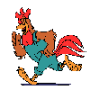
Goodbye

