Slide 1
HOW TO WRITE AN ABSTRACT

Slide 2
An abstract is a summary of a completed research project or paper. A well-written abstract will make the reader want to learn more about your research or read your paper. Abstracts also serve as a summary of the research so the paper can be categorized and searched by subject and keywords.
What is an abstract?

Slide 3
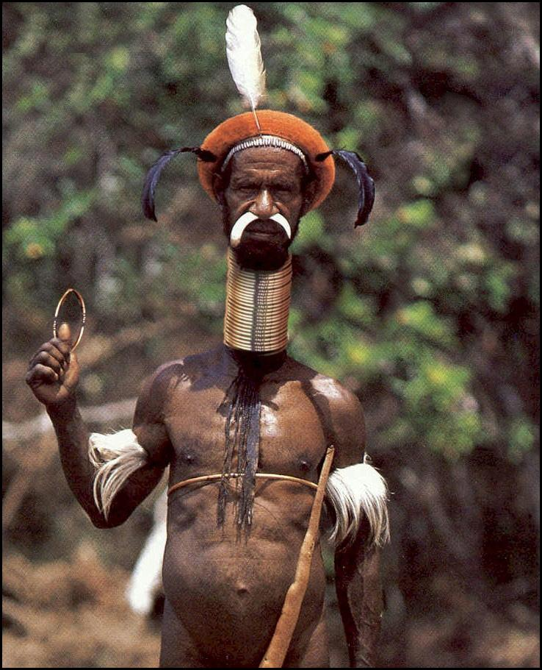
Generally, abstracts are limited to 200 to 300 words, but the exact word limit will be stated by the publication, conference, or organization requesting the abstract.
How long is an abstract?

Slide 4
Components of an abstract

Slide 5
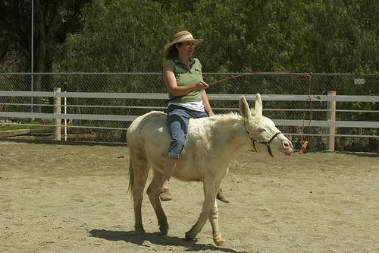
Why do we care about the problem? What practical, theoretical, scientific, or artistic gap is your research filling?
1. Motivation or Statement of Problem:

Slide 6
What did you actually do to get your results? Did you interview students, or applied a technique of survey methods? Write a memoir, invent(icat etmek)a more powerful cell, or translate a book? Did you approach your subject using a specific theoretical framework, technical procedure, or methodology?
2. Methods or Approach:

Slide 7
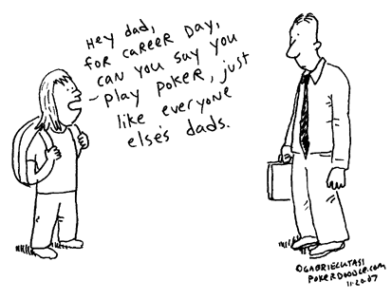
As a result of completing the above procedure or investigation, what did you learn, find, create, or invent?
3. Results or findings:

Slide 8
What are the larger implications(etki)of your findings, especially for the problem or gap identified in Step 1?
4. Conclusions or Implications:

