Slide 1
Reporting Research Findings

Slide 2
Learning to write findings well, especially the Results and Discussion section, sometimes called Findings or simply Results, is an important skill you will need to learn. This chapter suggests ways to write the Results and Discussion section of analytical reports in effective and convincing ways. To accomplish this, you will need to do the following:
● Use text and visual aids properly
● Interpret results
● Use headings and sub-headings
● Use language of reporting appropriately
● Refer to figures correctly

Slide 3
Use Text and Visual Aids Properly

Slide 4
In the Results section, you are expected to present the data in words with the help of tables, charts and graphs to make your data clear and easy to understand. However, you should remember that you write a report; you do not draw a report. The text is primary. The graphics support the text.
Findings, sholud start with information that can be concidered as extention of previous titles.

Slide 5
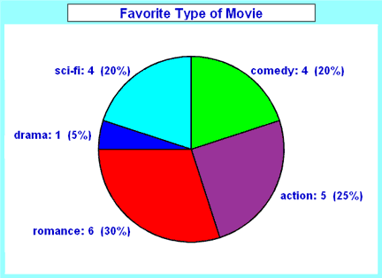
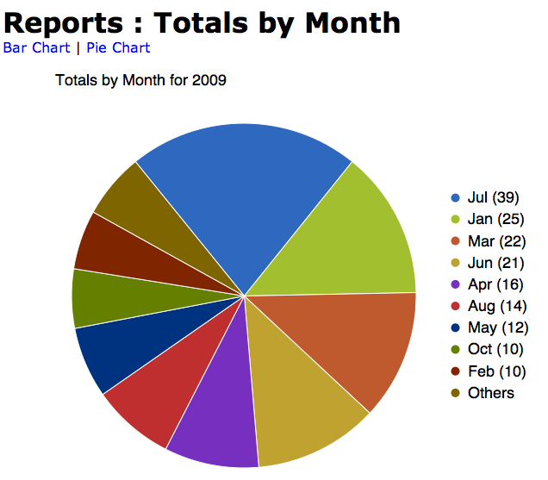
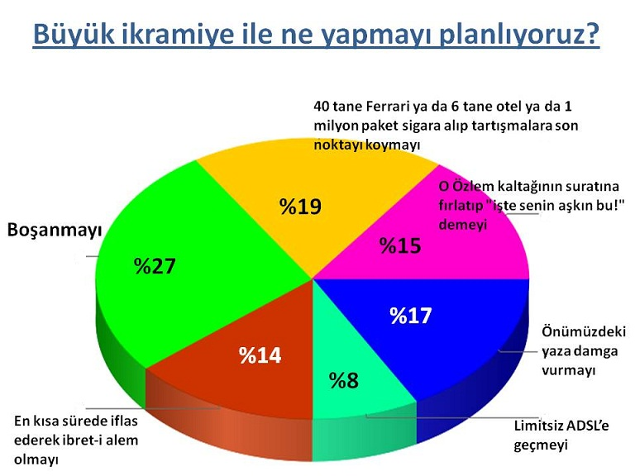
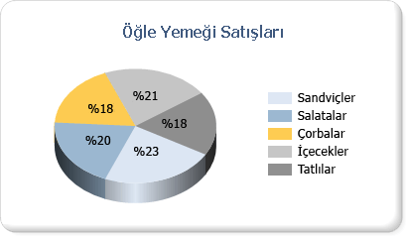
Pai Chart Grafics

Slide 6
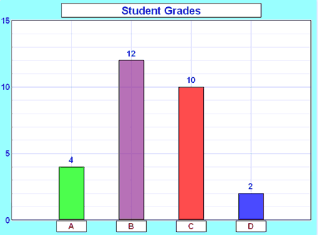
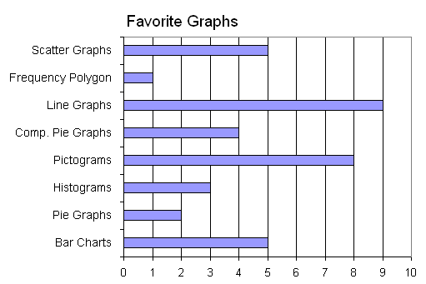
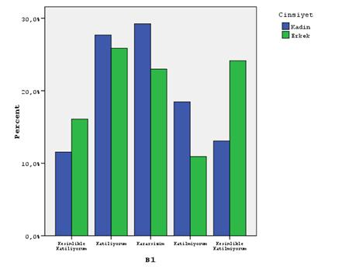
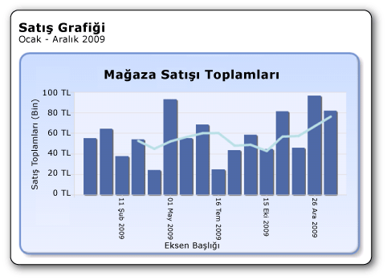
Bar Grafics

Slide 7
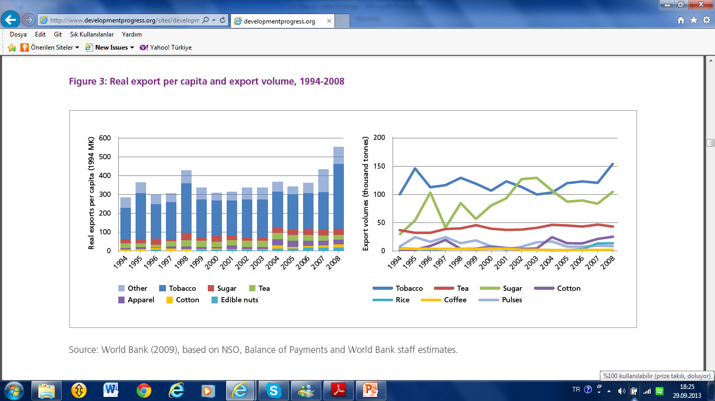

Slide 9
Interpret Results

Slide 10
Reporting data involves more than just presenting it. Often, you need to interpret or analyse the data, that is, say what it means, especially in relation to your research question. Specially if you are using tables, the numbers of the tabla data.

Slide 12
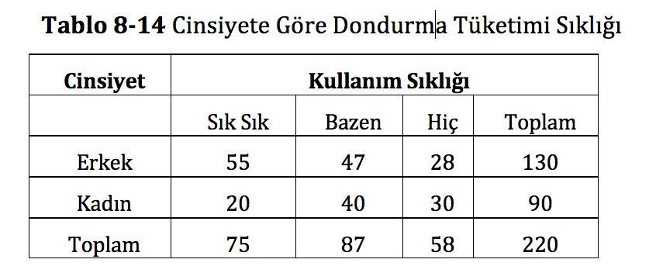

Slide 13
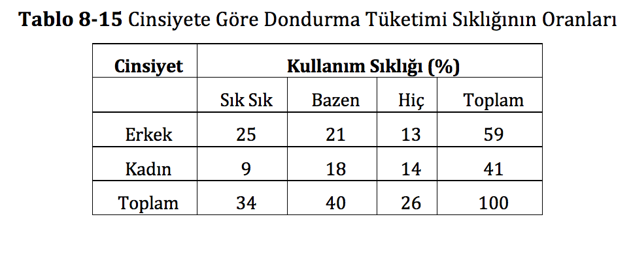

Slide 14
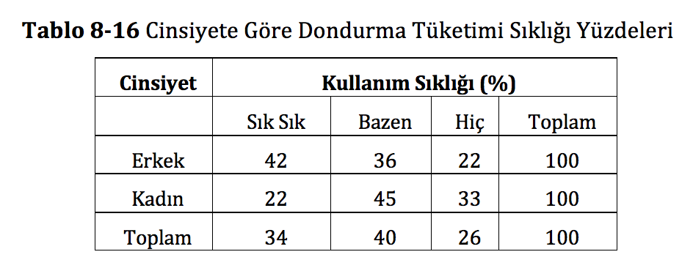

Slide 15
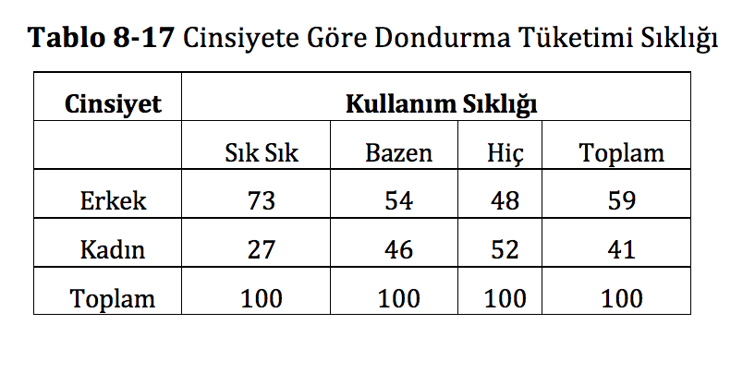

Slide 16
Use Headings and Subheadings

Slide 17
The section in which you present and interpret findings can go over several pages in some reports. In this case, you will need to use subheadings to indicate clearly what the findings are.
For instance, if your survey is on people’s experience with recycling, and your survey had questions related to their practice of recycling, you might divide your Results section according to what the survey found, using headings like these:

Slide 19
Choose appropriate type
of headings

Slide 20
There are two types of headings: talking and topic headings. Talking headings present a certain point of view whilst(iken)topic headings list only the topic to be discussed.

Slide 21
Keep your headings parallel

Slide 22
Remember also to keep headings of the same level under the same section parallel

Slide 23
Number your sections consistently

Slide 25
The End

