Slide 1
SAMPLING

Slide 2
What does it mean sampling?
1 Should a sample be taken?
2 If so, what process should be followed?
3 What kind of sample should be taken?
4 How large should it be?
5 What can be done to control and adjust for non-response errors?

Slide 3
Sampling is selecting a perfect representative sample from a predefined population

Slide 4
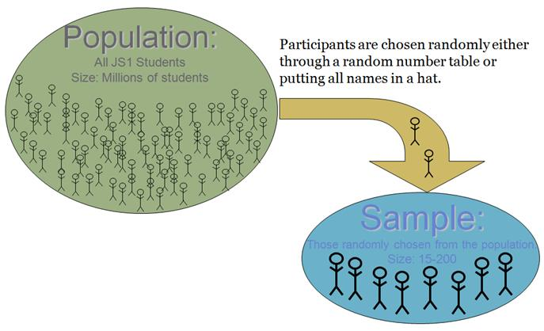

Slide 5
SAMPLING
Population
(N)
Sample
(n)

Slide 6
Sample or census
A census involves a complete enumeration of the elements of a population. The population parameters can be calculated directly in a straightforward way after the census is enumerated.
A sample, is a subgroup of the population selected for participation in the study. Sample character- istics, called statistics, are then used to make inferences(istidlal)about the population parameters. The inferences that link sample characteristics and population parameters are estimation procedures and tests of hypotheses.

Slide 7
How Much Sampling?
Full Census

Slide 8
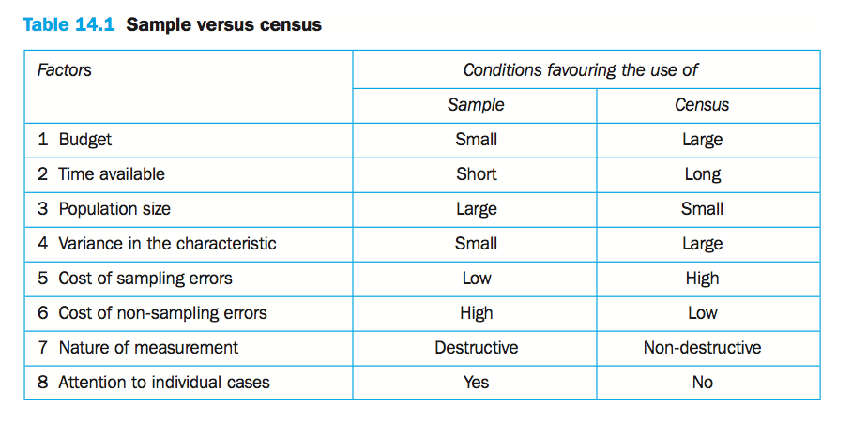
zararlı

Slide 9
The sampling design process

Slide 10
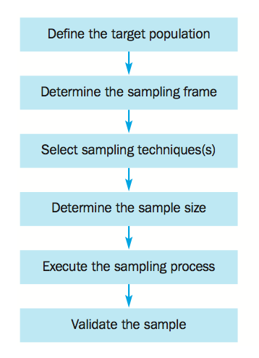

Slide 11
1. Define the target population
Target population
The collection of elements or objects that possess the information sought by the researcher and about which inferences are to be made.

Slide 12
Element
An object that possesses the information sought by the researcher and about which inferences are to be made.

Slide 13
Sampling unit
An element, or a unit containing the element, that is available for selection at some stage of the sampling process.

Slide 14
Examples:
Youth people in Middle East
Farmers who live in middle Anatolia
Factories who act in OSTIM
Students in Cankaya University
Turists who visit Turkey in 2013
Old people who live in almshouse

Slide 15
1. Determine the sampling frame
A sampling frame is a representation of the elements of the target population. It consists of a list or set of directions for identifying the target population.
Examples of a sampling frame include the telephone book, an association directory listing the firms in an industry, a customer database, a mailing list on a database.

Slide 16
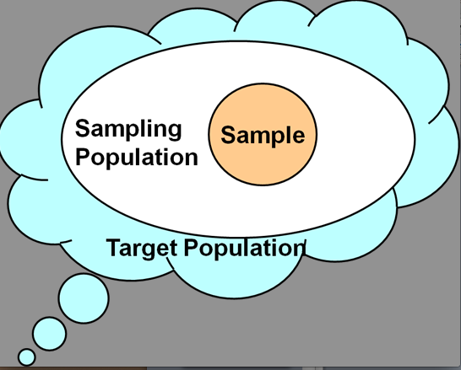
The sampling frame

Slide 17
2. Select a sampling technique
The researcher must decide whether to sample with or without replacement, and to use non-probability or probability sampling.

Slide 18
Sampling with replacement
A sampling technique in which an element can be included in the sample more than once.
Sampling without replacement
A sampling technique in which an element cannot be included in the sample more than once.

Slide 19
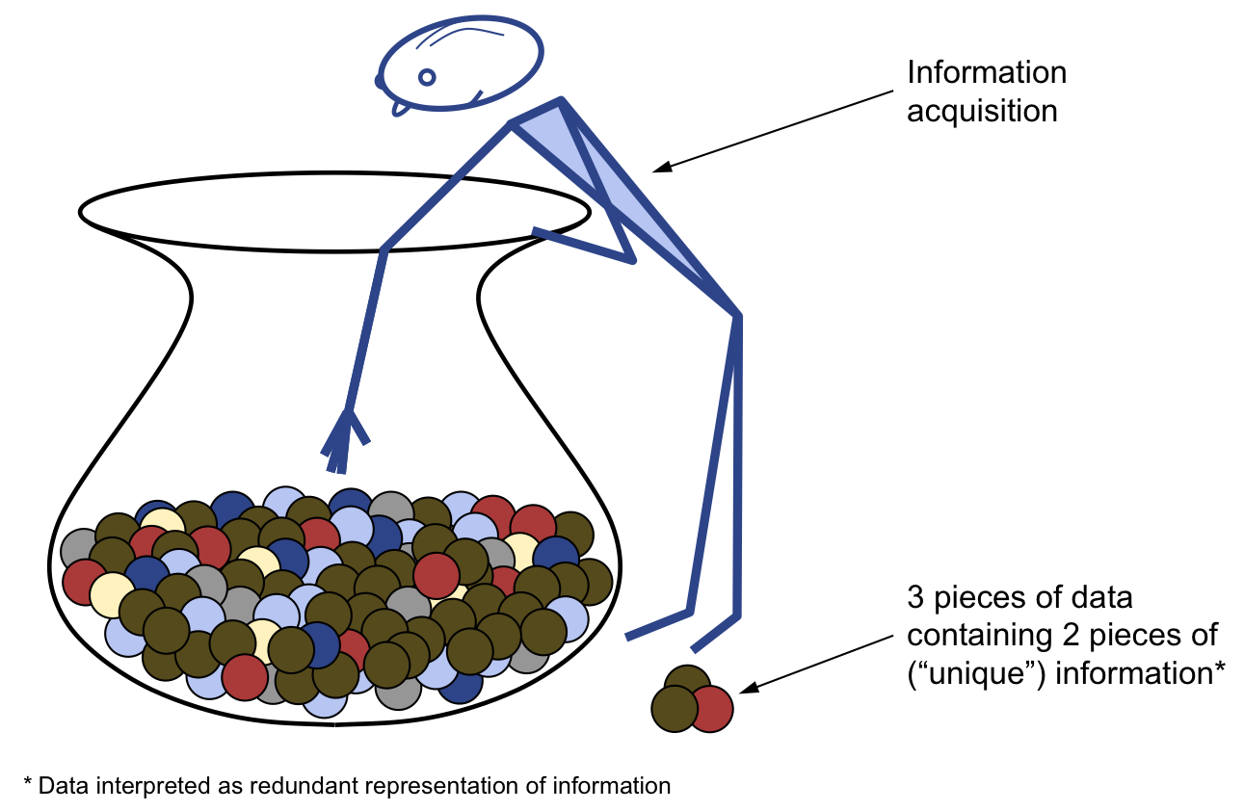

Slide 20
The most important decision about the choice of sampling technique is whether to use non-probability or probability sampling. Non-probability sampling relies on the judgement of the researcher, while probability sampling relies on chance.

Slide 21
3. Determine the sample size
Sample size refers to the number of elements to be included in the study. Determining the sample size involves several qualitative and quantitative considerations.

Slide 23
For exploratory research designs, such as those using qualitative research, the sample size is typically small. For conclusive research, such as descriptive surveys, larger samples are required.
Likewise, if data are being collected on a large number of variables, i.e. many questions are asked in a survey, larger samples are required.

Slide 24
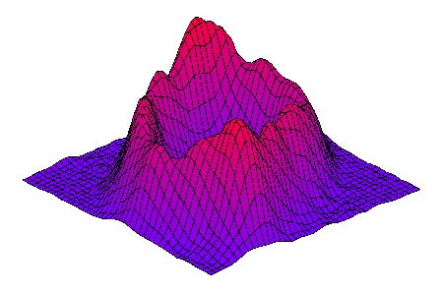
If sophisticated analysis of the data using multivariate techniques is required, the sample size should be large.
The more multivariate statistical analyses are used the more the sample size should be large

Slide 25
4. Execute the sampling process
Execution of the sampling process requires a detailed specification of how the sampling design decisions with respect to the population, sampling unit, sampling frame, sampling technique and sample size are to be implemented.

Slide 26
A classification of
sampling techniques

Slide 27
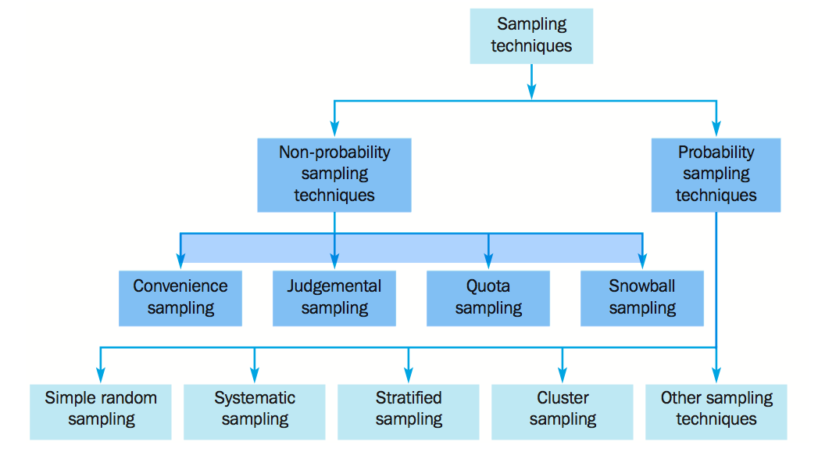

Slide 28
Convenience sampling
attempts to obtain a sample of convenient elements. The selection of sampling units is left primarily to the interviewer.
Often, respondents are selected because they happen to be in the right place at the right time.

Slide 29
Examples of convenience sampling include:
use of students, mosque groups and members of social organizations,
street interviews without qualifying the respondents,
some forms of e.mail and Internet survey,
tear-out questionnaires included in a newspaper or magazine, and
journalists interviewing ‘people on the street’.

Slide 30
EXAMPLE
Let us assume that we are planning to conduct a survey on 1000 consumers visiting any mall center by using convenience methods
3 questionnaires/hour X
12 Hours/day X
7 days/week X
4 Weeks =
1008 Questionnaires

Slide 31
Convenience sampling is the least expensive and least time-consuming of all sampling techniques. The sampling units are accessible, easy to measure and cooperative.
Despite these advantages, this form of sampling has serious limitations. Many potential sources of selection bias are present, including respondent self-selection.

Slide 32
Convenience samples are not representative of any definable population. Hence, it is not theoretically meaningful to generalise to any population from a convenience sample.
Convenience samples are not recommended for descriptive or causal research, but they can be used in exploratory research for generating ideas, insights or hypotheses. Convenience samples can be used for pretesting questionnaires, or pilot studies.

Slide 34
Judgemental Sampling
Judgemental sampling is a form of convenience sampling in which the population elements are selected based on the judgement of the researcher.
The researcher, exercising judgement or expertise, chooses the elements to be included in the sample because he or she believes that they are representative of the population of interest or are otherwise appropriate.

Slide 35
Common examples of judgemental sampling include:

Slide 36
test markets selected to determine the potential of a new product,
purchase engineers selected in industrial marketing research because they are considered to be representative of the company,
product testing with individuals who may be par- ticularly fussy or who hold extremely high expectations,
expert witnesses used in court, and
supermarkets selected to test a new merchandising display system. The use of this technique is illustrated in the context of the GlobalCash Project.

Slide 38
Quota sampling
Quota sampling may be viewed as two-stage restricted judgemental sampling that is used extensively in street interviewing.
The first stage consists of developing control characteristics, or quotas, of population elements such as age or gender.

Slide 39
Example
of these characteristics in the target population, such as Males 49%, Females 51% (resulting in 490 men and 510 women being selected in a sample of 1,000 respondents).
In the second stage, sample elements are selected based on convenience or judgement.

Slide 41
Snowball sampling
In snowball sampling, an initial group of respondents is selected, sometimes on a random basis, but more typically targeted at a few individuals who are known to possess the desired characteristics of the target population.

Slide 43
Probability sampling techniques
Simple random sampling (SRS)
A probability sampling technique in which each element has a known and equal probability of selection.
Every element is selected independently of every other element, and the sample is drawn by a random procedure from a sampling frame.

Slide 44
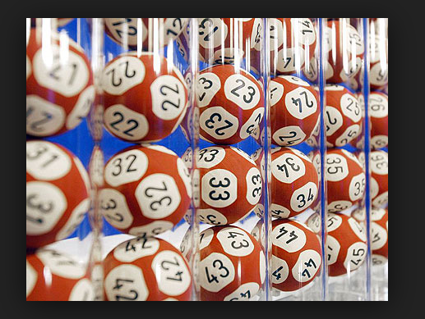
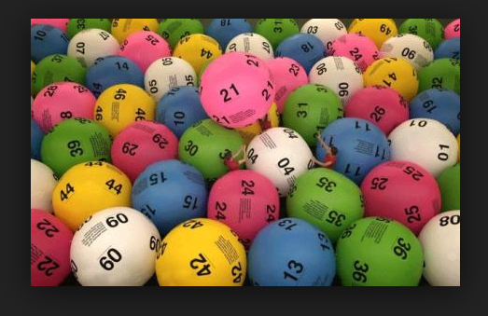

Slide 45
To draw a simple random sample, the researcher first compiles(derlemek)a sampling frame in which each element is assigned a unique identification number.
Then random numbers are generated to determine which elements to include in the sample. The random numbers may be generated with a computer routine.

Slide 47
Systematic sampling
In systematic sampling, the sample is chosen by selecting a random starting point and then picking every ith element in succession from the sampling frame.
The sampling interval, i, is determined by dividing the population size N by the sample size n and rounding to the nearest whole number.

Slide 48
For example, there are 100 elements in the population and a sample of 10 is desired. In this case, the sampling interval, i, is 10.
A random number between 1 and 10 is selected. If, for example, this number is 3, the sample consists of elements 3, 13, 23, 33, 43, 53, and so on.

Slide 50
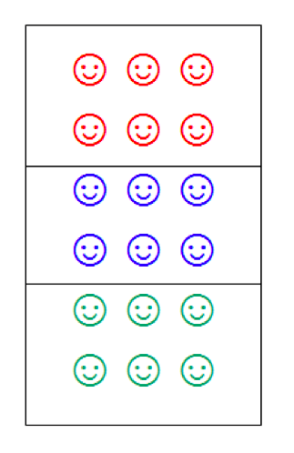
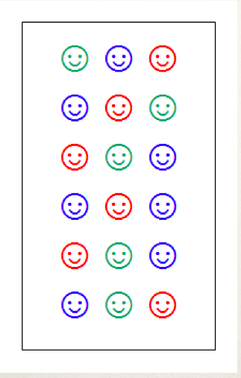
Stratified
Non-stratified

Slide 51
Stratified sampling
Stratified sampling is a two-step process in which the population is partitioned into sub-populations, or strata.
The strata should be mutually exclusive and collectively exhaustive(ayrıntılı)in that every population element should be assigned to one and only one stratum and no population elements should be omitted.
Next, elements are selected from each stratum by a random procedure.

Slide 52
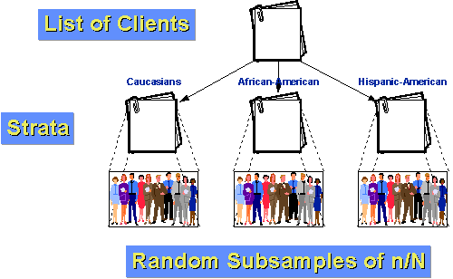
Turks
Arabs
Germans

Slide 53
Formen
Workers
Engineers
A Population With 3 Strata
N= N₁ + N₂ + N₃

Slide 54
A major objective of stratified sampling is to increase precision without increasing cost.

Slide 55
The criteria for the selection of these variables consist of homogeneity, heterogeneity, relatedness and cost.
The elements within a stratum should be as homogeneous as possible, but the elements in different strata should be as heterogeneous as possible.

Slide 56
Worker
Formen
Engineer

Slide 57
Example: A population consist of workers N!, formen N₂ and enginerrs N₃. The total of the population is 3000 persons.
The portion of the workers is %55, the formen %35 and the engineers is 10%. How can decide about the smaple size with three strata?

Slide 58
N = N₁ + N₂ + N₃
Workers N₁ = 3000 X 0.55 = 1650 Workers
Forman N₂ = 3000 X 0.35 = 1050 Formen
Engineers N₃ = 3000 X 0.10 = 300 Engineers
If the percentage of sample size is 10% the sample will be (3000X0.1=) 300 persons, therefore:
1650 X 0.10 = 165 Workers n₁
1050 X 0.10 = 105 Forman n₂
300 X 0.10 = 30 Engineers n₃
n = n₁ + n₂ +n₃ = 165 + 105 + 30 = 300

Slide 59
Cluster sampling
A two-step probability sampling technique where the target population is first divided into mutually exclusive and collectively exhaustive sub-populations called clusters.
Then a random sample of clusters is selected based on a probability sampling technique such as simple random sampling.
For each selected cluster, either all the elements are included in the sample, or a sample of elements is drawn probabilistically.

Slide 60
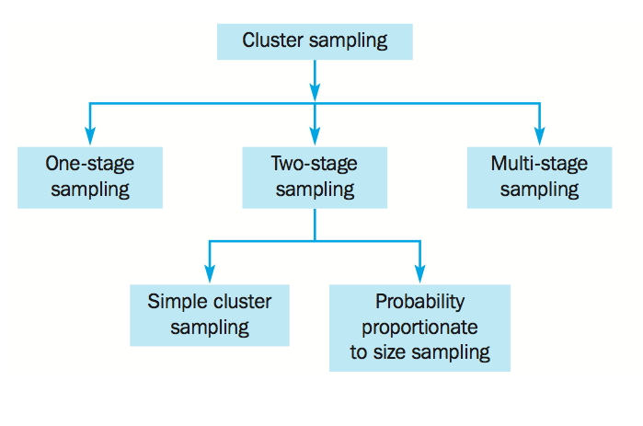

Slide 61
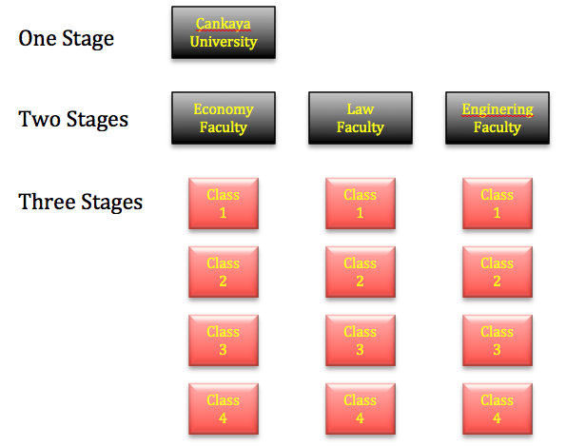
Engineering Faculty

Slide 62
The key distinction between cluster sampling and stratified sampling is that in cluster sampling only a sample of sub-populations (clusters) is chosen, whereas in stratified sampling all the sub-populations (strata) are selected for further sampling.

Slide 63
The objectives of the two methods are also different. The objective of cluster sampling is to increase sampling efficiency by decreasing costs, but the objective of stratified sampling is to increase precision.
With respect to homogeneity and heterogeneity, the criteria for forming clusters are just the opposite of those for strata.

Slide 64
Area sampling
A common form of cluster sampling in which the clusters consist of geographic areas such as counties, housing tracts, blocks or other area descriptions.

Slide 65
If only one level of sampling takes place in selecting the basic elements (all the households within the selected blocks are included in the sample), the design is called one-stage area sampling.
If two or more levels of sampling take place before the basic elements are selected (a few apartments in each block), the design is called two-stage (or multistage) area sampling.
The distinguishing feature of one- stage area sampling is that all the households in the selected blocks (or geographic areas) are included in the sample.

Slide 66
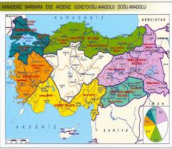
One Stage Area Sampling
Two Stages Area Sampling

Slide 67
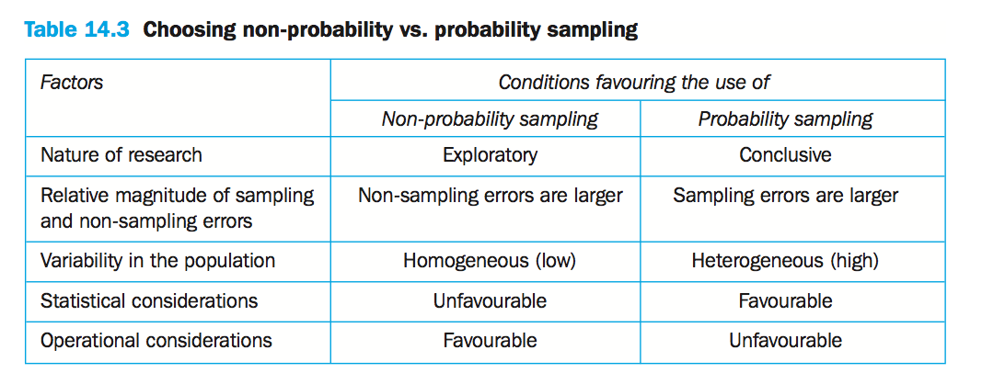

Slide 68
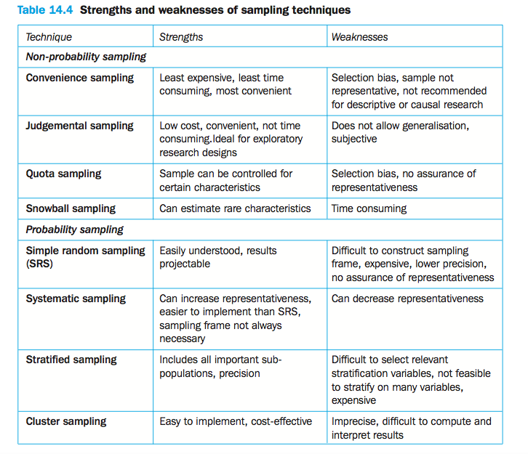

Slide 69
Internet Sampling

Slide 70
The ease and low cost of an Internet survey has contributed to a flood of online questionnaires, some more formal than others. As a result, frequent Internet users may be more selective about which surveys they bother answering.
Researchers investigating college students’ attitudes toward environmental issues found that those who responded to an e-mail request that had been sent to all students tended to be more concerned about the environment than students who were contacted individually through systematic sampling.

Slide 71
Web Site Visitors
Many Internet surveys are conducted with volunteer respondents who visit an organization’s Web site intentionally or by happenstance(tesadüfi).
These unrestricted samples are clearly convenience samples. They may not be representative because of the haphazard(gelişigüzel)manner by which many respondents arrived at a particular Web site or because of self-selection bias.

Slide 72
Panel Samples
Drawing a probability sample from an established consumer panel or other prerecruited membership panel is a popular, scientific, and effective method for creating a sample of Internet users.
Typically, sampling from a panel yields a high response rate because panel members have already agreed to cooperate with the research organization’s e-mail or Internet surveys.

Slide 73
Often panel members are compensated(telafi)for their time with a sweepstakes(çekiliş), a small cash incentive, or redeemable(kurtarılabilir)points.
Further, because the panel has already supplied demographic characteristics and other information from previous questionnaires, researchers are able to select panelists based on product ownership, lifestyle, or other characteristics.

Slide 74
Some Important Definitions
■ Parameter. A parameter is a summary description of a fixed characteristic or measure of the target population. A parameter denotes the true value that would be obtained if a census rather than a sample was undertaken.
■ Statistic. A statistic is a summary description of a characteristic or measure of the sample. The sample statistic is used as an estimate of the population parameter.

Slide 75
■ Precision level. When estimating a population parameter by using a sample statistic, the precision level is the desired size of the estimating interval.
This is the maximum permissible difference between the sample statistic and the population parameter.

Slide 76
■ Confidence interval. The confidence interval is the range into which the true population parameter will fall, assuming a given level of confidence.
■ Confidence level. The confidence level is the probability that a confidence interval will include the population parameter.

Slide 77
Sample Size Determination

Slide 78
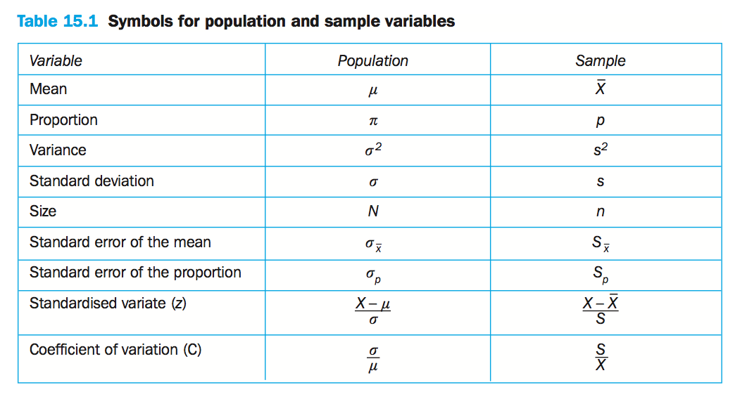

Slide 79
Descriptive and Inferential Statistics
descriptive statistics
Statistics which summarize and describe the data in a simple and understandable manner.
Inferential(istintaç)statistics
Using statistics to project(tasvir)characteristics from a sample to an entire population.
But both can not be used to interpret the statistical data

Slide 80
Sample Statistics and Population Parameters
sample statistics
Variables in a sample or measures computed from sample data.
population parameters
Variables in a population or measured characteristics of the population.

Slide 81
frequency distribution
A set of data organized by summarizing the number of times a particular value of a variable occurs.
percentage distribution
A frequency distribution organized into a table (or graph) that summarizes percentage values associated with particular values of a variable.

Slide 82
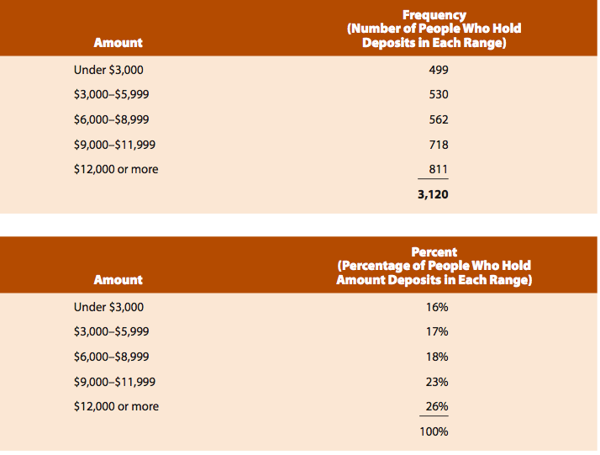
Mevduat
499/3,120 = 0,16=16%

Slide 83
Probability
is the long-run relative frequency with which an event will occur. Inferential statis- tics uses the concept of a probability distribution, which is conceptually the same as a percentage distribution except that the data are converted into probabilities.

Slide 84
The probability of selecting a respondent falling into the top category of $12,000 or more is the highest, 0.26.

Slide 85
Measures of Central Tendency
Central tendency can be measured in three ways—the arithmatical mean, median, or mode—each of which has a different meaning.

Slide 86
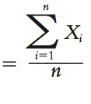
■ THE MEAN
The mean is simply the arithmetic average, and it is perhaps the most common measure of central tendency.
If from population
If from sample
N

Slide 87
Suppose our sales manager supervises eight salespeople to express the sum of the salespeople’s calls in 􏰥 notation, we just number the salespeople (this number becomes the index number) and associate subscripted variables with their numbers of calls:

Slide 88
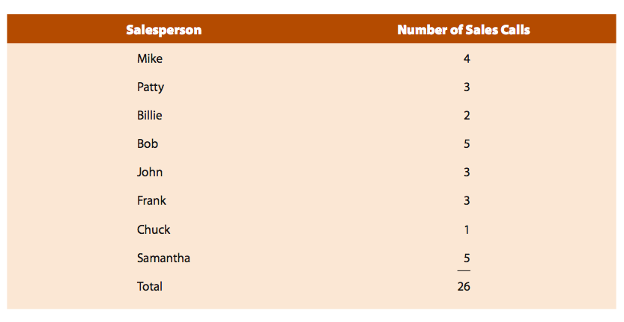
N

Slide 89
■ THE MEDIAN
The next measure of central tendency, the median, is the midpoint of the distribution, or the 50th percentile. In other words, the median is the value below which half the values in the sample fall, and above which half of the values fall.
In the sales manager example, 3 is the median because half the observations are greater than 3 and half are less than 3.
4 3 2 5 3 3 1 5
1 2 3 3 3 4 5 5

Slide 90
■ THE MODE
In statistics the mode is the measure of central tendency that identifies the value that occurs most often. value 3 occurs most often, so 3 is the mode.The mode is determined by listing each possible value and noting the number of times each value occurs.
4 3 2 5 3 3 1 5

Slide 91
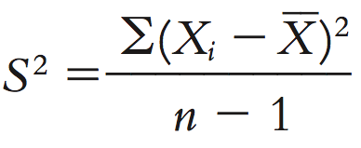
Variance
Statistical variance gives a measure of how the data distributes itself about the mean or expected value. Unlike range that only looks at the extremes, the variance looks at all the data points and then determines their distribution.
If calculated from the population N
If calculated from the sample n

Slide 92
Variance is a very good index of dispersion.The variance, will equal zero if and only if each and every observation in the distribution is the same as the mean. The variance will grow larger as the observations tend to differ increasingly from one another and from the mean.

Slide 93
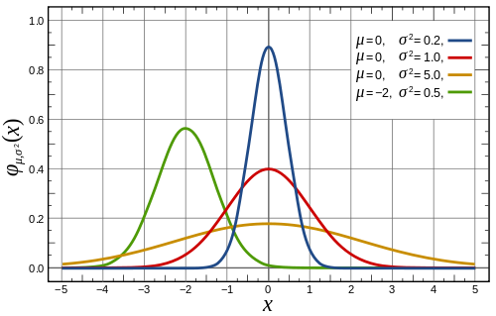
If arithmetical mean is zero, observation values are:
---- very close and similar to mean
---- far and totally different than mean
---- normal distribution

Slide 94
Standard Deviation
While the variance is frequently used in statistics, it has one major drawback(sakınca). The variance reflects a unit of measurement that has been squared.
For instance, if measures of sales in a territory are made in dollars, the mean number will be reflected in dollars, but the variance will be in squared dollars.

Slide 95
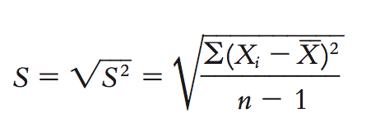
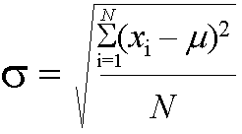
Because of this, statisticians often take the square root of the variance. Using the square root of the variance for a distribution, called the standard deviation, eliminates the drawback of having the measure of dispersion in squared units rather than in the original measurement units.
If calculated from the sample n
If calculated from the population N

Slide 96
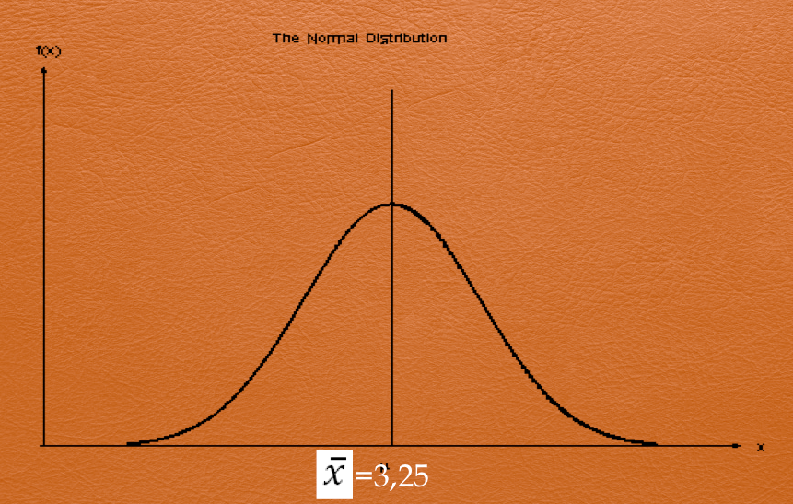
The sales call numbers are scattering around the mean with 1.3887 units (calls) to the right and to the left.

Slide 97
The Normal Distribution
One of the most common probability distributions in statistics is the normal distribution, commonly represented by the normal curve.
This mathematical and theoretical distribution describes the expected distribution of sample means and many other chance occurrences.The normal curve is bell shaped, and almost all (99 percent) of its values are within ±3 standard deviations from its mean.

Slide 98
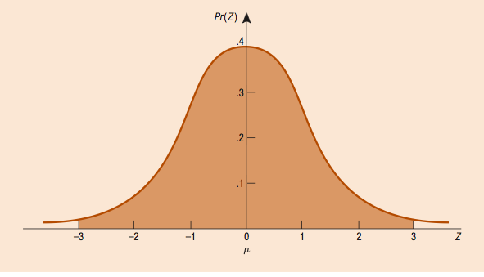
The normal curve is bell shaped, and almost all (99 percent) of its values are within ±3 standard deviations from its mean.

Slide 99
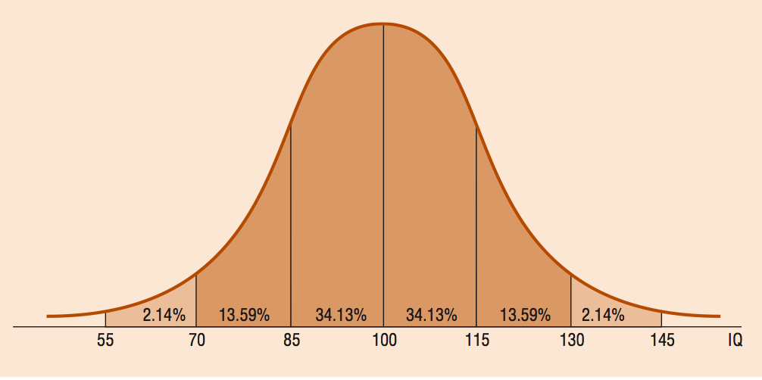
34,13+13,59+2,14=49,86
49,86X2=99,72
An example of a normal curve, the distribution of Intelligence Quotient. In this example, 1 standard deviation for IQ equals 15. We can identify the proportion of the curve by measuring a score’s distance (in this case, standard deviation) from the mean (100).

Slide 100
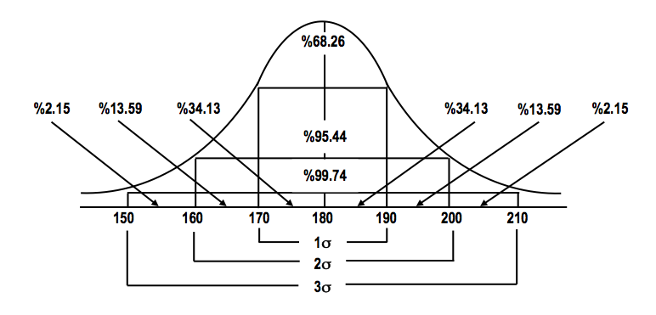

Slide 101
The standardized normal distribution is a specific normal curve that has several characteristics:
It is symmetrical about its mean; the tails on both sides are equal.
2. The mode identifies the normal curve’s highest point, which is also the mean and median, and the vertical line about which this normal curve is symmetrical.

Slide 102
3. The normal curve has an infinite number of cases (it is a continuous distribution), and the area under the curve has a probability density equal to 1.0.
4. The standardized normal distribution has a mean of 0 and a standard deviation of 1.

Slide 103
Standardized Normal Distribution
The standardized normal distribution is a purely theoretical probability distribution, but it is the most useful distribution in inferential statistics.
Statisticians have spent a great deal of time and effort making it convenient for researchers to find the probability of any portion of the area under the standardized normal distribution.

Slide 104
All we have to do is transform, or convert, the data from other observed normal distributions to the standardized normal curve.
In other words, the standardized normal distribution is extremely valuable because we can translate, or transform, any normal variable, X, into the standardized value, Z

Slide 106
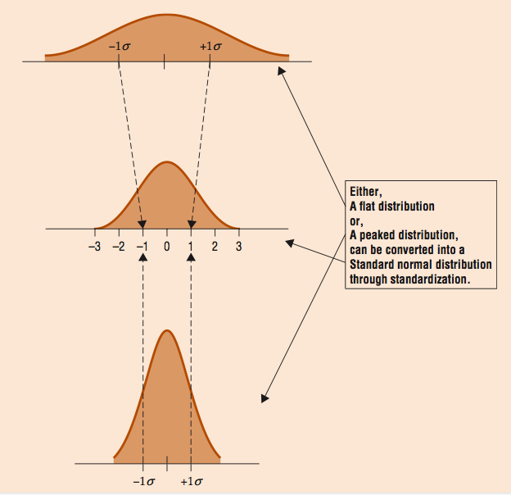

Slide 107
Sample Size

Slide 108
Factors in Determining Sample Size for Questions Involving Means
Three factors are required to specify sample size: (1) the heterogeneity (i.e., variance) of the population; (2) the magnitude of acceptable error; and (3) the confidence level (i.e., 90 percent, 95 percent, 99 percent).
The determination of sample size heavily depends on the variability within the sample. The variance, or heterogeneity, of the population is the first necessary bit of information.

Slide 109
In statistical terms, this refers to the standard deviation of the population. Only a small sample is required if the population is homogeneous.
For example, predicting the average age of college students requires a smaller sample than predicting the average age of people who visit the zoo on a given Sunday afternoon.
As heterogeneity increases, so must sample size. Thus, to test the effectiveness of an employee training program, the sample must be large enough to cover the range of employee work experience (for example).

Slide 110
The magnitude of error, or the confidence interval, is the second necessary bit of information. Defined in statistical terms as E, the magnitude of error indicates how precise the estimate must be.
It indicates a certain precision level. From a managerial perspective, the importance of the decision in terms of profitability will influence the researcher’s specifications of the range of error.

Slide 111
If, for example, favorable results from a test-market sample will result in the construction of a new plant and unfavorable results will dictate not marketing the product, the acceptable range of error probably will be small; the cost of an error would be too great to allow much room for random sampling errors.
In other cases, the estimate need not be extremely precise. Allowing an error of $1,000 in total family income instead of E 50% may be acceptable in most market segmentation studies.

Slide 112
The third factor of concern is the confidence level. In our examples, as in most business research, we will typically use the 95 percent confidence level.
This, however, is an arbitrary(keyfi)decision based on convention(mutabakat); there is nothing sacred about the 0.05 chance level (that is, the probability of 0.05 of the true population parameter being incorrectly estimated).

Slide 113
Calculating Sample Size in Simple Random Sampling
A. If is known but N is unknown
n : Sample size
Z : standardized value that corresponds to the confidence level
Varians of the population
E : acceptable magnitude of error, plus or minus error factor (PERSENTAGE)

Slide 114
EXAMPLE: Let’s assume that we are planning to open an ‘’İskender’’ restaurant in Polatlı. so we should learn many thinks about the city’s consumers by arranging a survey to discover the habits and preferences of the people in this city. Therefore the population fram of our research is the people who live and prefer eating outside door.
Let’s suppose that acceptable magnitude of error should not be over 10% and the standardized value that corresponds to the confidence level should not be under 95%. From previous studies it is known that the standard deviation of average of eating outside door in Polatlı is arround 1.39.

Slide 115
In this case:
Z :%95 Table Value: 1.96
: σ = 1.39 1.39² = 1.93
E : %10

Slide 116
Calculating Sample Size in Simple Random Sampling
B. If and N are known
N : Population
n : Sample size
Z : standardized value that corresponds to the confidence level
Varians of the population
E : acceptable magnitude of error, plus or minus error factor (PERSENTAGE)

Slide 117
Let’s go back to the example and suppose that 2000 people in total has excpected to perefer eating outdoor regularly in Polatlı.

Slide 118
Calculating Sample Size bu Proportions
A. N is unknown
(Howsoever(her halukarda) not needed)
P : proportion of successes
q = 1 – p, or proportion of failures
n : Sample size
Z : standardized value that corresponds to the confidence level
E : acceptable magnitude of error, plus or minus error factor (PERSENTAGE)

Slide 119
Example: A mall manager wants to measure the satisfaction of the consumers who visit the mall. acceptable magnitude of error is %4 which means that the percentage of doing any error during the sampling stages should not exceed 4%.
Confedance level is 99%. This means that the sample shoud show confedence not less than 99% which is very high confedence leve. The target consumers are defined as people who visit the mall at least once a week. The pervious researches confirme that 30% of the city visit the mall at least once a week. Calculat the sample size.

Slide 120
P : 30%
q = 1 – p, 1-30% = 70%
Z :%99 Table Value: 2,58
E : %10
= 874 persons

Slide 121
N is known
Let`s assume that the total amount of 30.000 people, visiting the mall at least once and see howmuch the sample size will be changed.

Slide 122
n = 848 visiters
It is clear to see that the size of the population does not affect the sample size strongly

Slide 123
Fly freely like butterfly

